Slide 1
TAKE FIVE for Safety-
Frank Craner
November 25, 2025

Slide 2
Loose Wire on Containership Dali Leads to Blackouts and Contact with Baltimore’s Francis Scott Key Bridge
WASHINGTON (Nov. 18, 2025) -- The NTSB said Tuesday that a single loose wire on the 984-foot-long containership Dali caused an electrical blackout that led to the giant vessel veering and contacting the nearby Francis Scott Key Bridge in Baltimore, which then collapsed, killing six highway workers.
Investigators said the loose wire in the ship’s electrical system caused a breaker to unexpectedly open -- beginning a sequence of events that led to two vessel blackouts and a loss of both propulsion and steering near the 2.37-mile-long Key Bridge on March 26, 2024.
Investigators found that wire-label banding prevented the wire from being fully inserted into a terminal block spring-clamp gate, causing an inadequate connection.

Slide 3
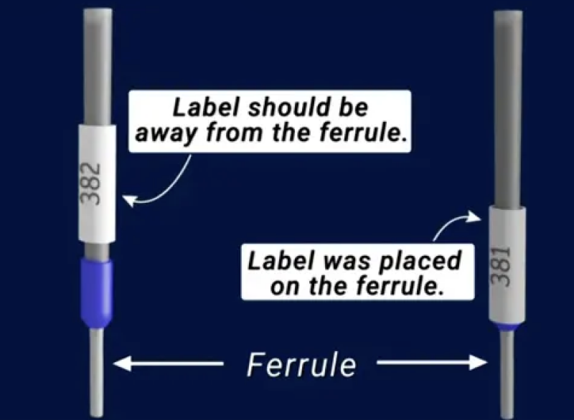

Slide 4
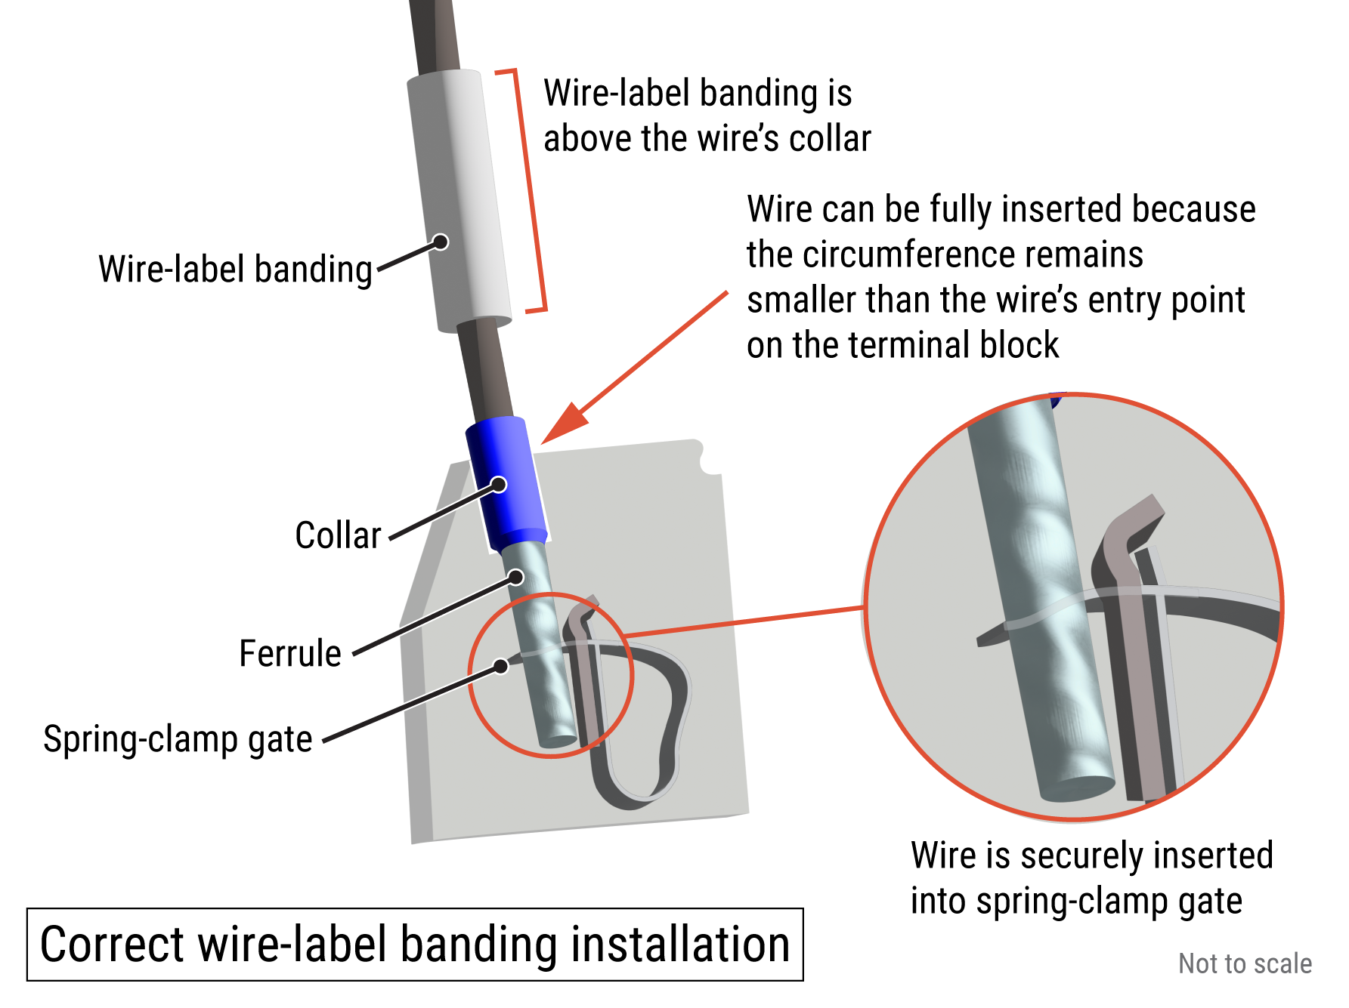
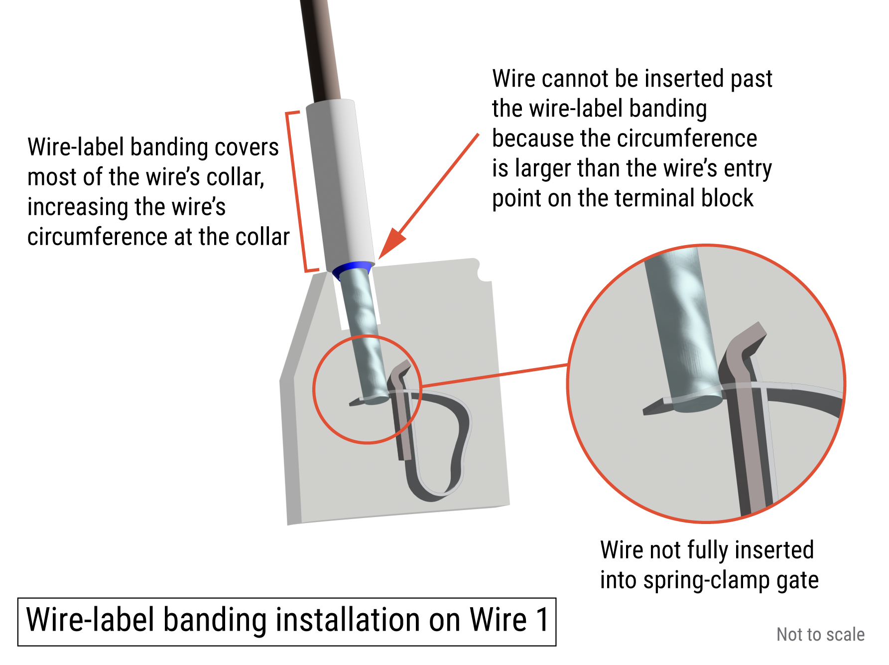
Loose Wire on Containership Dali Leads to Blackouts and Contact with Baltimore’s Francis Scott Key Bridge

Slide 5
One loose wire among thousands
There were thousands of wires on the Dali, and the one loose wire that caused this incident would not have been easily found by the crew.
It would have been nearly impossible to check every connection, but thermal imaging would have helped identify the problem in a shorter timeframe, the NTSB noted.

Slide 6
Link to Investigation Reports
Contact of Containership Dali with the Francis Scott Key Bridge and Subsequent Bridge Collapse
Loose Wire on Containership Dali Leads to Blackouts and Contact with Baltimore’s Francis Scott Key Bridge

