Slide 1
Preinjector Status
D. Raparia
Time Meeting
November 25, 2025

Slide 2
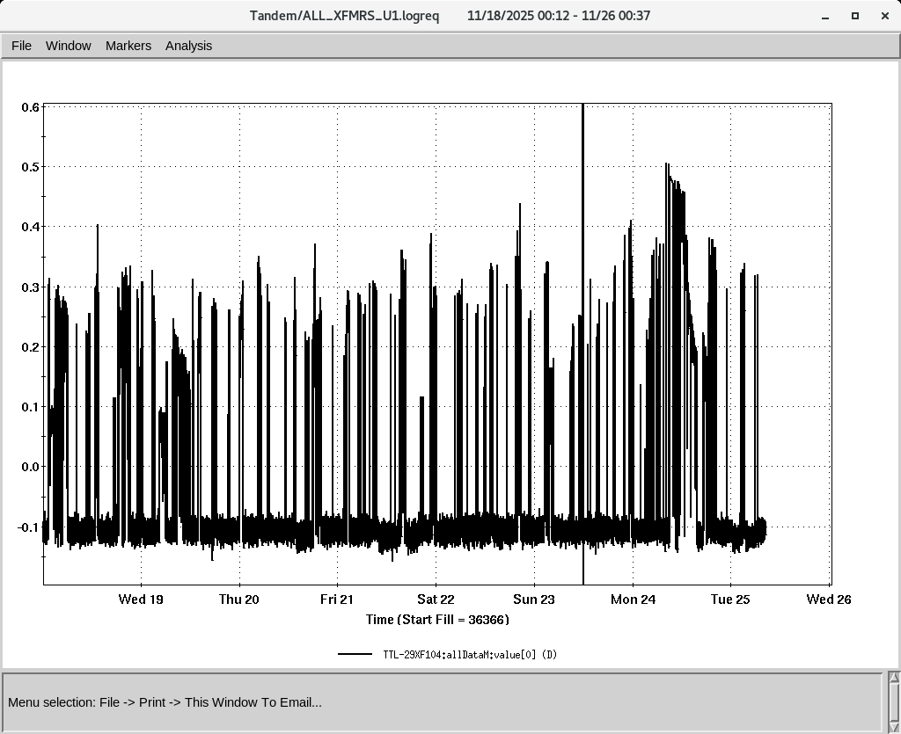
Tandem
MP7- RHIC support
Running well
Au⁺³¹ to NSRL on Monday
MP6 – external users
This week Ion source group experiment continue

Slide 3
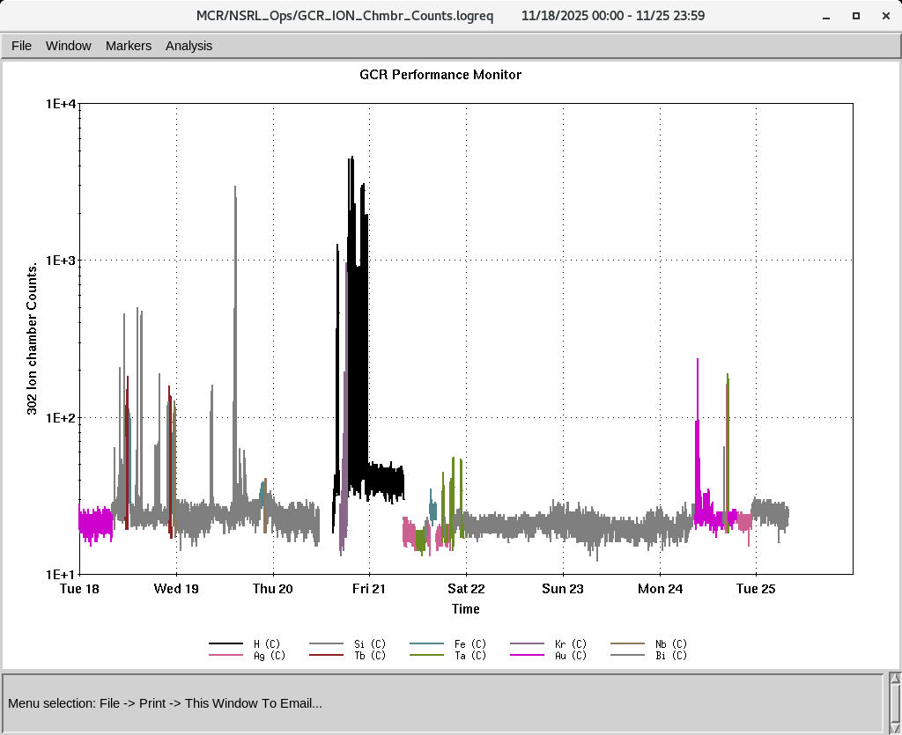
EBIS
Smooth operation for NSRL
Providing all ions
IONS to NSRL
Si^{+11 ,}Fe⁺²⁰ , Kr⁺¹⁸,Nb⁺²³,Ag⁺²⁹, Tb⁺³⁵,Ta⁺³⁸, Bi⁺⁴³,
P (Linac)
Au⁺³¹ (Tandem)

Slide 4
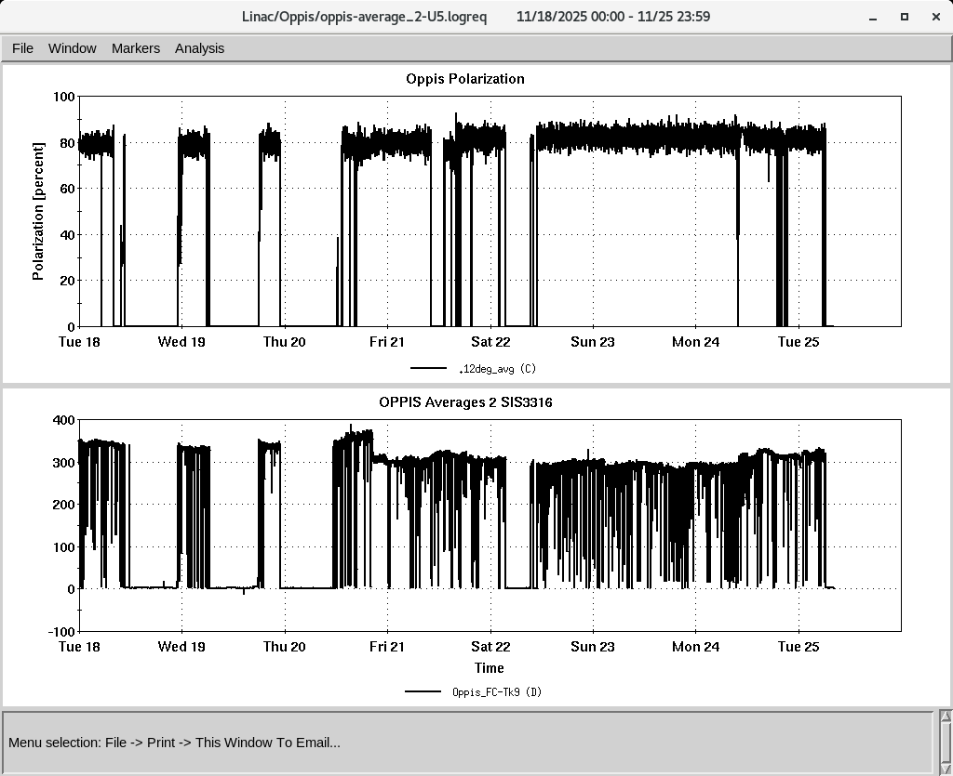
LINAC
BLIP has requested beam on 12/19/2025
PP beam is currently being used for setup
OPPIS operating with normal beam intensity with pol ~ 80%
High intensity H- source is currently being conditioned.
RF tube 7835 is being changed today

