Slide 1
sPHENIX Status
Kin Yip
sPHENIX Director of Operations
Time Meeting
Nov. 25, 2025

Slide 2
sPHENIX Status
sPHENIX continues to accumulate luminosity towards the luminosity goal of ~7/nb (Au + Au) until ~Dec. 8.
We did some maintenance work on Nov. 19 on TPC PLC system to shorten its recovery time in case it crashes again.
Today, we’ll finish installing the UPS for this PLC.
Magnet tripped @10:27 on Nov. 20 due to quench program stopping abruptly (after running >3 week).
It’s ramped back to the full current/field ~14:51.
Maintenance Day: EMCAL experts today will investigate their electronics to eliminate occasional small dead zones (<1%).
Other works today include coil cleaning for chillers next to 1008C, airflow sensor adjustment (NE dehumidifier in IR) …

Slide 3
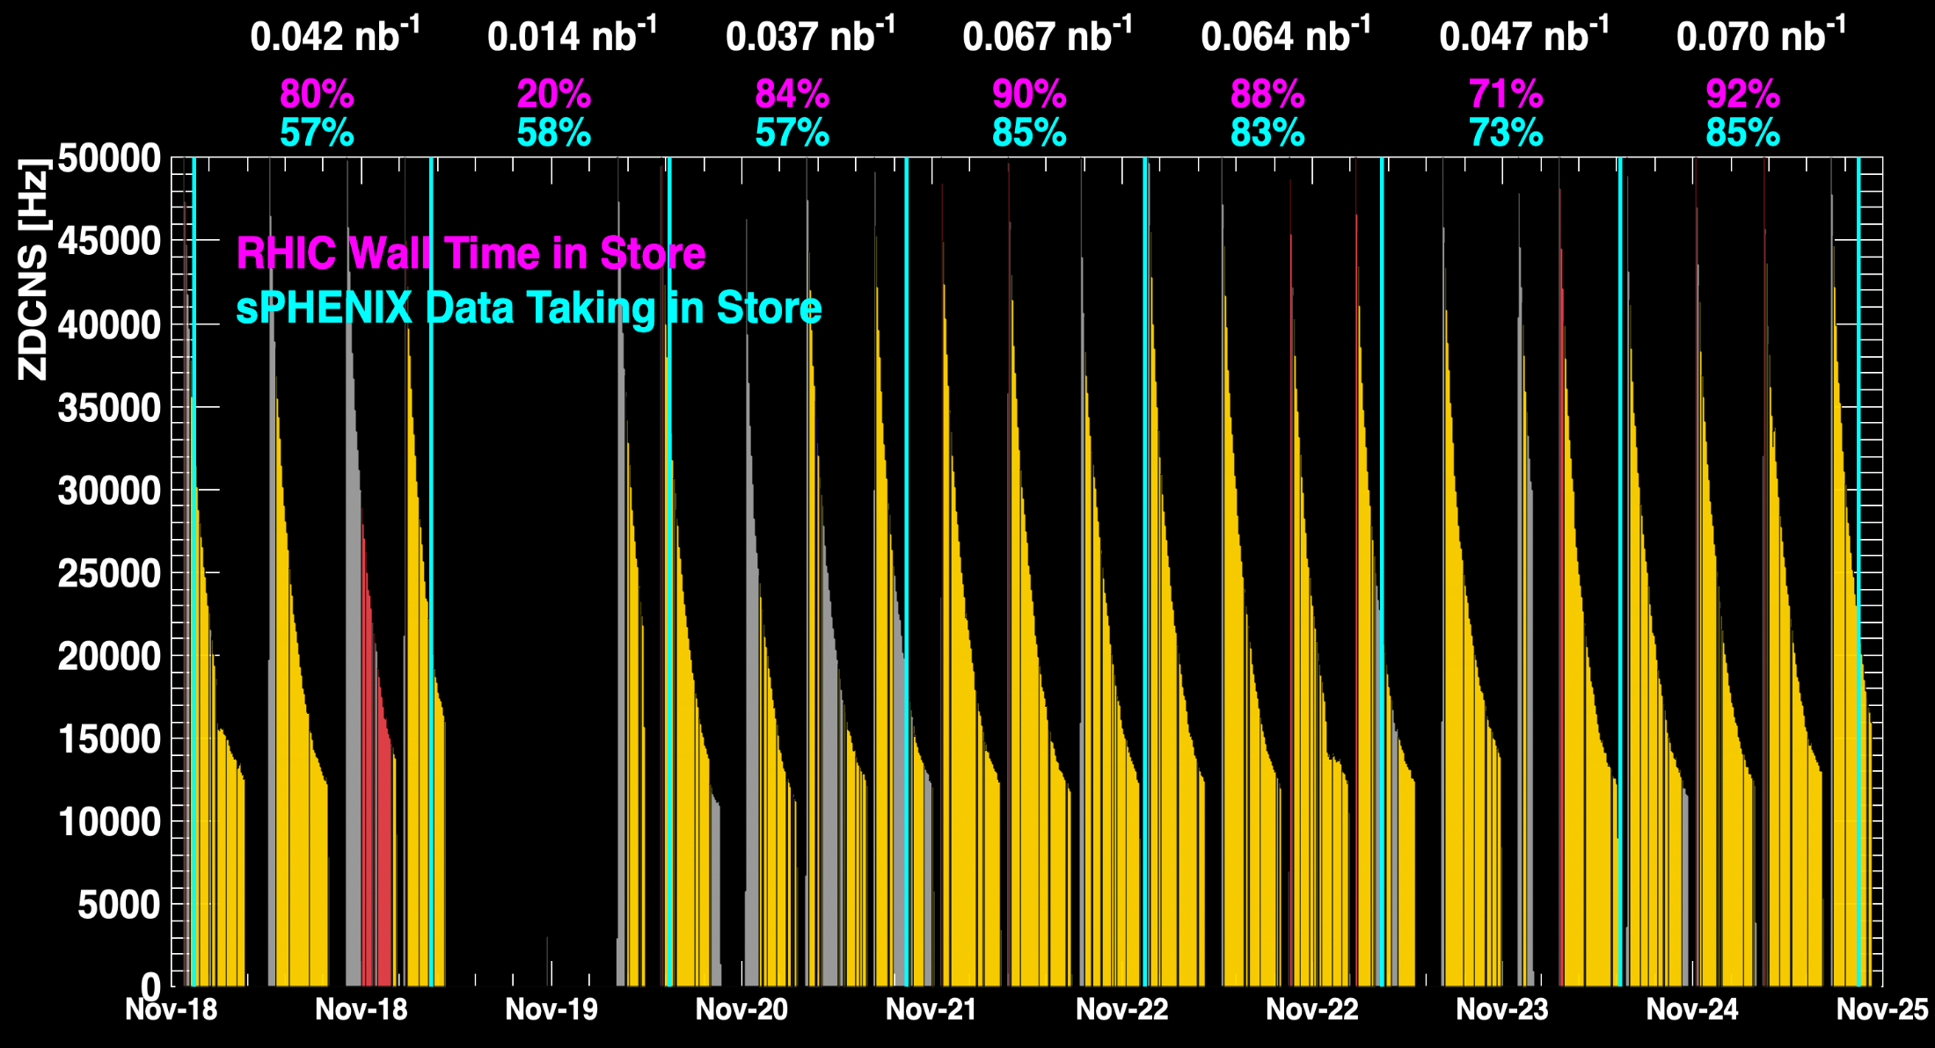
sPHENIX Status (cont.)
1008C pump trips
CDU issue
1008C pump trips
CDU issue
6x6
When all sPHENIX detectors were being operated.
No TPC

Slide 4
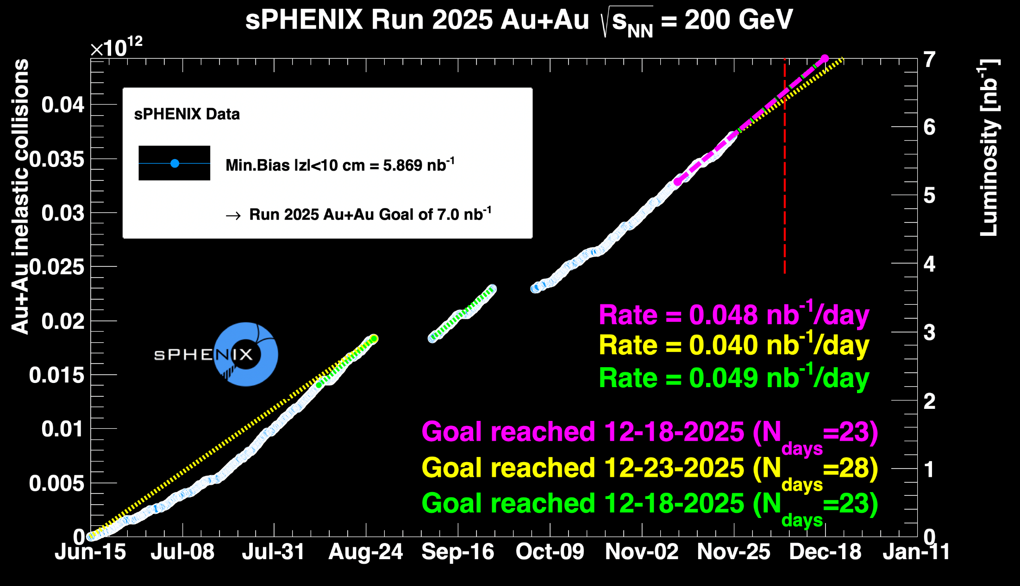
sPHENIX Status (cont.)
~ 83.8%

