Slide 1
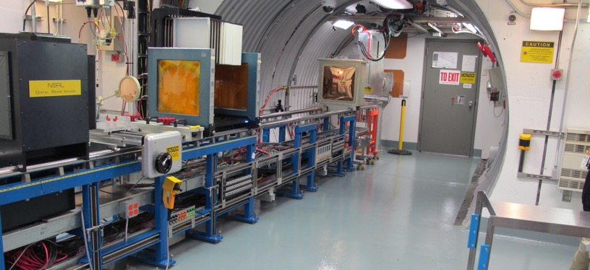
NSRL Time Meeting Report
25 November 2025
Michael Sivertz

Slide 2
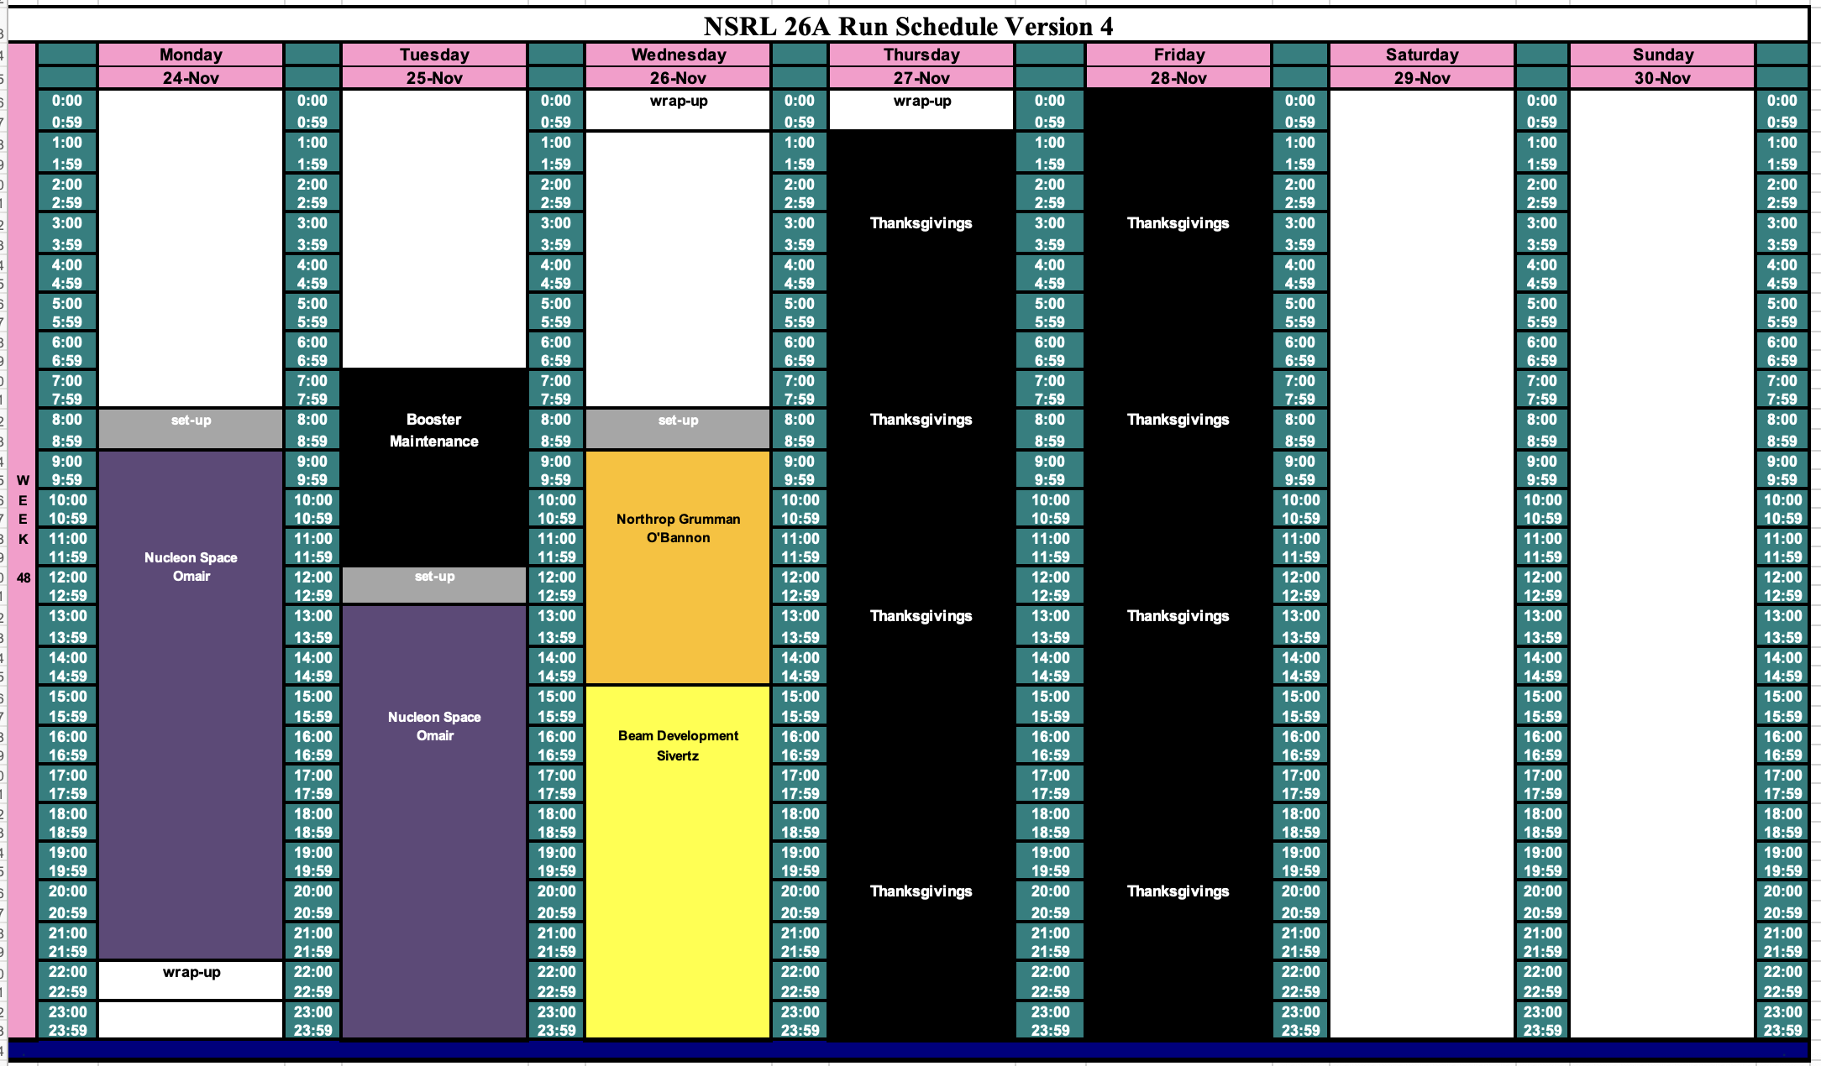
Schedule for this week

Slide 3
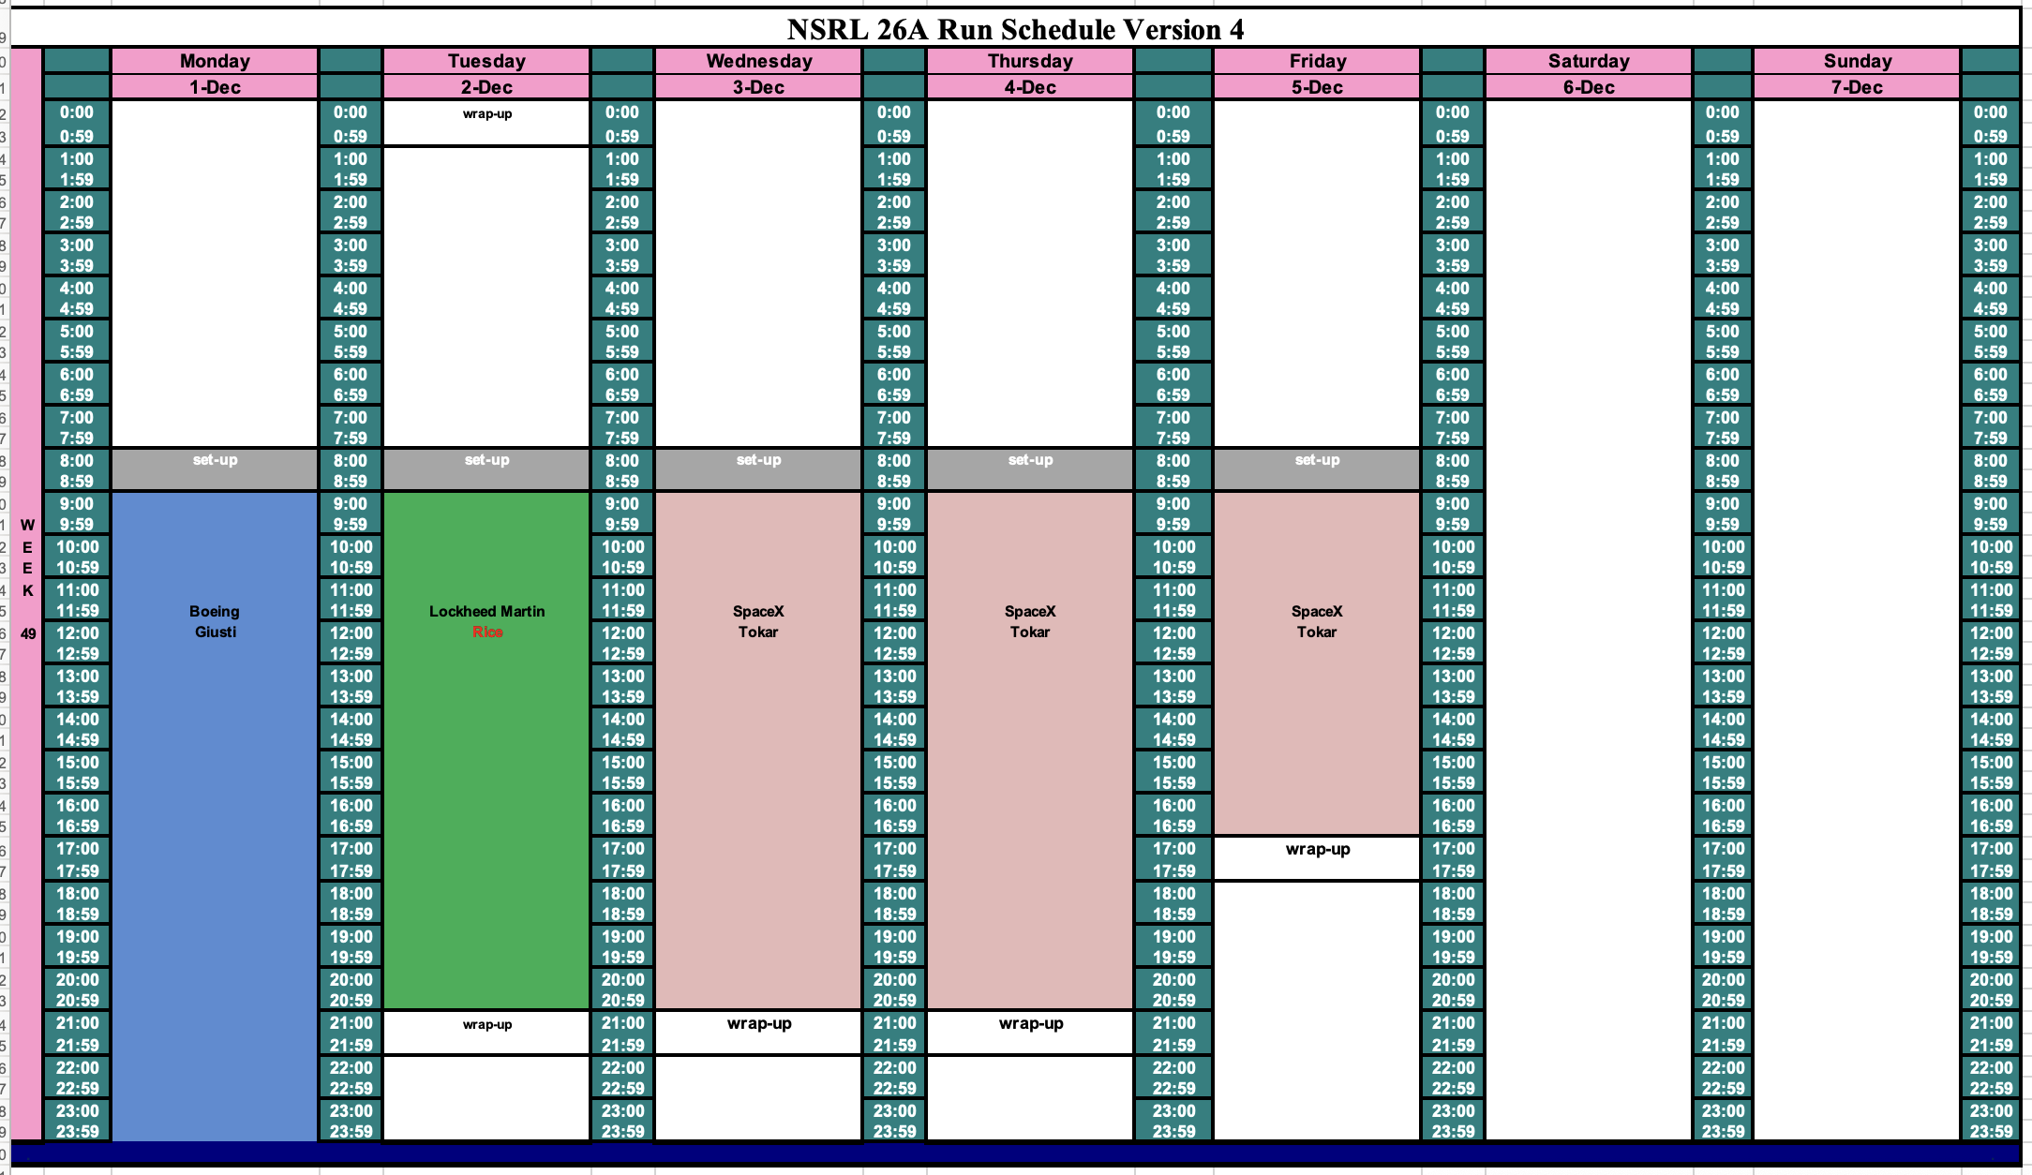
Schedule for next week

Slide 4
Future Schedule
Daily electronics testing: Smooth running from both Tandem and EBIS.
We hope to do some proton beam development after the electronics testing tomorrow, Wednesday 26 December to complete the high intensity small beam spot proton beams at 100, 200, 300, and 400 MeV.
We had a cancellation the following week, allowing us to remove Saturday from the NSRL schedule.
NSRL has been filling requests for high intensity Gold beams with Au from the Tandem. After RHIC finishes with Gold on 6 December, NSRL will be taking Au from EBIS only.

