Slide 1
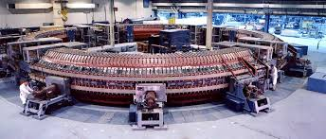
Time Meeting
Accelerator Operations Support

Slide 2

Accesses & activities this week
Today: Booster running for NSRL
Maintenance elsewhere
Laser CA in sector 2: No access
Tunnel sweeps shortly
Experimental area sweeps at 1600

Slide 3

Next Maintenance December Monday December 8th
Planning and scheduling on Friday dec 5th
here and streaming

