Slide 1
Lesson Learned: ASE Violation at NSLS-II
Ray Fliller
Time Meeting 12/02/25

Slide 2
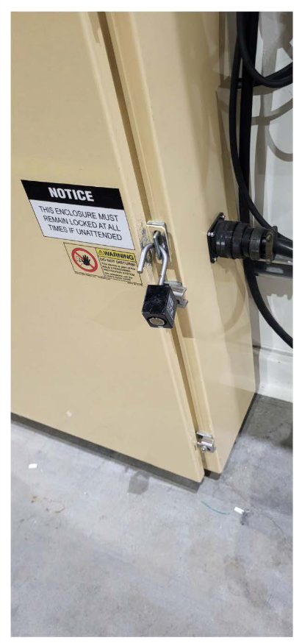
NSLS-II ASE Violation
On May 12, 2025, at approximately 9:25 p.m., an NSLS-II floor coordinator discovered that a PPS control enclosure at the 16-ID beamline was not properly secured. Although the padlock shackle was inserted through the cabinet locking hasp, it had not been locked as required.
A similar condition was discovered the following morning, May 13, 2025, at approximately 7:00 a.m., at the 12-ID beamline.
Pre-start beamline enabling checklists completed on May 8 and May 9 confirmed that all PPS enclosures were locked prior to starting operations.
PPS cabinets, however, are routinely accessed during operations to reset system faults, troubleshoot issues, or verify operability. When accessing an enclosure, the worker is responsible for reinstalling and fully securing the lock once the task is complete.
During the event review, staff provided conflicting accounts of activity related to one of the enclosures. A beamline scientist stated that operations staff had unlocked the enclosure while resolving an issue preventing beamline securement. Operations staff reported that they did not need to open the enclosure to complete their work. The cause of the second unlocked enclosure could not be determined.

Slide 3
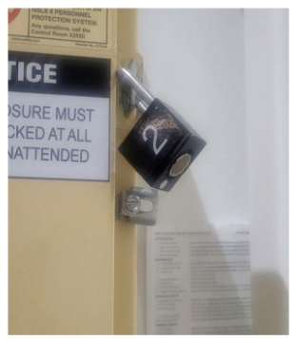
Other Details
At NSLS-II only 2 groups require access to the PPS cabinets. The safety system group and operations group.
It is the job of the operations group to assure that the cabinets are locks prior to startup of the beamline.
Not all faults require accessing the cabinet, and that is usually done under the guidance of the safety system group
Checking the locks is a job that is done all the time.

Slide 4
Analysis
The review identified several contributing factors: • No requirement to verify PPS enclosure locking after non-routine access such as resets or troubleshooting.
• Time pressure and distractions during restart activities following a long shutdown.
• Human performance issues, including assumptions, inconsistent recollections, and no documentation of enclosure access.
• Existing checklists applied only to routine activities and did not cover the conditions present during the event.
• Additional configuration concerns—such as missing shielded covers at 12-ID—required intervention and may have contributed to the locks not being fully engaged.

Slide 5
Corrective Actions
• Add written access logs at all PPS enclosures requiring worker and verifier signatures each time an enclosure is opened and re-secured.
• Create an NSLS-II access procedure defining when logs must be completed and updating posted instructions accordingly.
• Install captive-key locks to ensure enclosures cannot be inadvertently left unlocked.
• Move first optical enclosure (FOE) reset buttons outside PPS enclosures to reduce the number of entries required and track progress through a compiled FOE list.
• Centralize PPS cabinet keys in the Control Room using a formal sign-out system for accountability.
• Increase configuration management awareness through weekly All-Hands messaging and by assigning Beamline 101 training to all personnel with PPS enclosure access.

Slide 6
Lessons for us
We have our own Operational Readiness Checklists.
We recently updates our Checklist process to address issues with ours:
Consistent format
Clearer requirements on when they expire (everyone’s favorite)
More clarity on what belongs in them.
We also have a lot of tasks that are repetitive and require checking things routinely. It is easy to do a quick check and not really see the thing you are looking for. (e.g. you see the lock, but don’t notice that it is not locked.)

