Slide 1
Preinjector Status
D. Raparia
Time Meeting
December 02, 2025

Slide 2
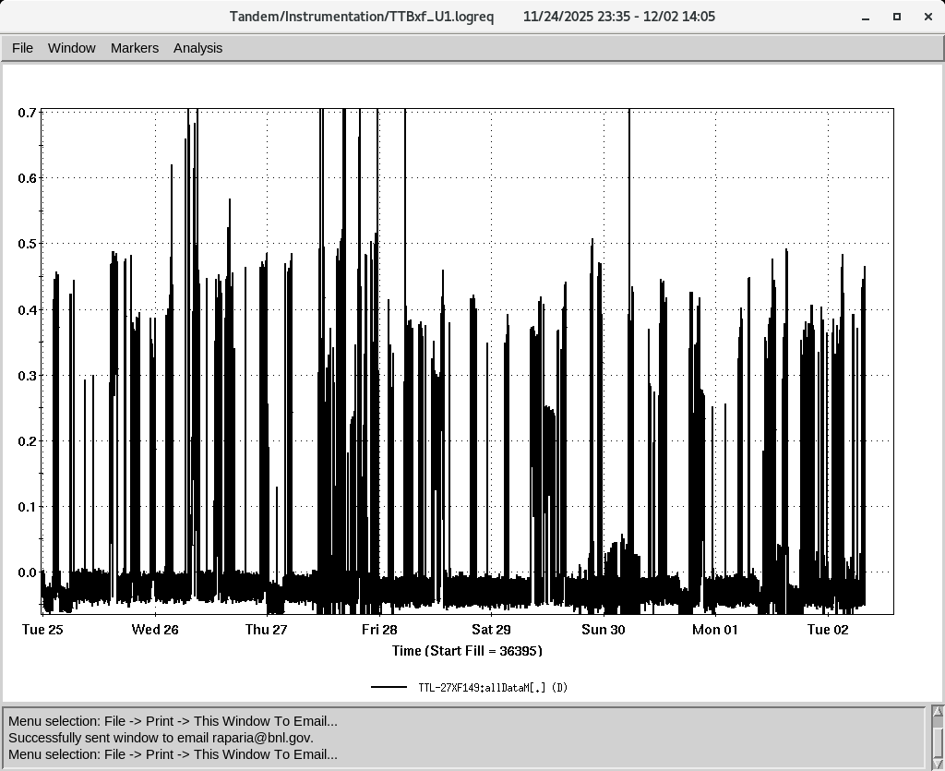
Tandem
MP7- RHIC support
Running well
Switched ion source yesterday
Au⁺³¹ to NSRL
MP6 – external users
Last week Ion source group experiment continue

Slide 3
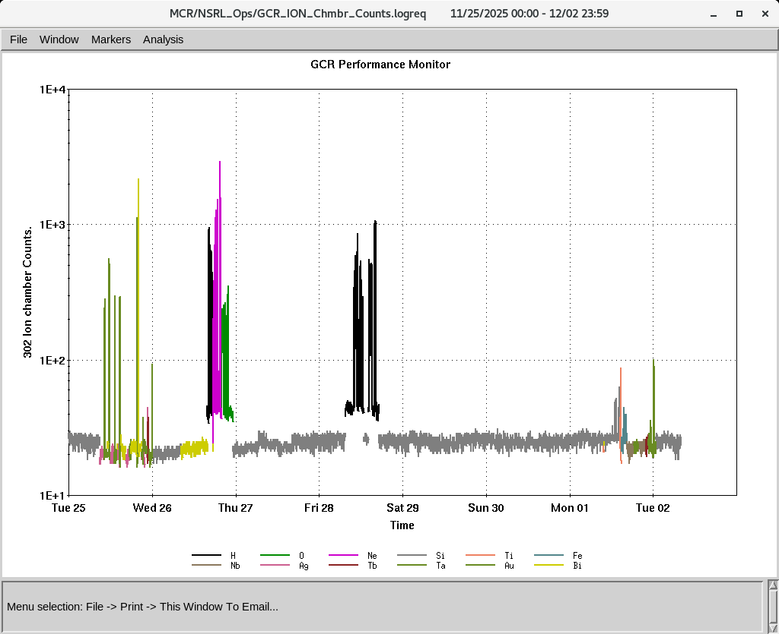
EBIS
Smooth operation for NSRL
Extractor bias supply was replaced yesterday
IONS to NSRL
O^{+7,} Ne⁺⁸ Si^{+11 ,}Fe⁺²⁰ ,Ti⁺¹⁷ Nb⁺²³,Ag⁺²⁹, Tb⁺³⁵,Ta⁺³⁸, Au⁺⁴⁷ Bi⁺⁴³,
P (Linac)
Au⁺³¹ (Tandem)

Slide 4
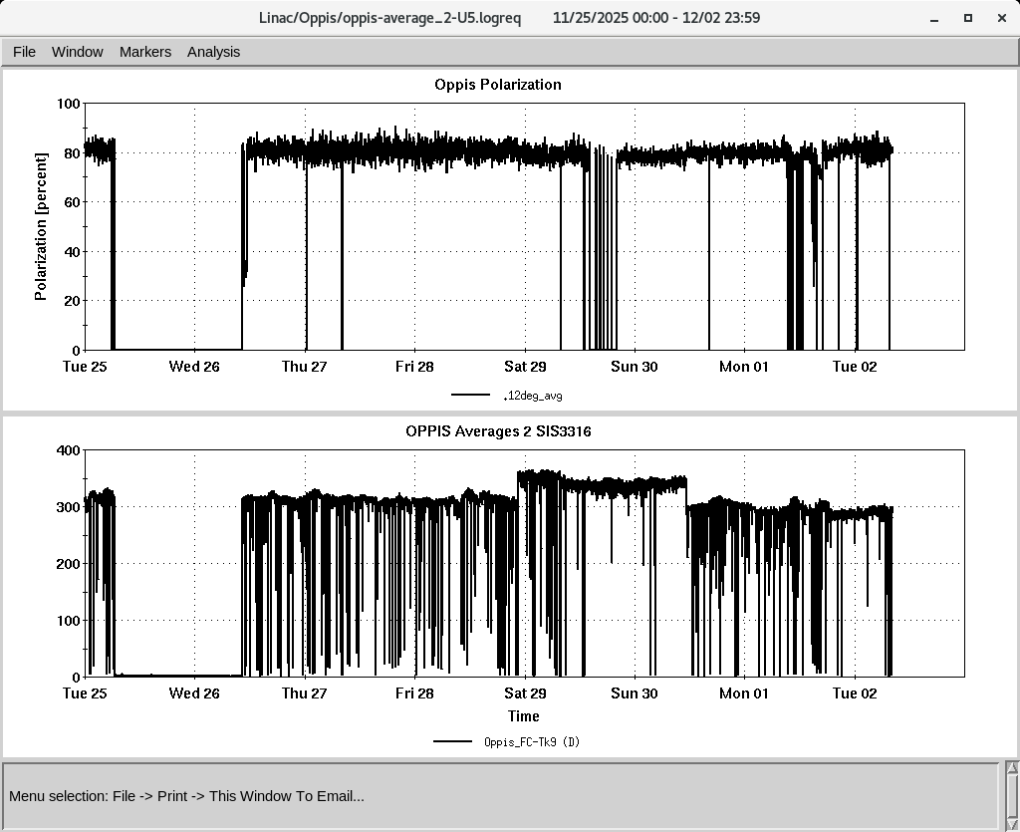
LINAC
BLIP has requested beam on 12/19/2025 ,Canceled
PP beam is currently being used for setup
OPPIS operating with normal beam intensity with pol ~ 80%
High intensity H- source is operational.
RF modulator tube 8616 (V3) in mod 7 is changed today

