Slide 1
sPHENIX Status
Kin Yip
sPHENIX Director of Operations
Time Meeting
Dec. 2, 2025

Slide 2
sPHENIX Status
sPHENIX continues to accumulate luminosity towards the luminosity goal of ~7/nb (Au + Au). We plan for switching to p+p of 13/pb (p+p) ~ Dec. 8, the next must-do priority recommended by PAC25.
Magnet tripped ~7:10 pm on Nov. 26 due to Cryo Interlock.
It was ramped back to the full current/field ~11:33 pm.
Short access requests during the long holiday weekend:
Nov. 27: There was an IR access to regain control the TPC Central Membrane.
Nov. 29: This access was to replace a MPOD module for EMCAL.
Dec. 1: Early morning access to replace power supplies for TPC.

Slide 3
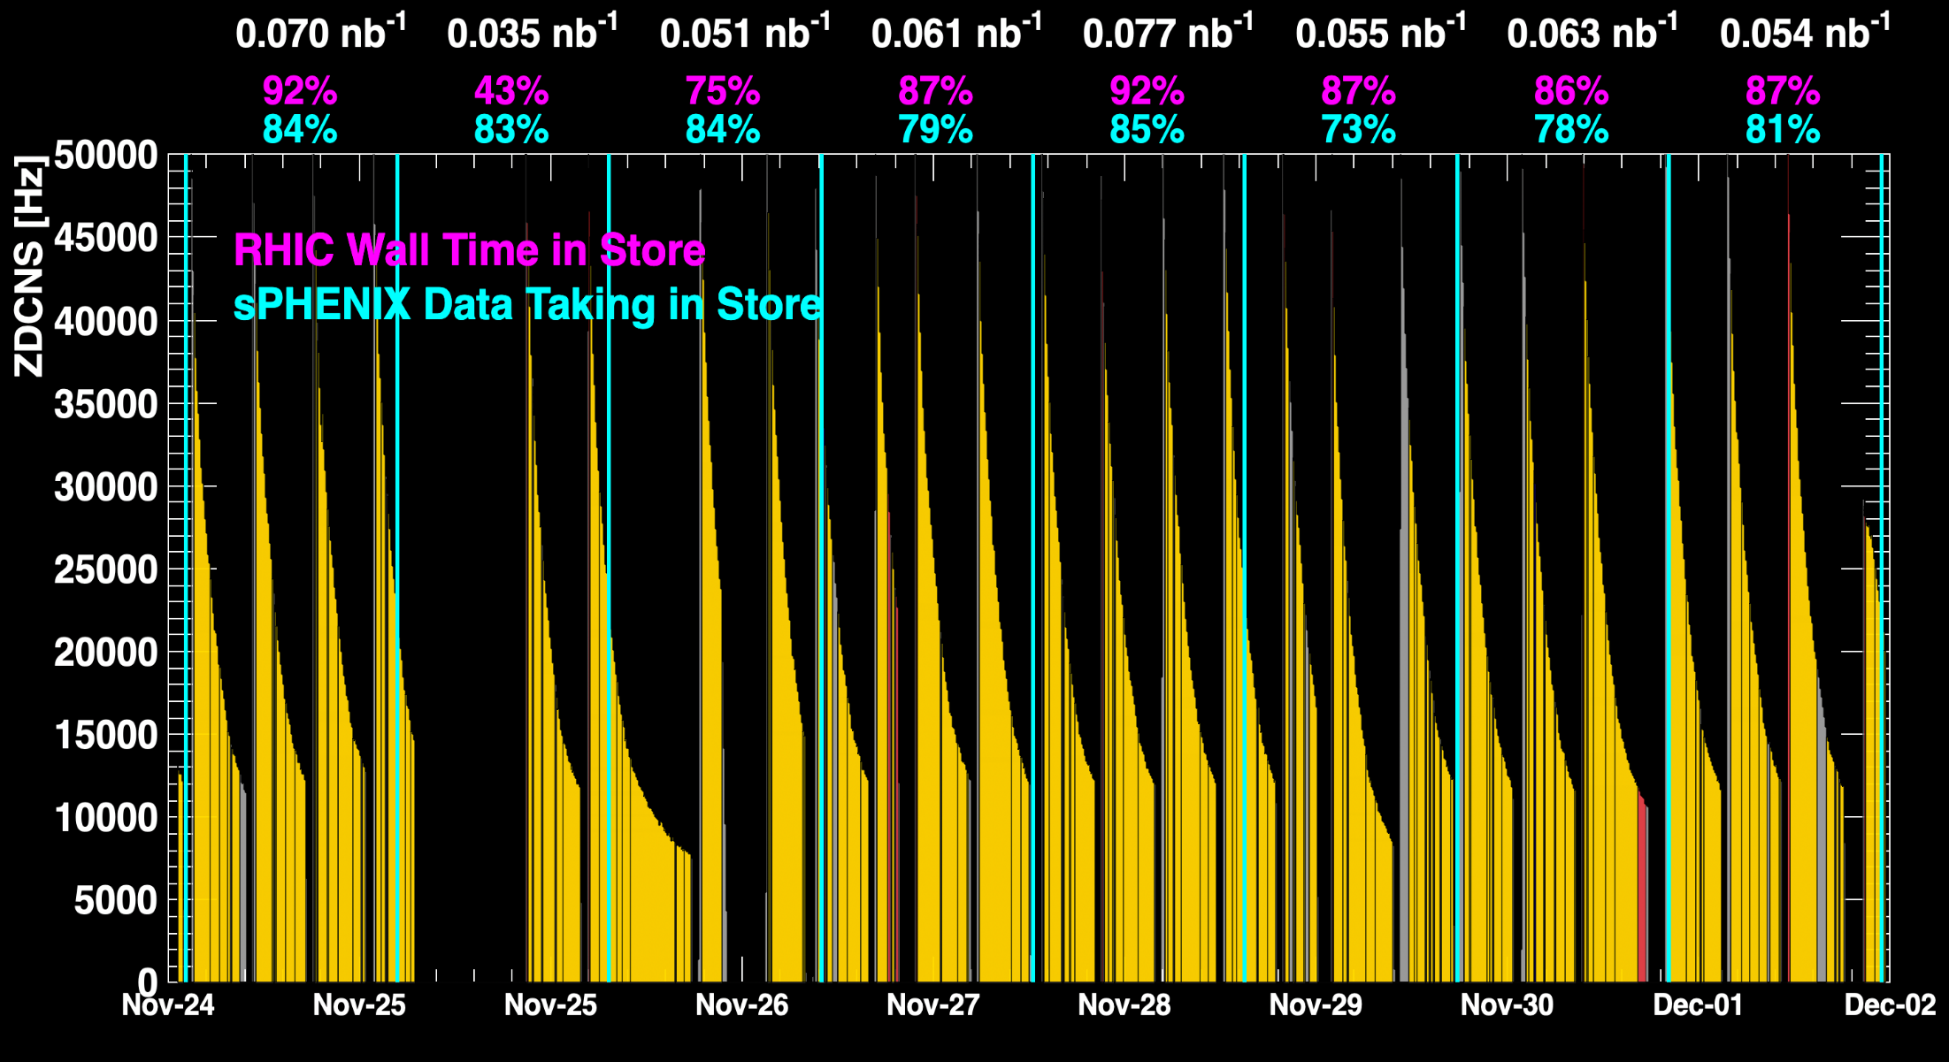
sPHENIX Status (cont.)
1008C pump trips
CDU issue
1008C pump trips
CDU issue
6x6
When all sPHENIX detectors were being operated.
No TPC

Slide 4
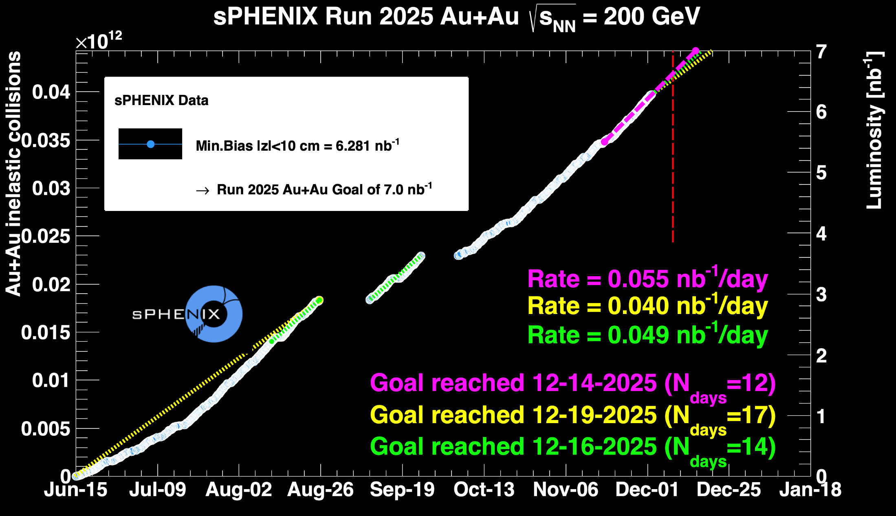
sPHENIX Status (cont.)
~ 89.7%

