Slide 1
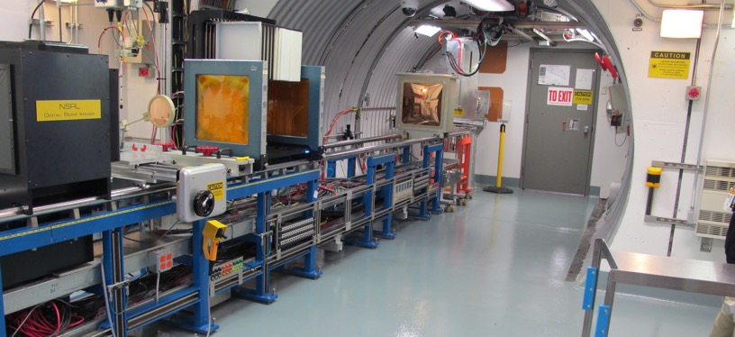
NSRL Time Meeting Report
2 December 2025
Michael Sivertz

Slide 2
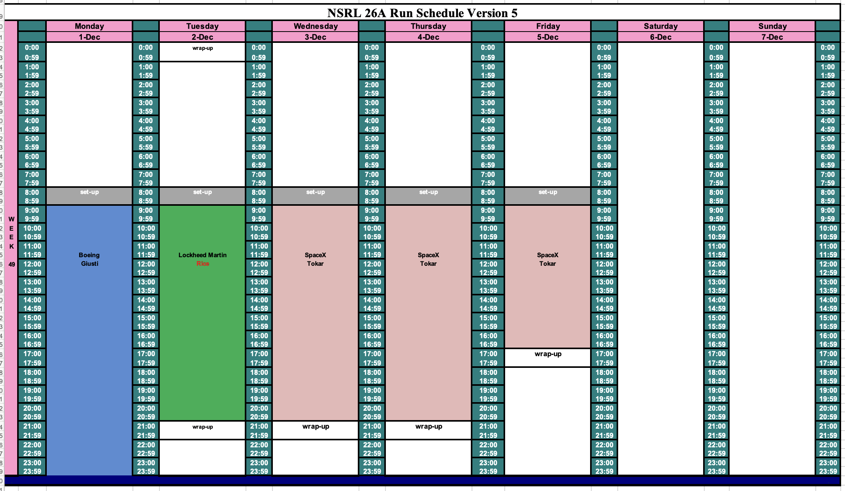
Schedule for this week

Slide 3
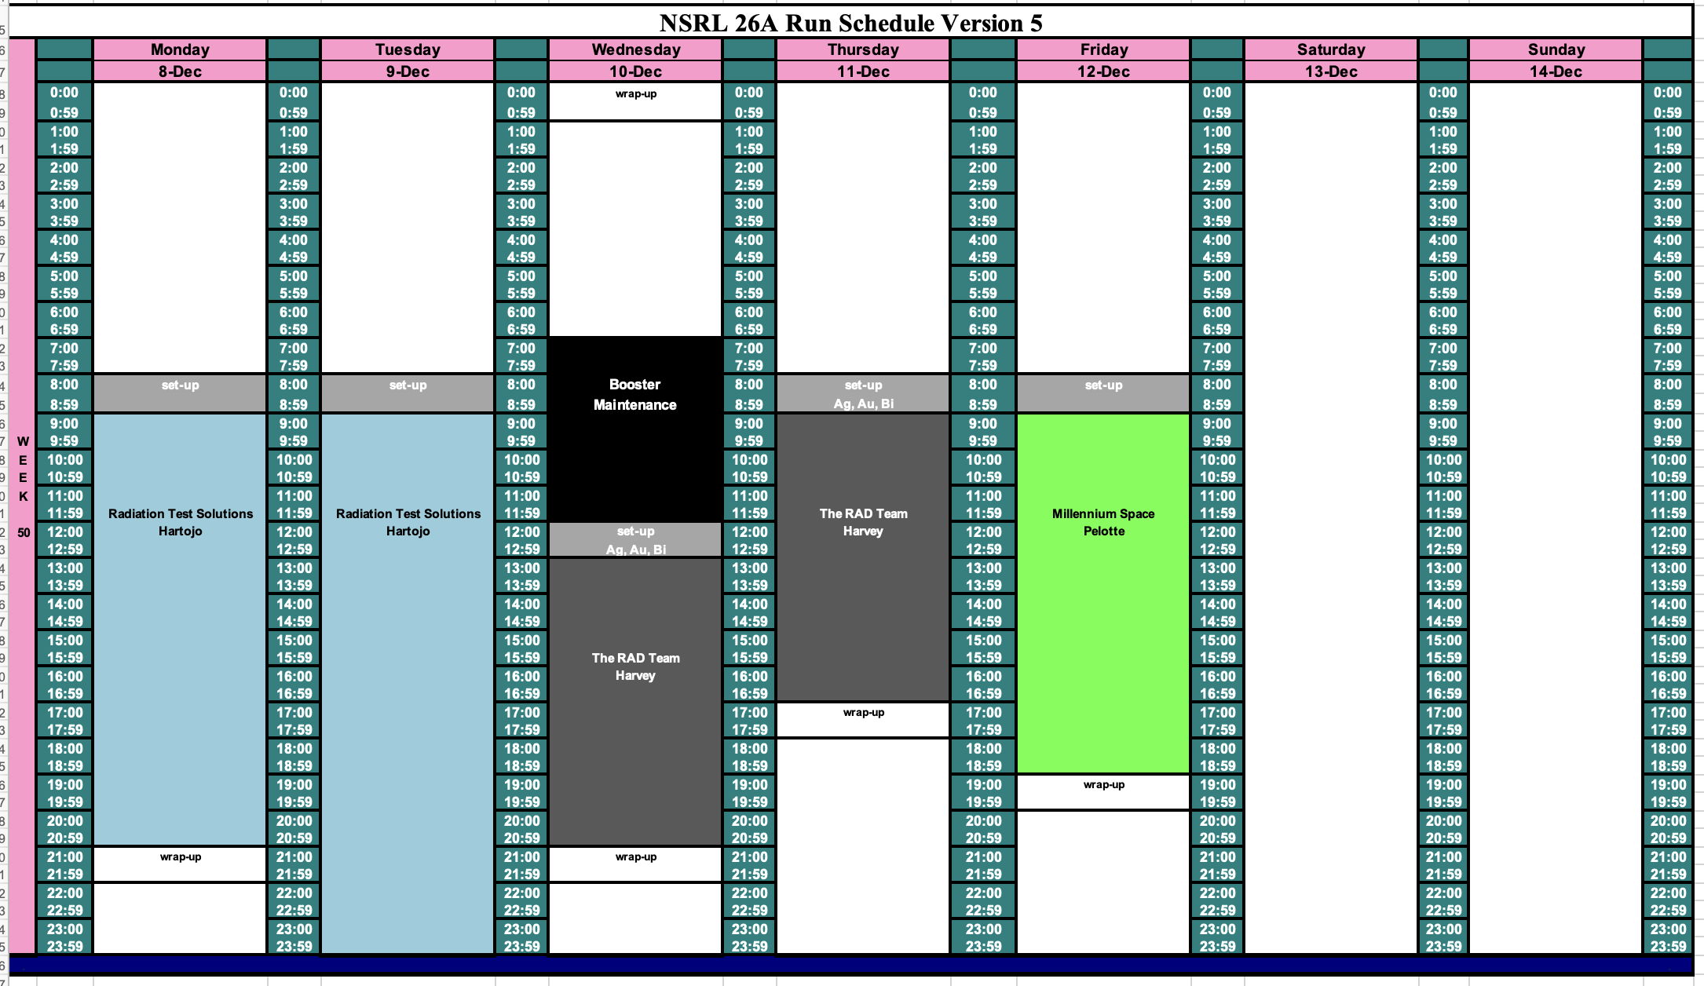
Schedule for next week

Slide 4
Future Schedule
Daily electronics testing: Smooth running from both EBIS (after power supply replacement).
There is still some uncertainty about the date/time of the Booster Maintenance for the water leak repair currently listed as Wednesday morning 10 December.
This may get moved to this Friday, or Saturday, or next Monday, or …

