Slide 1
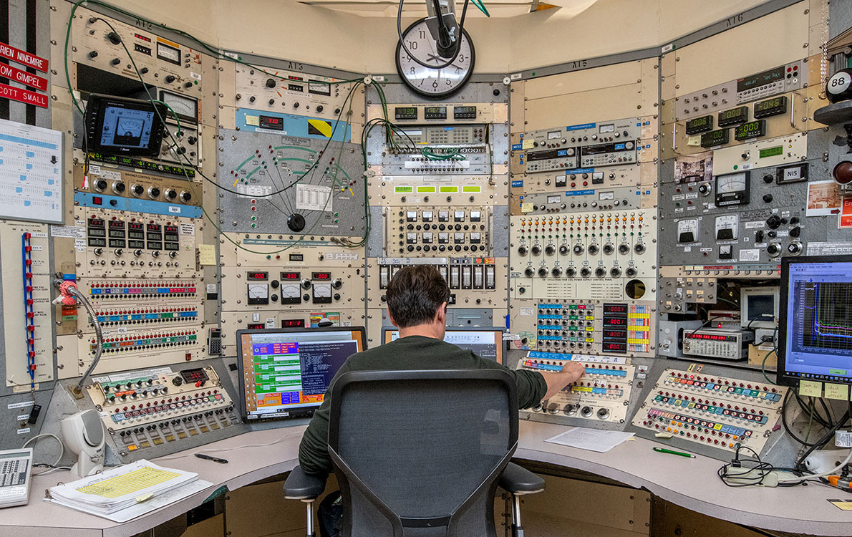
Time Meeting
Accelerator Operations Support

Slide 2

Accesses & activities this week
Maintenance items went well
Failure on contactor fo UD1-2 on turn on
Repairs wrapping up
Last scheduled RHIC Maintenance Dec 23rd!!!!!

Slide 3

Next Maintenance December Tuesday December 23rd
Planning and scheduling on Friday Dec 22nd 2:30 pm here and streaming

Slide 4
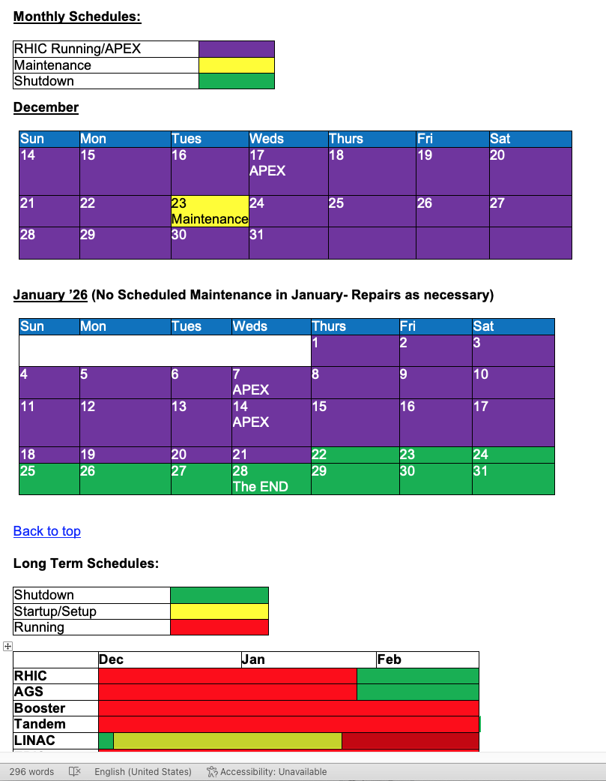
End game

