Slide 1
Preinjector Status
D. Raparia
Time Meeting
December 09, 2025

Slide 2
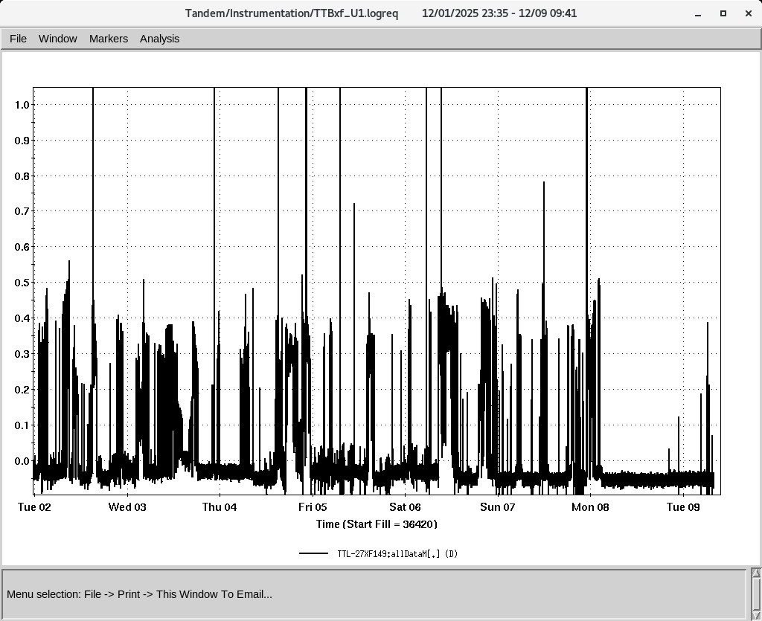
Tandem
MP7- RHIC support
Au concluded on Monday
Au⁺³¹ to NSRL
External user on this Thursday

Slide 3
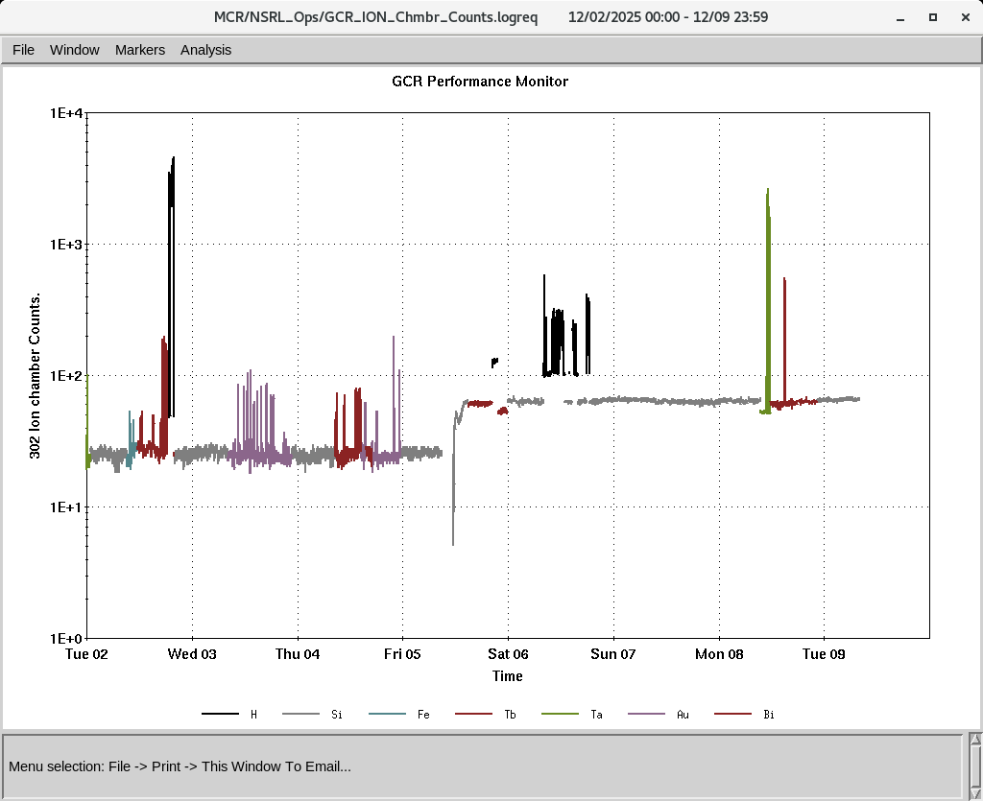
EBIS
Smooth operation for NSRL
LEBT solenoid cooling,
MEBT Q1/Q2 resets , DT6 Trek PS replaced
IONS to NSRL
Si^{+11 ,}Fe⁺²⁰ Tb⁺³⁵,Ta⁺³⁸, Au⁺⁴⁷ Bi⁺⁴³,
P (Linac)
Au⁺³¹ (Tandem)

Slide 4
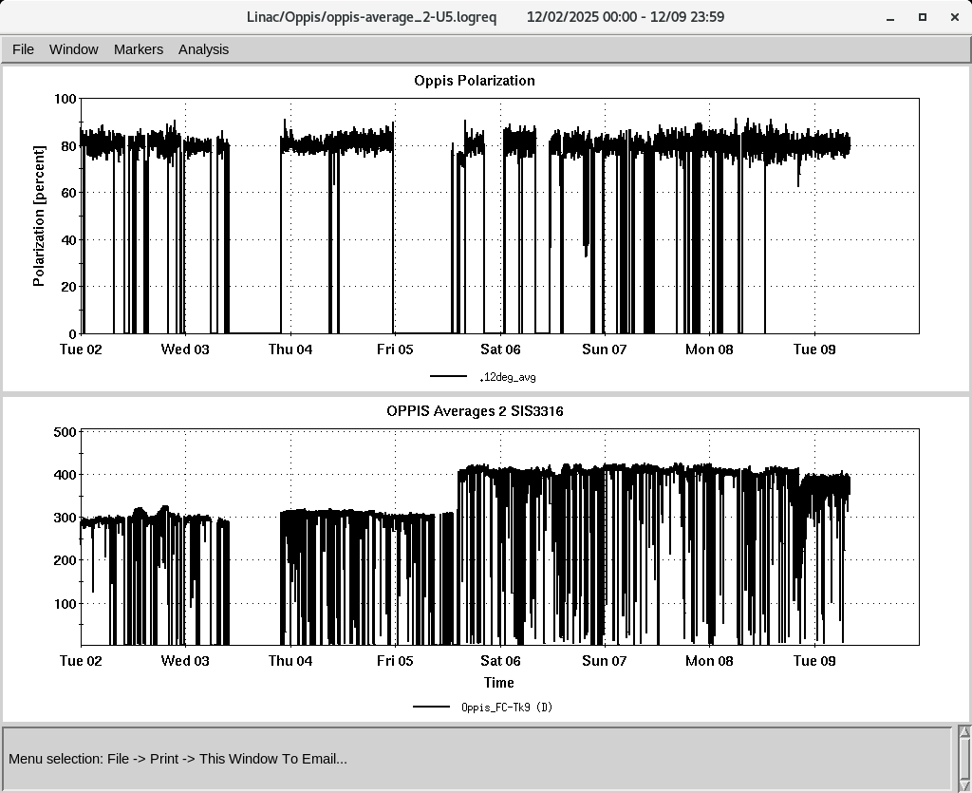
LINAC
PP beam is currently being used for setup
OPPIS operating with normal beam intensity with pol ~ 80%
High intensity H- source is operational.
Mod 7 issues resolved by changing modulator tubes (V2 and V3) 8618
H-Jet , maintenance, Nozzle for jet was replace, broken chopper motor was replaced

