Slide 1
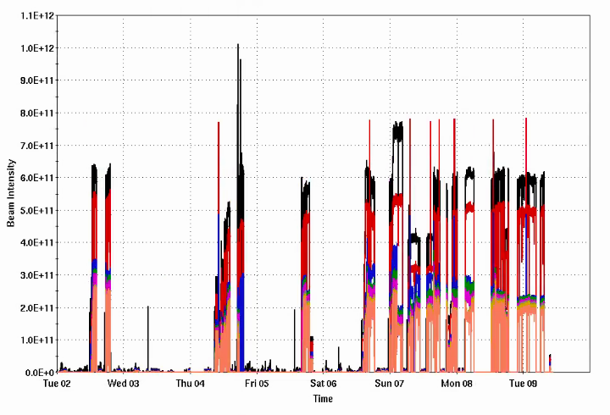
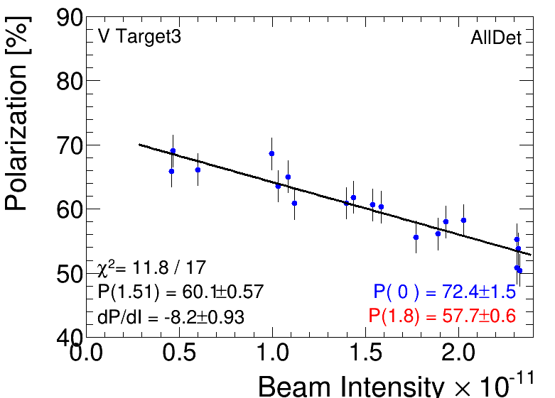
Injector Status: Time meeting 12/9/25
Booster input intensity routinely up to 6x1011
Nominal RHIC fill 6-7x1011
AGS extraction intensity ~ 2x1011
Polarization vs intensity scan shows
low ‘zero intensity’ polarization (normally associated with source or Booster resonances)
High slope (dP/dI ~ -8%).
With hor resonance measures, usually dP/dI ~ -4%
Circulating loss during extraction, can be tuned out
Complicated by local-only control of the extraction bump amplitude
Uarc4 failure (a.k.a UD1-2)
Injector Intensity (protons)
Intensity
Pol v Intensity

Slide 2
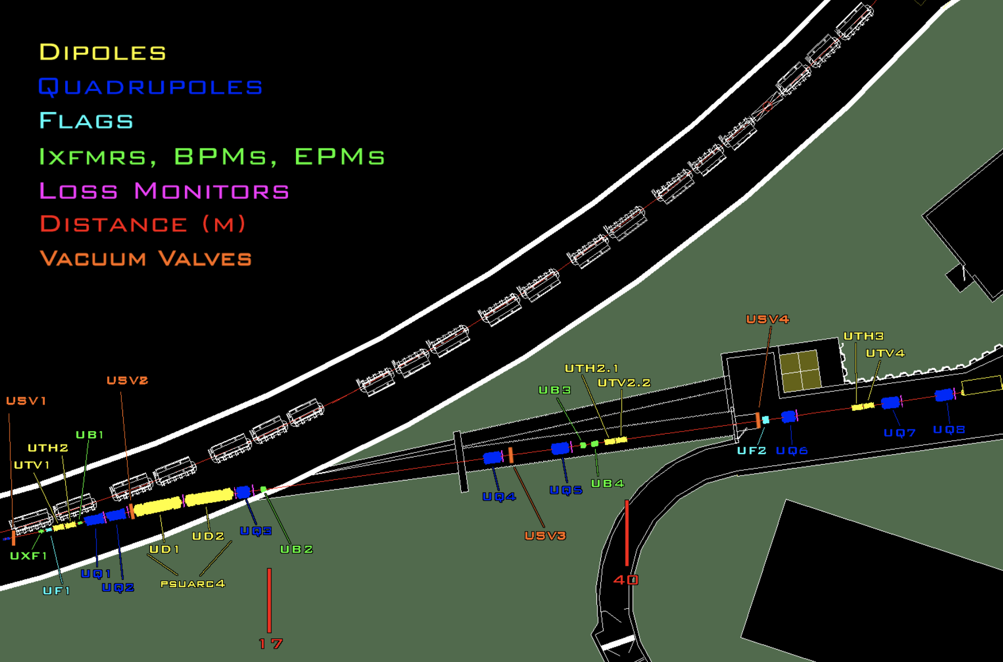
U-arc 4 Contactor Failure
U-arc 4: 4 deg dipole bend, two magnets powered in series (UD1 and UD2)
AGS extraction critical device (i.e locking this out is verified to prevent beam from leaving the AGS enclosure)
Replacement of 300 lb breaker requires rigging, significant work planning
Opted to delay repair to this morning
Repair estimated to be finished ~1330 (roughly now-ish)
AGS circulatng
U-line to RHIC

