Slide 1
sPHENIX Status
Kin Yip
sPHENIX Director of Operations
Time Meeting
Dec. 9, 2025

Slide 2
sPHENIX Status
sPHENIX completed taking (Au + Au) data on Dec. 8 (morning). We’re preparing to take (p+p) data towards the goal of 13/pb, the next must-do priority recommended by PAC25.
Dec. 3: UPS was fully installed for the PLC system (TPC) in the Gas Mixing House.
Minor leak was confirmed to be from EMCAL SiPM cooling liquid during the weekend and we opened the Magnet door and a few HCAL panels Monday morning to investigate the leak.
At the end, we were able to mitigate the leak falling on the HCAL by diverting its flow, and clean the HCAL panels.
We aim to close up the Magnet door today.

Slide 3
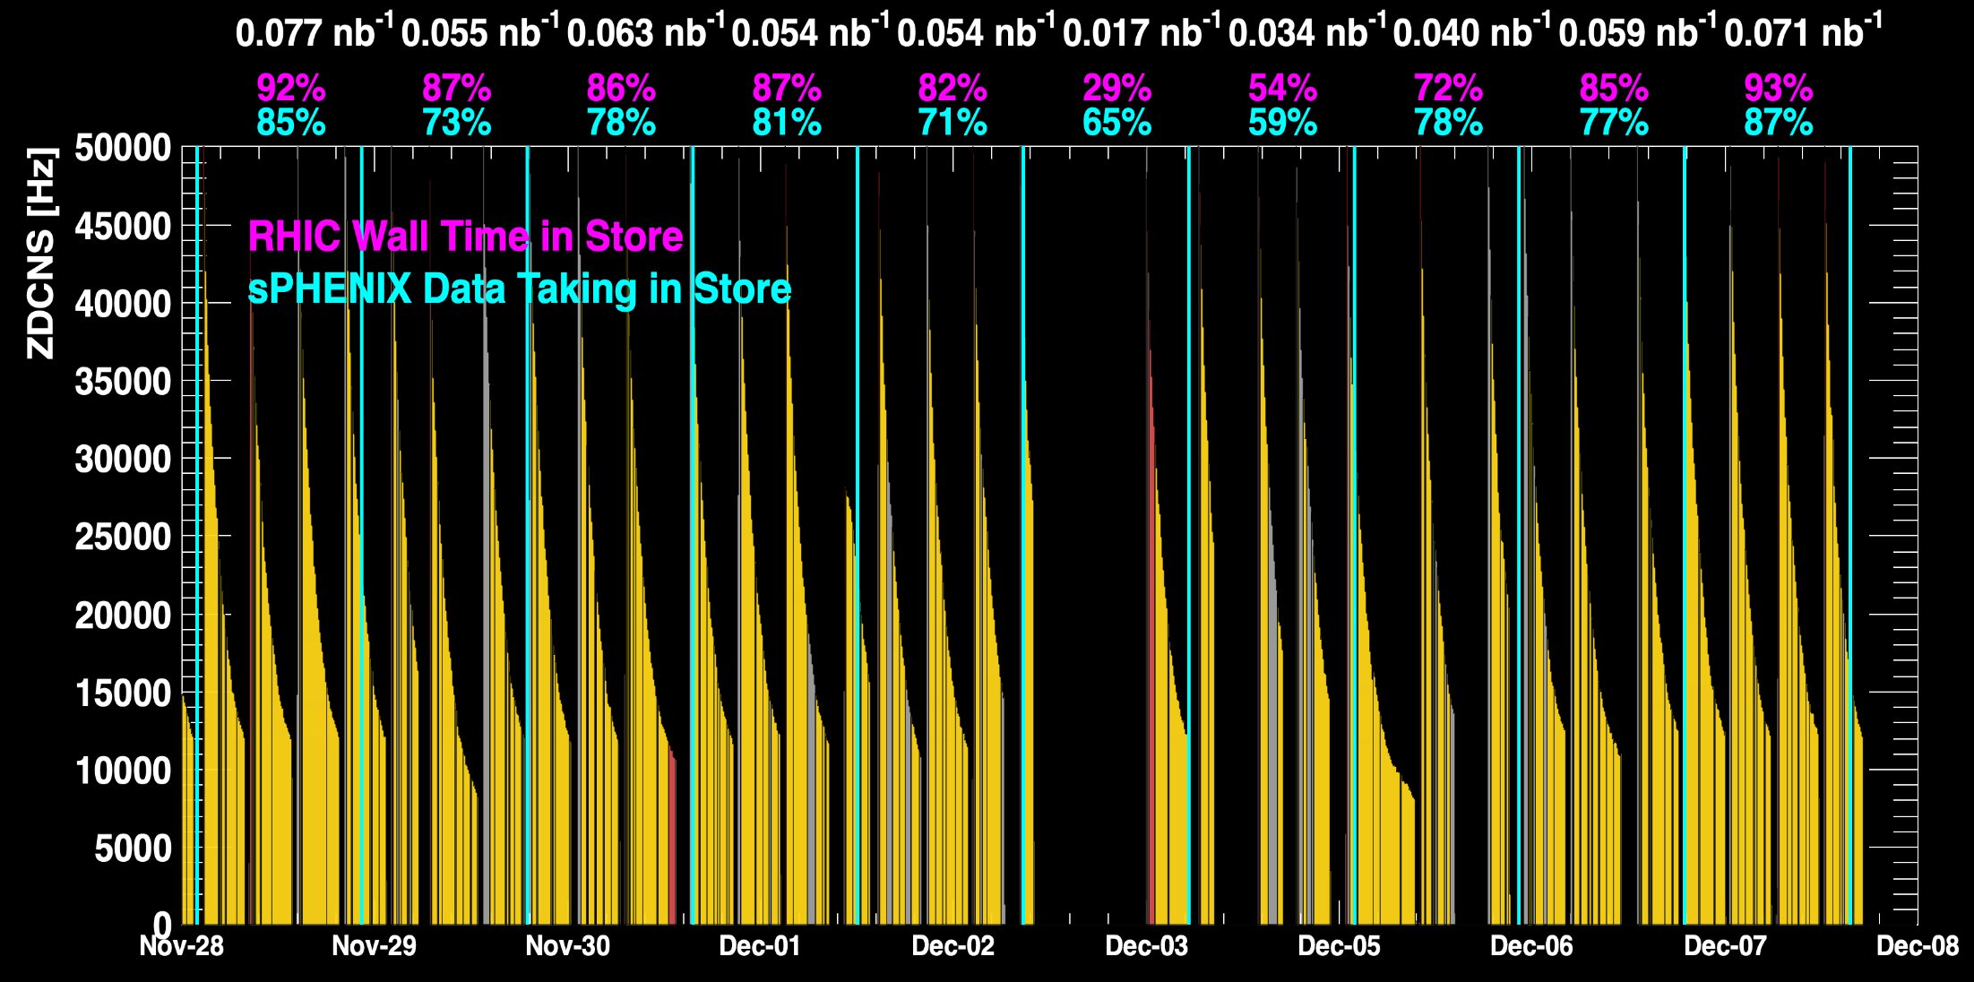
sPHENIX Status (cont.)
1008C pump trips
CDU issue
1008C pump trips
CDU issue
6x6
APEX
When all sPHENIX detectors were being operated.
No TPC

Slide 4
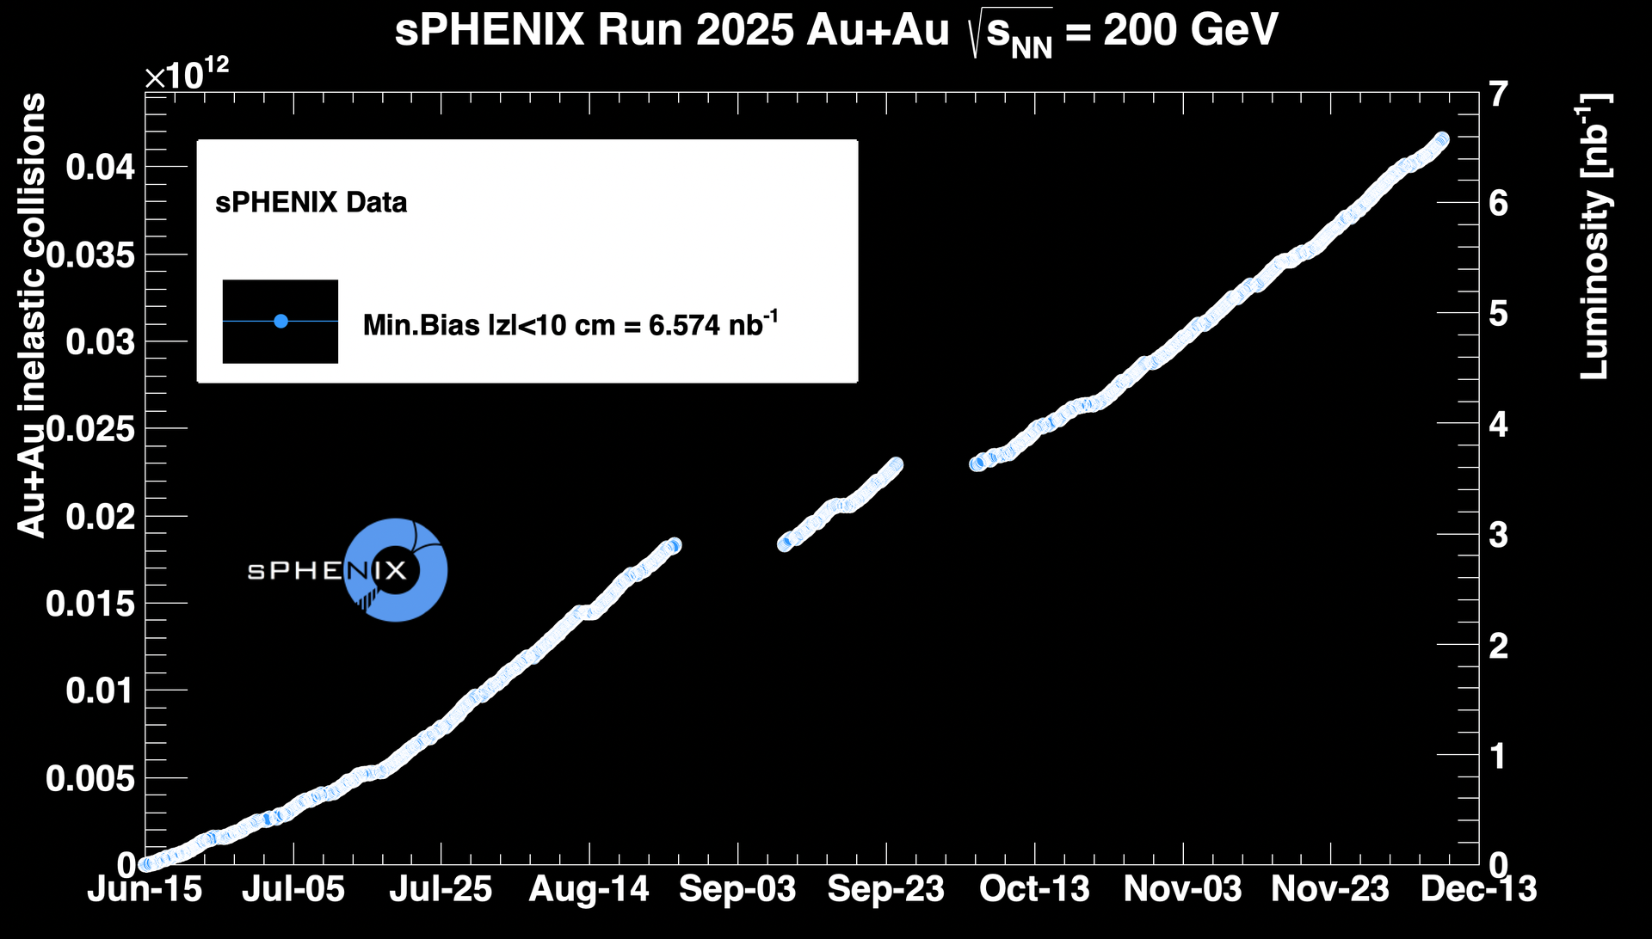
sPHENIX Status (cont.)
~ 93.9% of the goal ( 7 nb⁻¹ )

