Slide 1
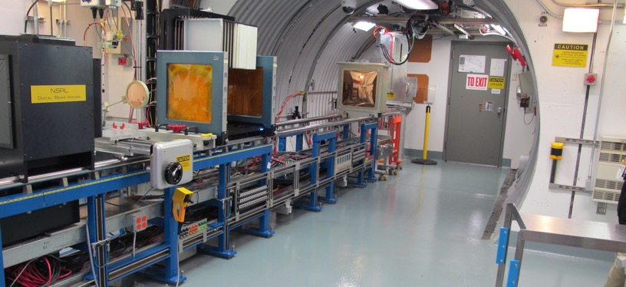
NSRL Time Meeting Report
12/09/2025
Michael Sivertz and Xiaodong Jiang

Slide 2
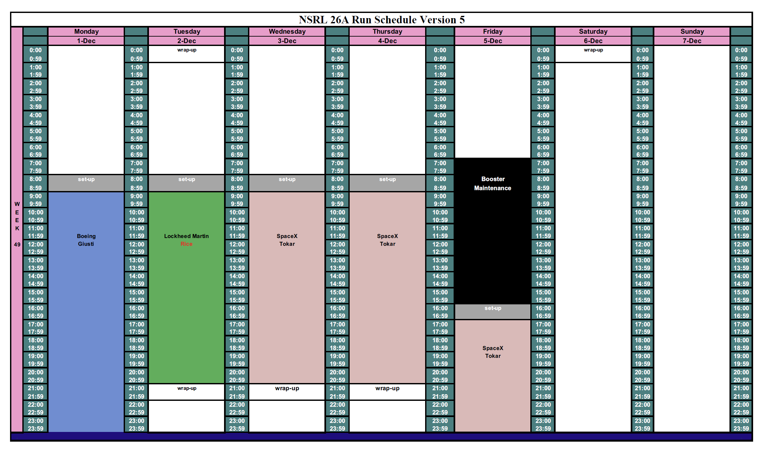
Scheduled users last week

Slide 3
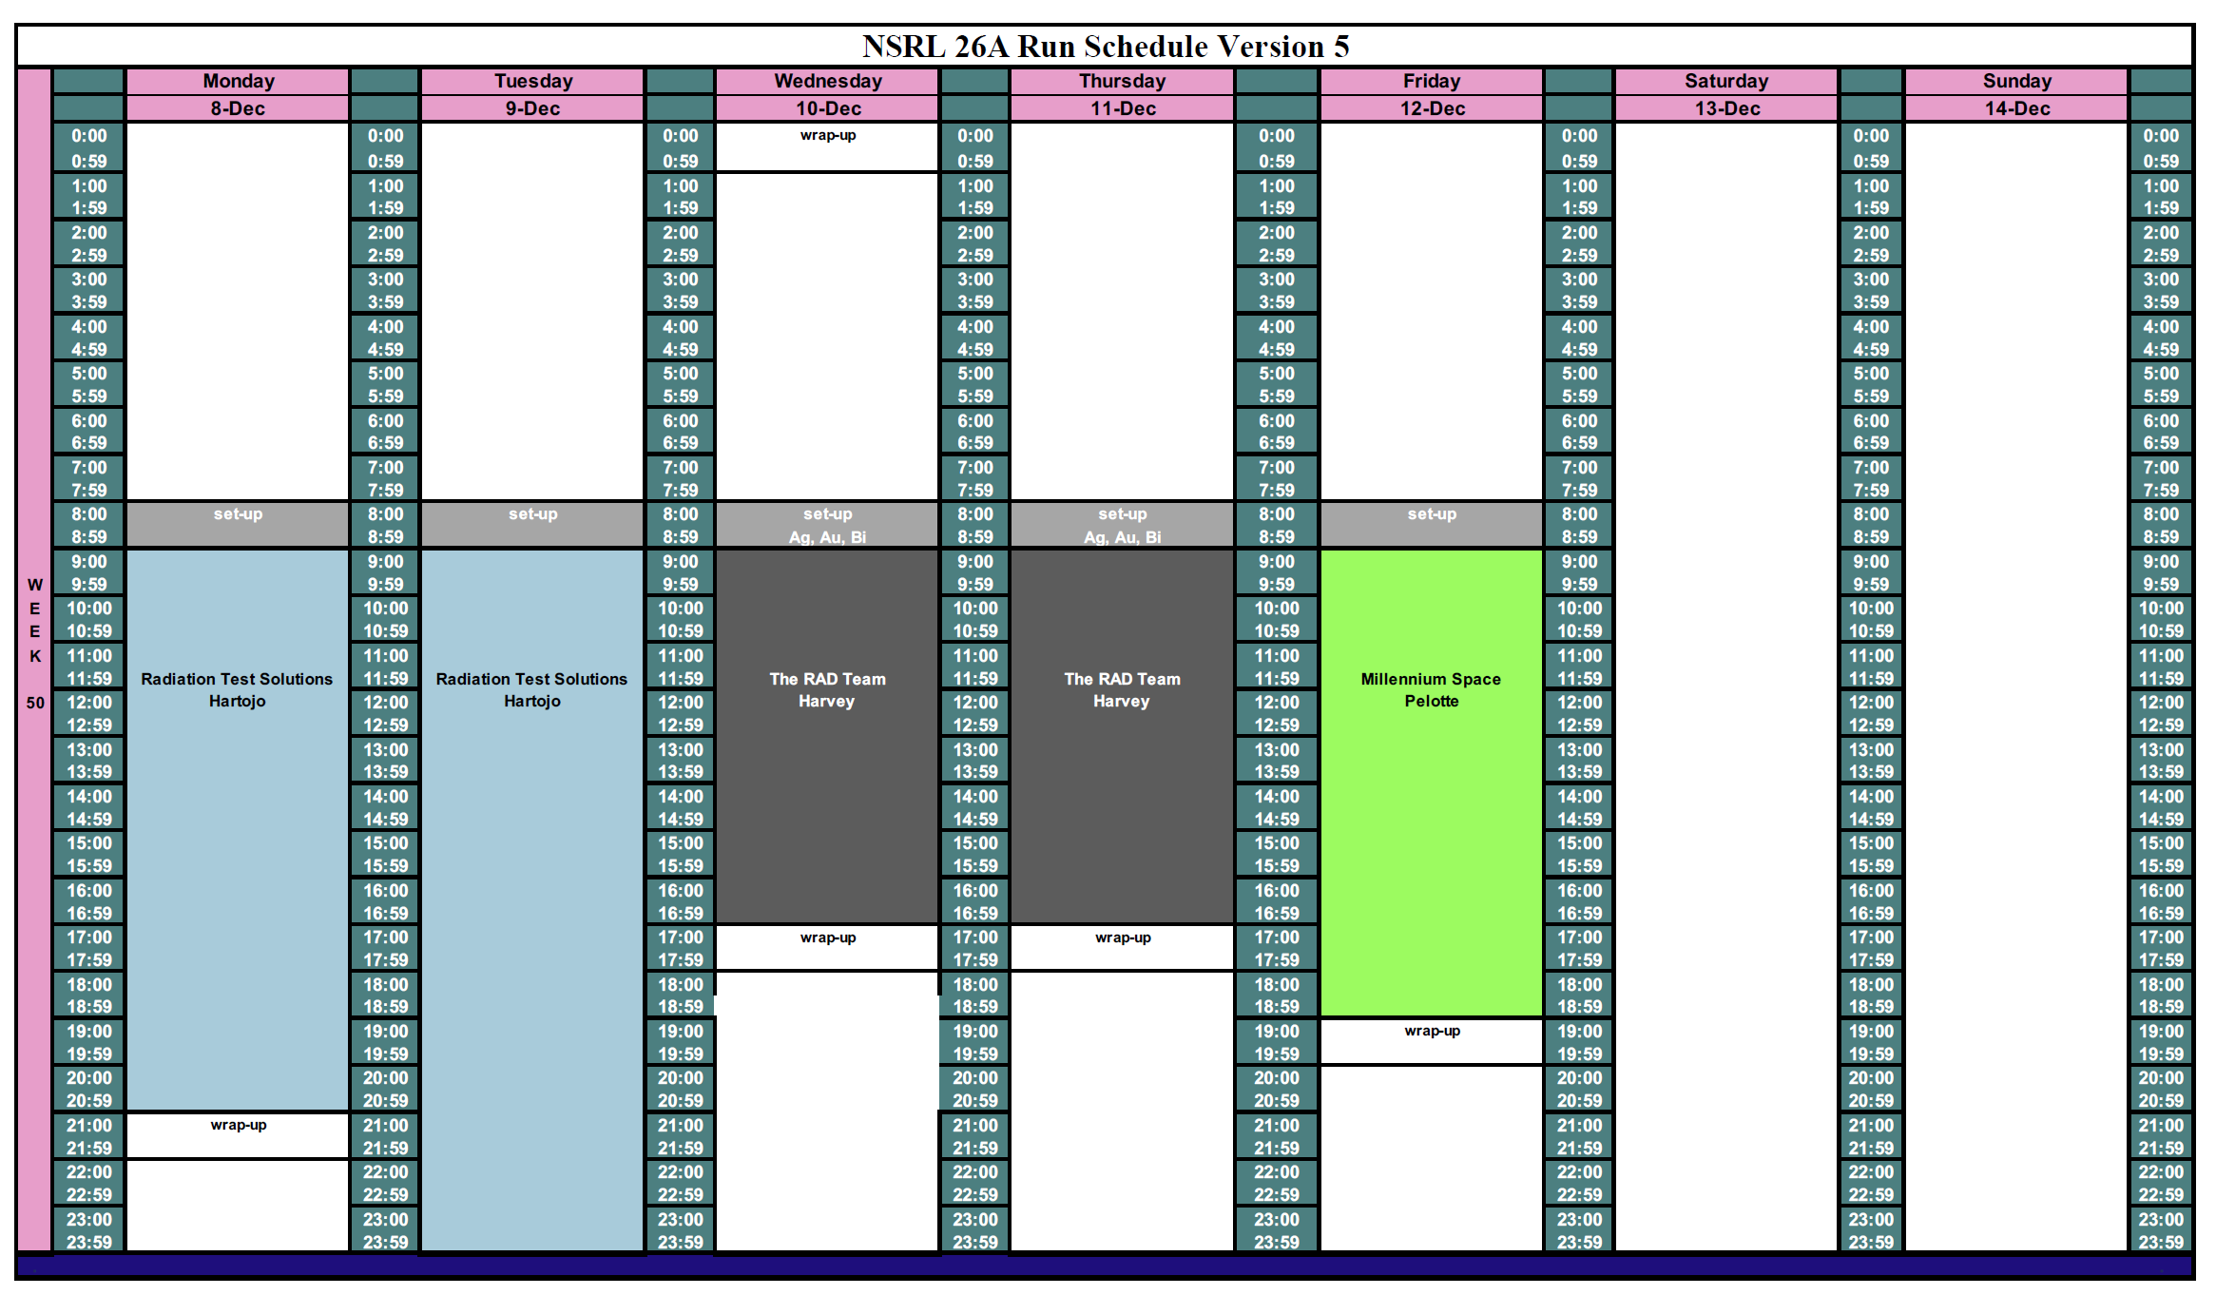
Scheduled for this week

Slide 4
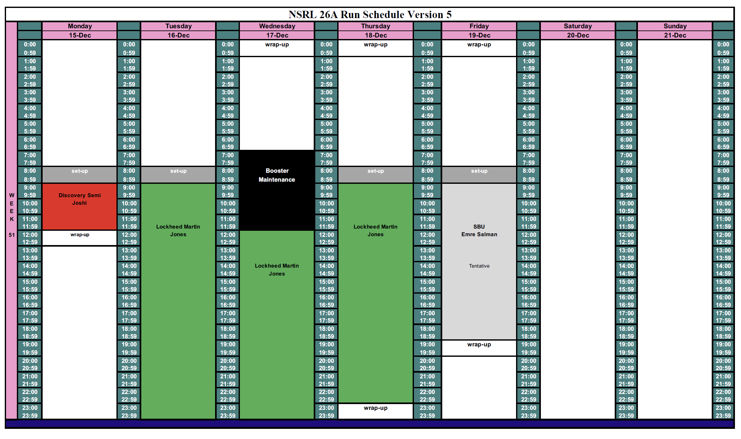
Scheduled for next week

Slide 5
Future Schedule
December 22nd, 2-hours for Blue Origin, HALU material activation test.
NSRL will not be running during the holiday weeks.
NSRL users are scheduled starting Jan. 5th, 2026.
Thanks to EBIS.
Thanks to MCR.
Thanks to everyone that support NSRL.

