Slide 1
Data courtesy C. Naylor

Slide 2
Data courtesy C. Naylor

Slide 3
Data courtesy C. Naylor

Slide 4
Data courtesy C. Naylor

Slide 5
Data courtesy C. Naylor

Slide 6
Data courtesy C. Naylor

Slide 7
Data courtesy C. Naylor

Slide 8
Data courtesy C. Naylor

Slide 9
Data courtesy C. Naylor

Slide 11
Data courtesy C. Naylor

Slide 12
Data courtesy C. Naylor

Slide 13
Data courtesy C. Naylor

Slide 14
Data courtesy C. Naylor

Slide 15
Data courtesy C. Naylor

Slide 16
Data courtesy C. Naylor

Slide 17
Data courtesy C. Naylor

Slide 18
Data courtesy C. Naylor

Slide 19
Data courtesy C. Naylor

Slide 20
Data courtesy C. Naylor

Slide 21
Operations for BLIP
No BLIP
this past week
BLIP remains in shutdown.
Notes:
BLIP plot from LogView /MCR/PerformanceStats/timeMeetingBLIP.lvdisp
Avail calc on nsrl time Excel sheet

Slide 22
NSRL activity past weeks: 12/2-9/2025 (as of 0800)
NSRL running continues.
Various setup and user beam time through the week.
5 EBIS species, Tandem Au, Linac protons logged to NSRL
Run 26-A continues, schedule posted with users up to 21 December.
Availability: 98%
Notes:
Graph and avail calc from nsrl time.xlsx

Slide 23
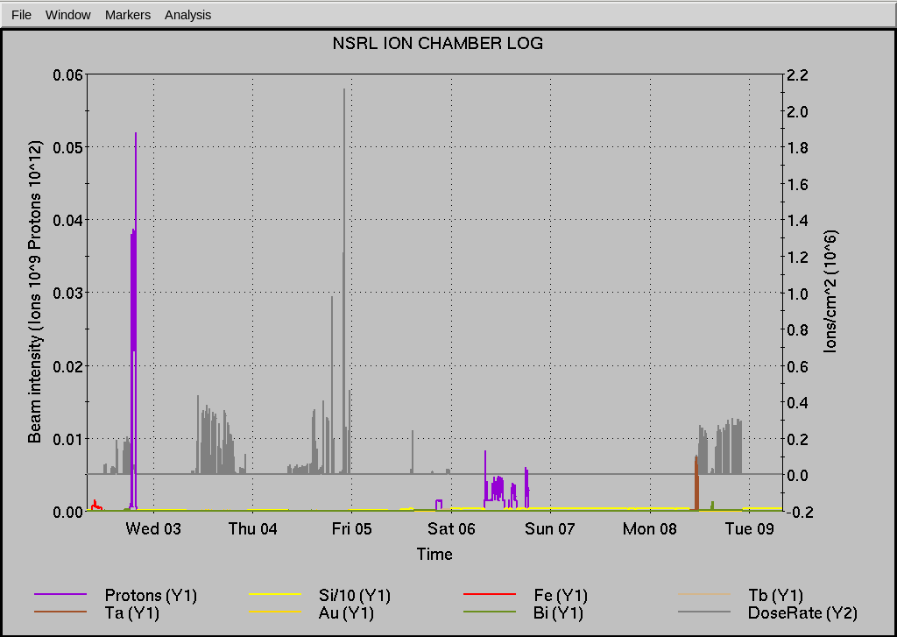
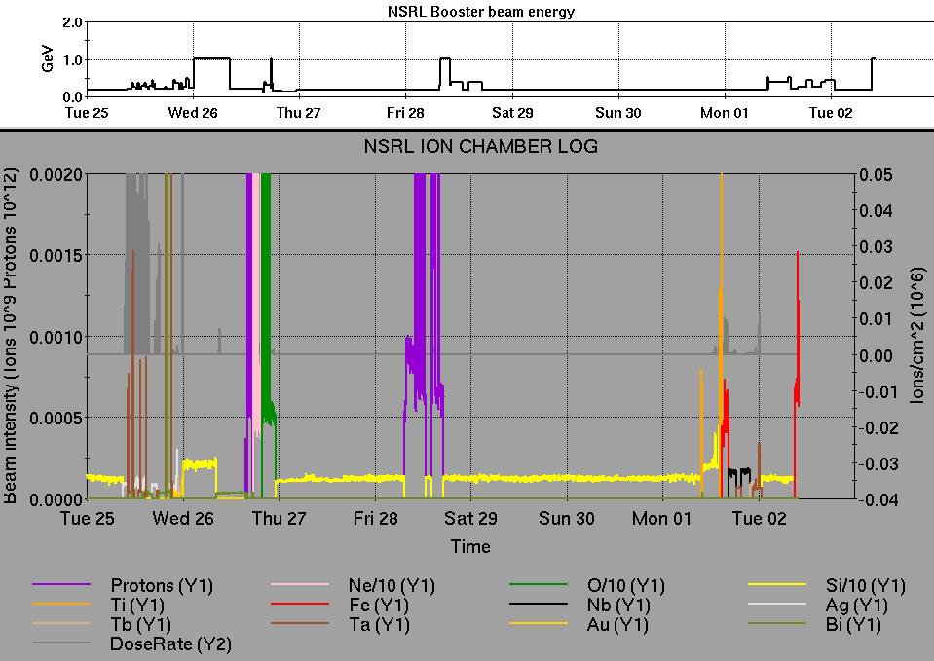
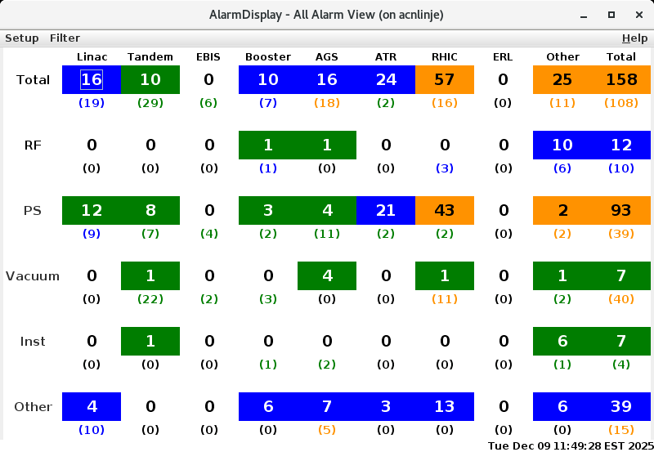
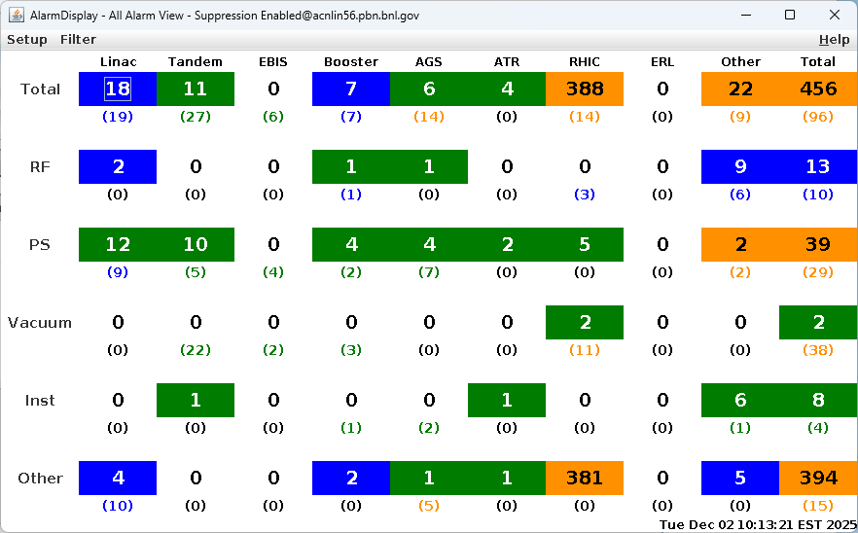
Notes from Operations
Notable failures (>1 hr)
Quench Detector cfe-11b-qd1 – lost comms, fec reset
QPAIC – replaced chassis in 11B
STAR TPC trouble & chiller trips
Cryo Lead Flow – flow controller input card
sPHENIX – detector water leak
Quench Detector cfe-9b-qd1 – power cycled fec
Uarc4 PS (UD1&2) – main breaker failed, repairs
underway
Other notes
Maintenance (12/5) to repair leak – BMMPS IIA choke
Small power dips – tripped NQBPS
Yo12-tq6-ps trouble – needs attention
Other various trips, resets, tuning, foil
changes (21 resets logged, in addition to
short failures)
Over 56 hours polarized beam development and other setup
behind stores this week
Notes:
NSRL plot from LogView /MCR/PerformanceStats/timeMeetingNSRL.lvdisp, select Dose Rate and ion species in use
Screenshot of AlarmSummary

Slide 24
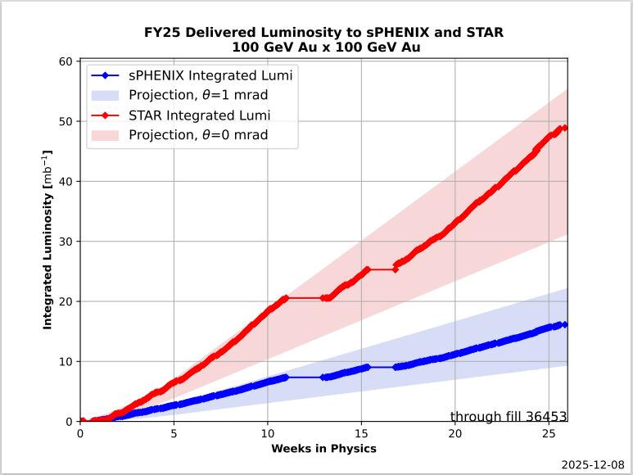
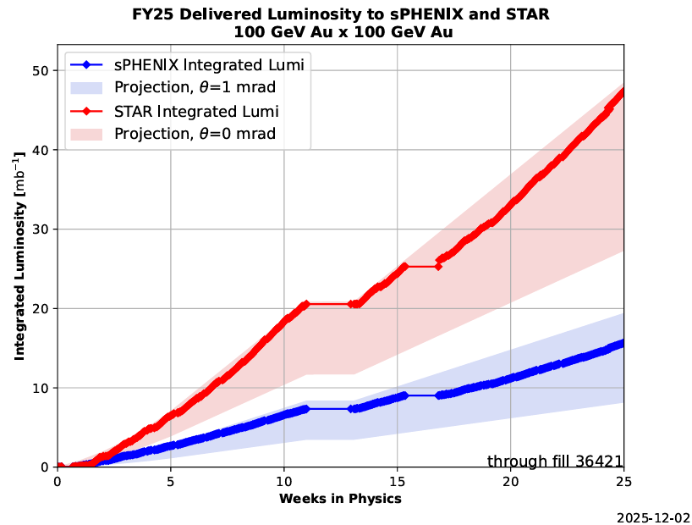
Reminder from Operations
MCR beam operations continue
  RHIC physics continues this week with polarized protons from LINAC
  NSRL shifts scheduled for users & MD, 2 shifts/6 days this week, 5 days next.
    Protons from Linac OPPIS
    Other ion beams from EBIS
  BLIP run cancelled for December.
    ORC in progress, but no planned beam in BLIP line.
  AGS tuning, pp setup, other studies to continue
  behind stores as time allows.
  MCR shift coverage 24/7
Data courtesy A. Nicola/C.S. Towle

Slide 25
Keytree notes
Remote keytree systems require a database lookup to validate and authorize distribution of keytokens. The Keytrak system’s database is available for lookup functionality, but can no longer be modified in any way to add or edit qualified personnel.
Personnel affected:
New employees, experimenters arriving after 12/1/2024 could not be enrolled in database
Existing employees & experimenters, not already enrolled, cannot be added or modified in database
Remote keytrees affected:
Iris scan @NSRL
BNLID scan @AGS South gate, North Conjunction Gate
Iris scan @RHIC STAR, sPHENIX, IP12, IP4
Keytrees NOT affected:
BNLID scan @Linac, Booster
BNLID scan @RHIC IP2
MCR keytrees

Slide 26
Keytree notes, continued
Mitigation:
Choose entrants that are currently enrolled to perform the work in the enclosure under Controlled Access (CA).
Obtain CA keys from MCR for remote gate watch
Arrange for local gate watch using other tokens for entrants.
Arrange for Restricted Access, and allow for delays incurred to sweep areas.
CAUTION
Follow procedures. Gate Watch staff will remain vigilant.
  No “piggy-backing” – one key/token per entrant.
  Access keys are not candy! Authenticated entrant retains possession.
Radiological Controls and the Access Controls System are not to be circumvented. This is (has been) enforced with disciplinary action (dismissal).

Slide 28
Notes:
Reliability comparisons to previous runs

Slide 29
Notes:
Reliability comparisons to previous runs

Slide 30
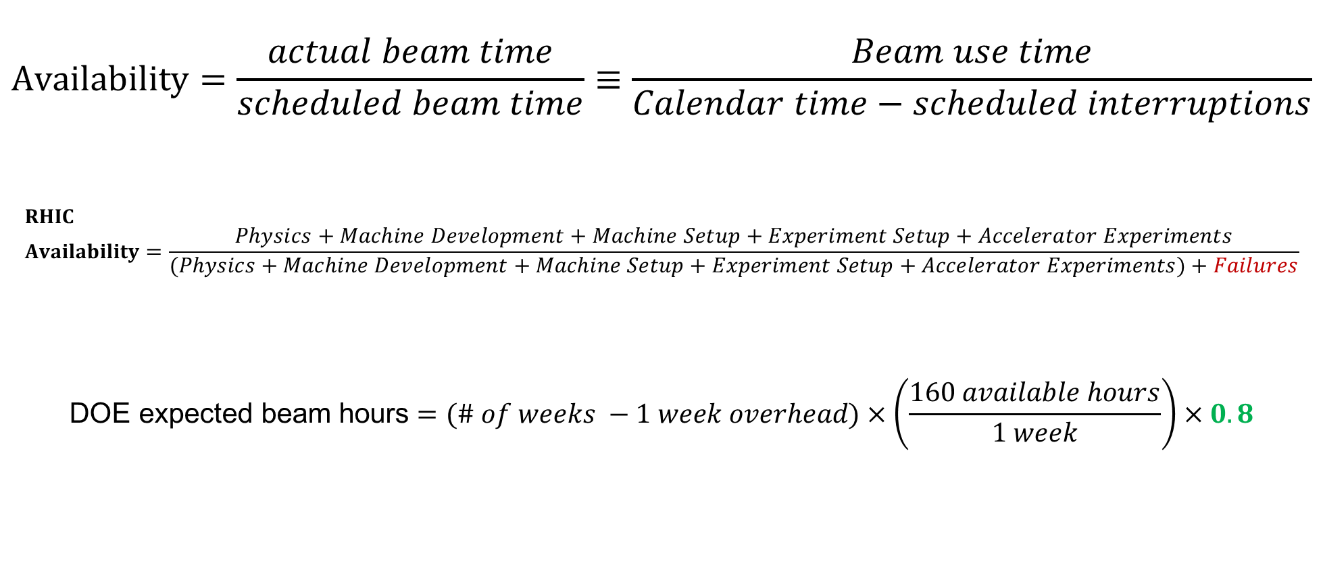
Availability, expected beam hours
$$Availability=\frac{actual beam time}{scheduled beam time}≡\frac{Beam use time}{Calendar time−scheduled interruptions}$$
$$RHIC \\ Availability=\frac{Physics+Machine Development+Machine Setup+Experiment Setup+Accelerator Experiments}{(Physics+Machine Development+Machine Setup+Experiment Setup+Accelerator Experiments)+Failures}$$
$$\text{DOE} \text{expected} \text{beam} \text{hours}=(\# of weeks −1 week overhead)×\left(\frac{160 available hours}{1 week}\right)×0.8$$
Notes:
Normally hidden. Explains how the 85% from DOE comes in to play, & general availability metrics

