Slide 1
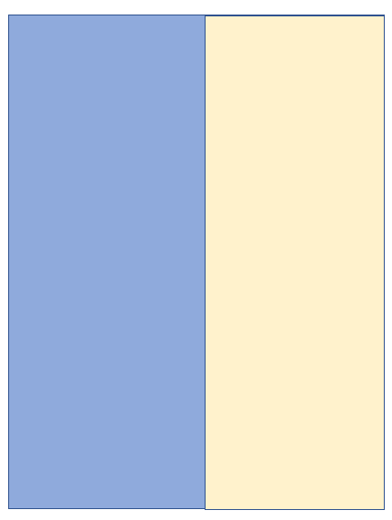
APEX Plan for Dec.17 , Wednesday
( 8:00am - 24:00 pm )
8am
Store
31 GeV
25-10
Benchmark IBS rates with coupling for flat beam
Yun, Brendan, Kevin, MCR
13pm
Store
18.2GeV
25-02:
CEC experiment
Vladimir, Yichao, CEC team, MCR
23pm
Back to Physics
24pm
Physics

Slide 2
Backup APEX Plan for Dec.17 , Wednesday
( 8:00am - 24:00 pm )
8am
31GeV
25-10
Benchmark IBS rates with coupling for flat beam
Yun, Brendan, Kevin, Travis, MCR
Store
18.2GeV
13pm
25-02:
CEC experiment
Vladimir, Yichao, CEC team, MCR
Store
100GeV
25-01:
Maximize beam-beam parameters with flat beam collision
Yun, Brendan, Kevin, Travis, MCR
23pm
Back to Physics
24pm
Physics

