Slide 1
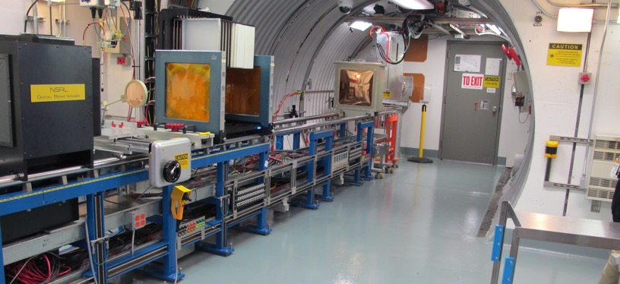
NSRL Time Meeting Report
16 December 2025
Michael Sivertz

Slide 2
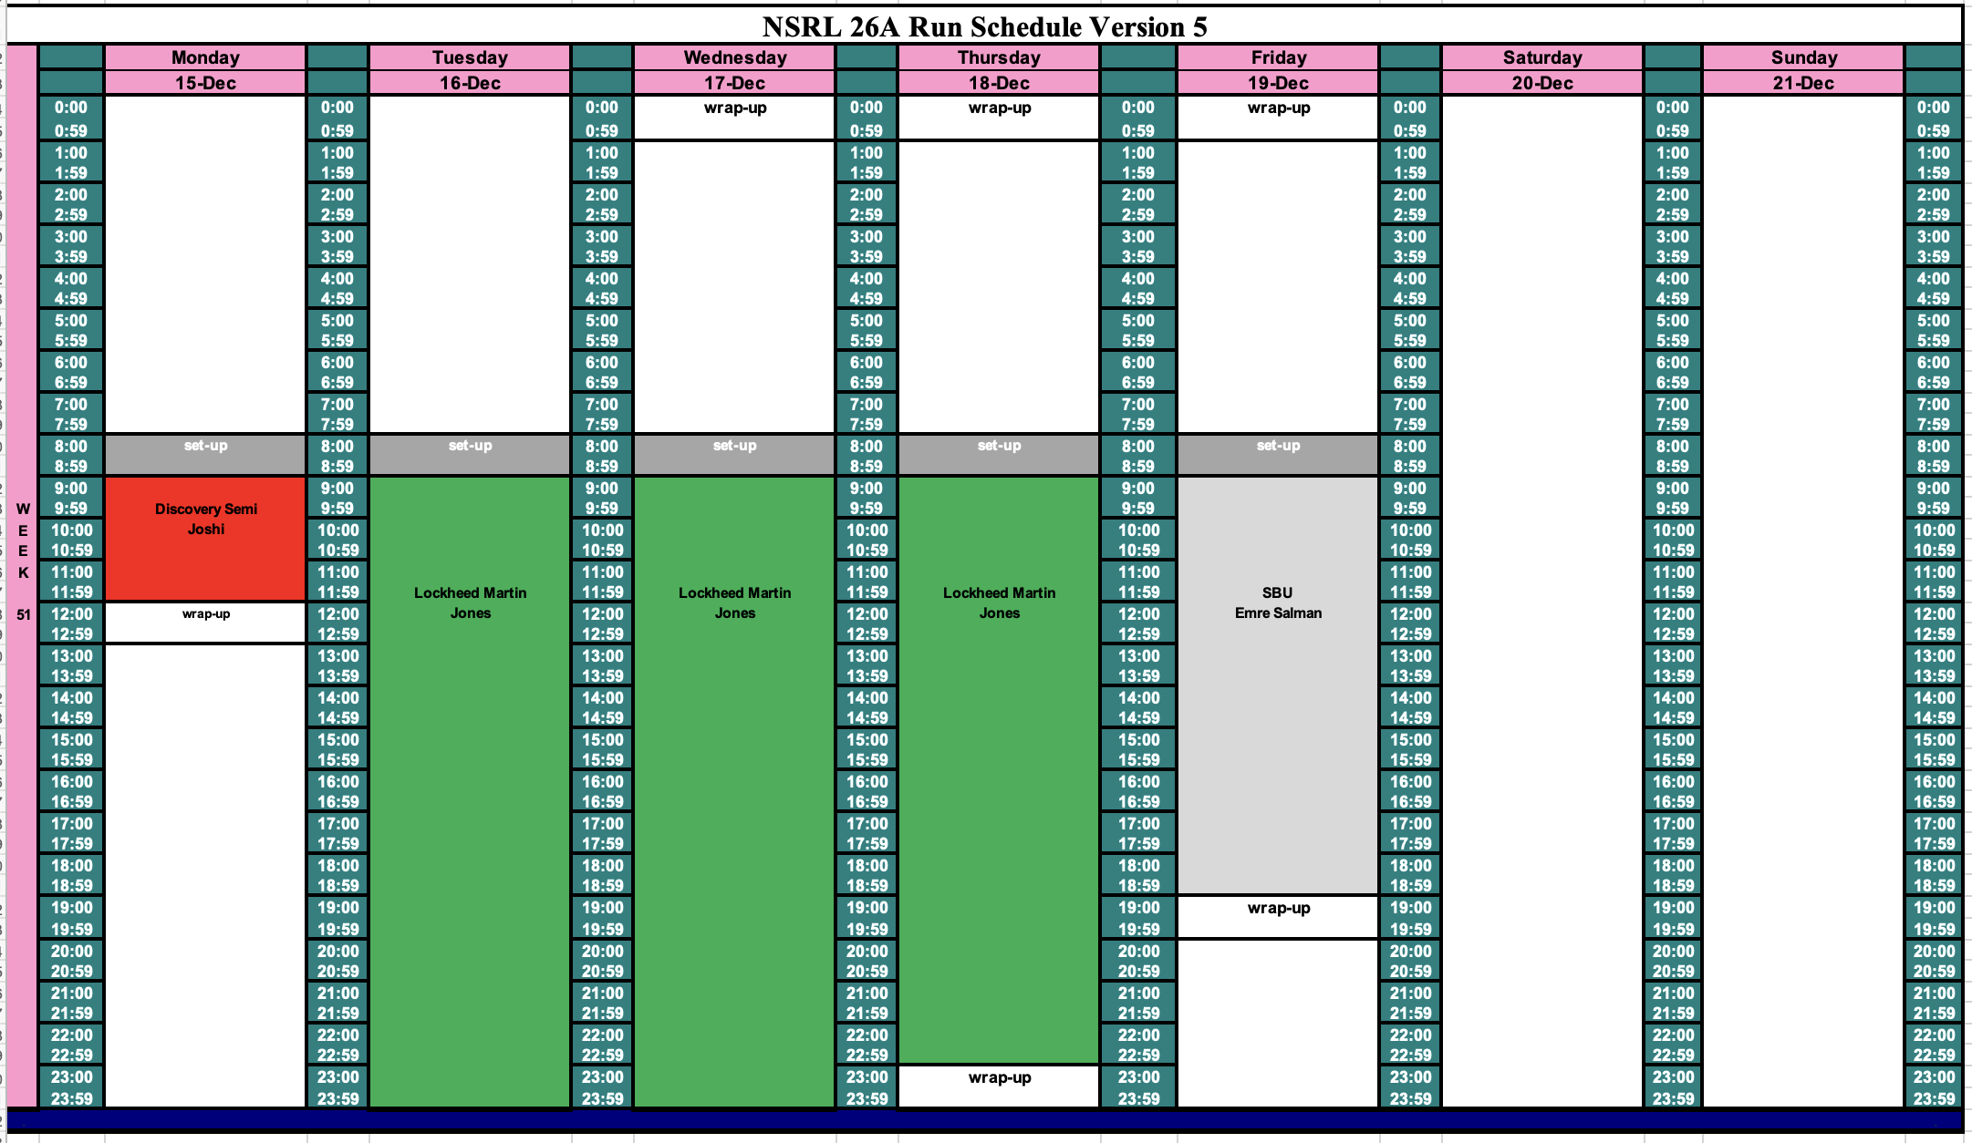
Schedule for this week

Slide 3
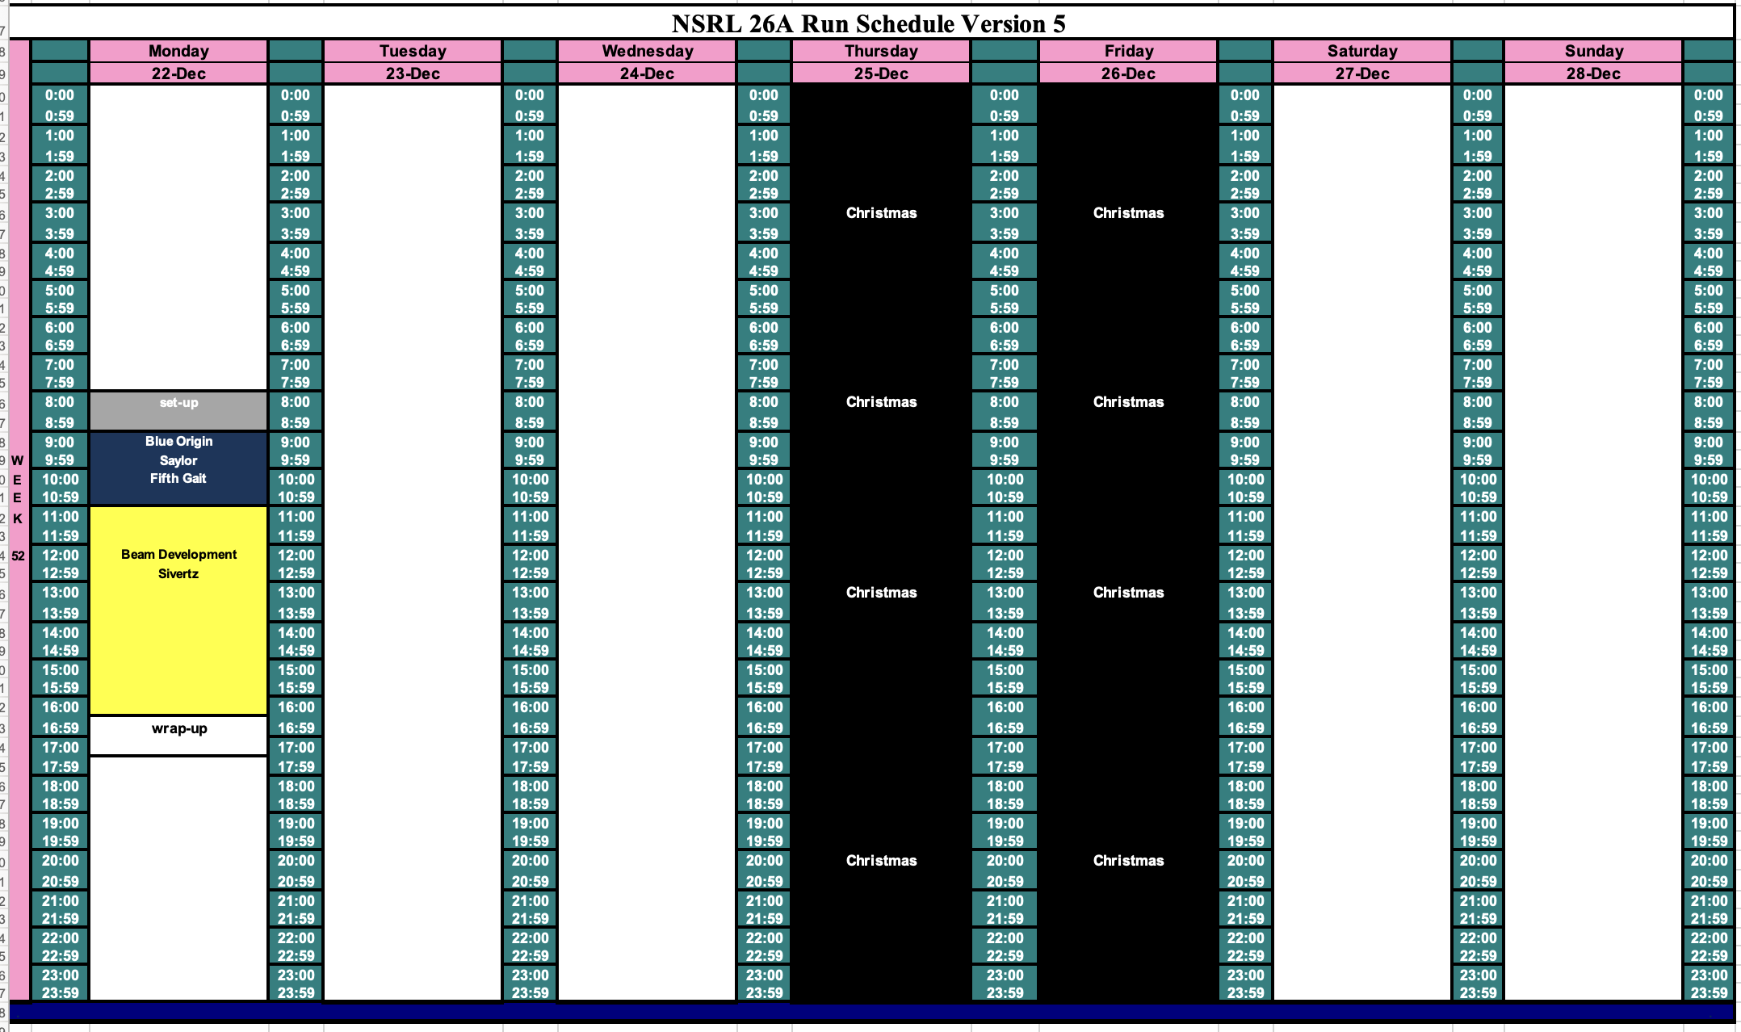
Schedule for next week

Slide 4
Future Schedule
Daily electronics testing: Smooth running from EBIS and LINAC
NSRL is running COMSEC material testing on 17 – 18 December.
Access to NSRL will be restricted.
The only work next week will be protons from LINAC on Monday, followed by some proton and deuteron beam development.

