Slide 1
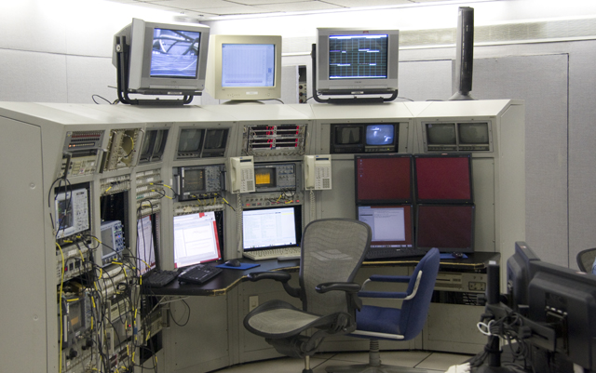
Time Meeting
Accelerator Operations Support

Slide 2

FINAL Scheduled Maintenance Dec 23…
Opportunistic maintenance in January
Compliance items to be scheduled at RHIC daily

Slide 3

Next Maintenance December Tuesday December 23rd
Planning and scheduling on Monday Dec 22nd 11:30 am here and streaming

Slide 4
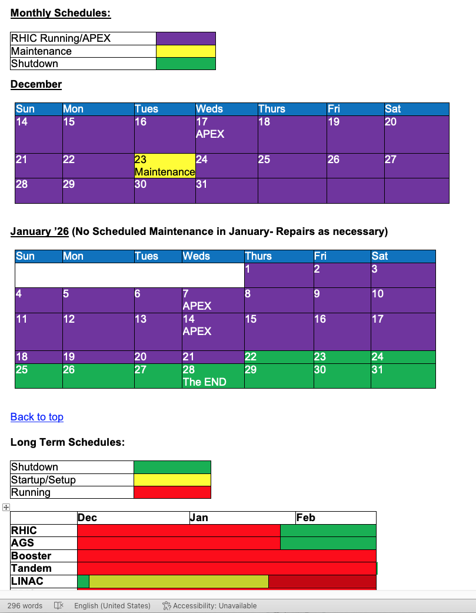
End game

