Slide 1
APEX Report
RHIC Time Meeting, Dec 16, 2025

Slide 2
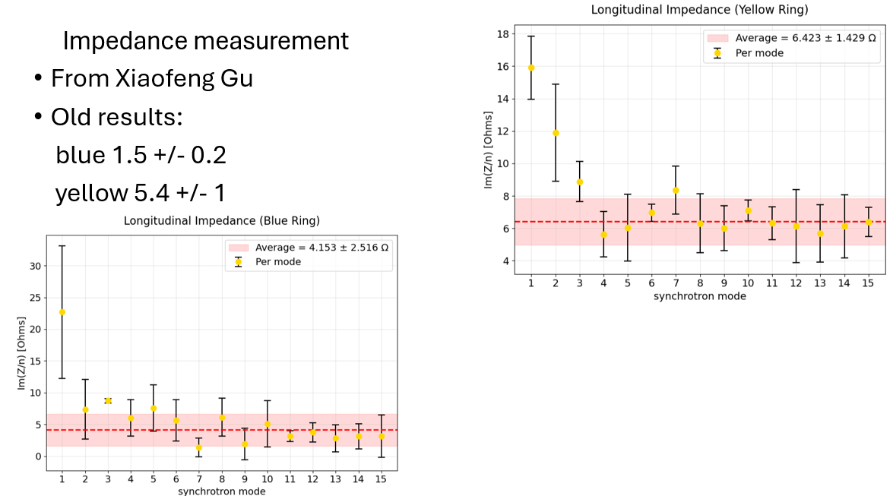
Impedance Measurement: @Mike B., Nov. 5 APEX

Slide 3
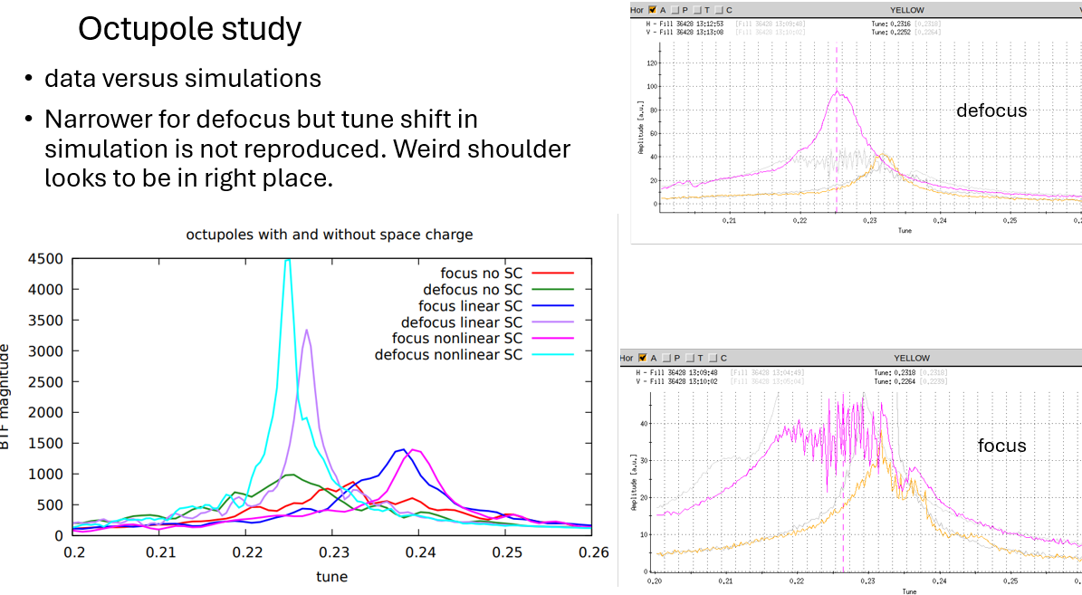
RHIC Octupole Limit @ Mike B. , Dec 3 APEX
Fuzzy BTF

Slide 4
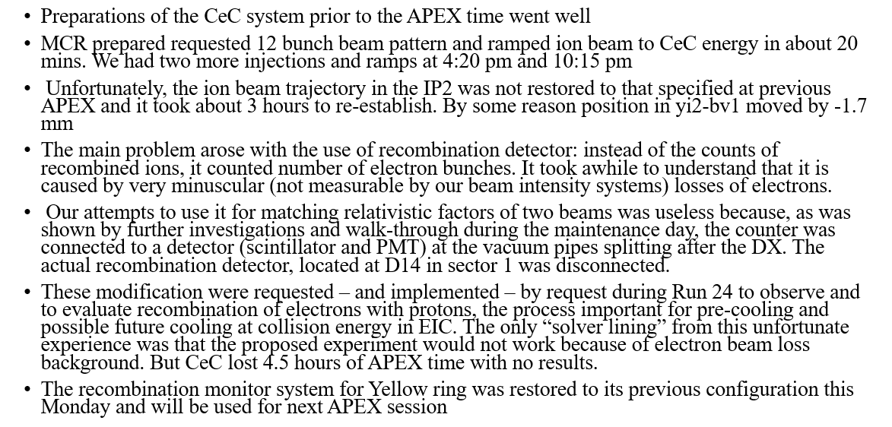
Coherent Electron Cooling Experiment @Vladimir , Dec. 3 APEX

Slide 5
