Slide 1
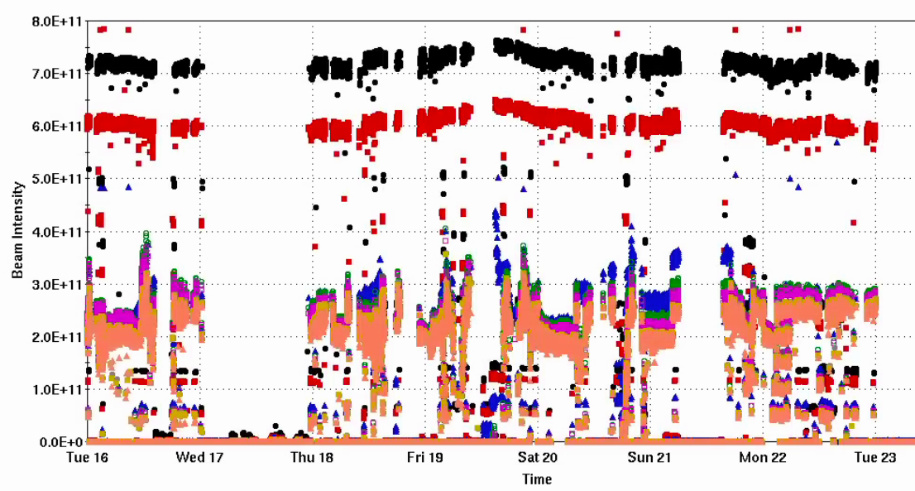
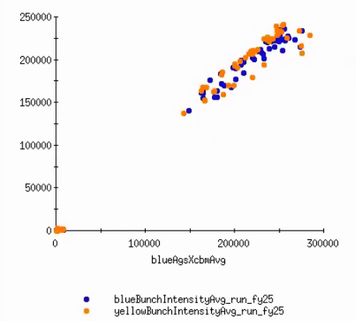
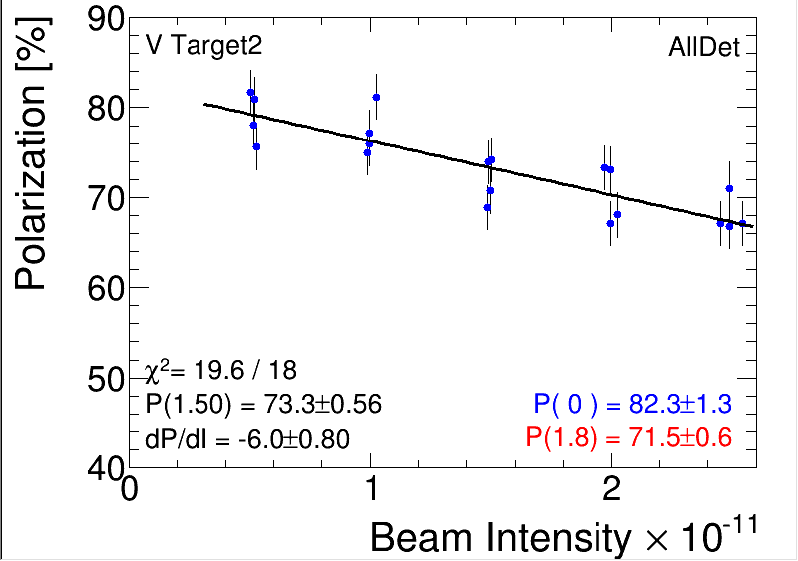
Injector Status: Time meeting 12/23/25
Injector Intensity (protons)
Booster input intensity routinely up to 7x10¹¹
AGS extraction intensity ~ 2.5x10¹¹
Incremental fill-by-fill increases
Increasing longitudinal emittance to avoid fast RHIC injection instability
Pol vs intensity slope nearing previous optimum
Intensity
Pol vs intensity
RHC Injected intensity
Flattens near
2.5x10¹¹
AGS extracted intensity

Slide 2
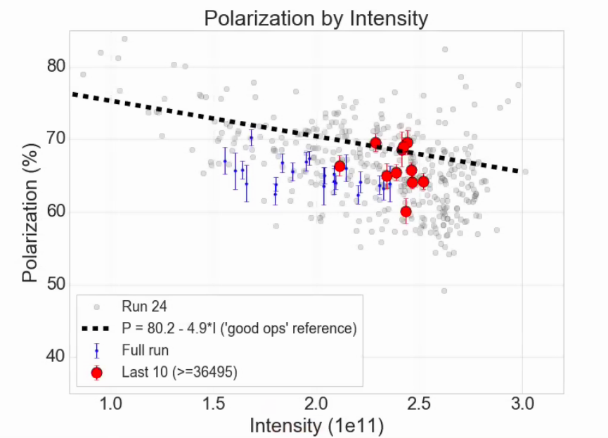
Polarization by fill: comparison to Run 24

Slide 3
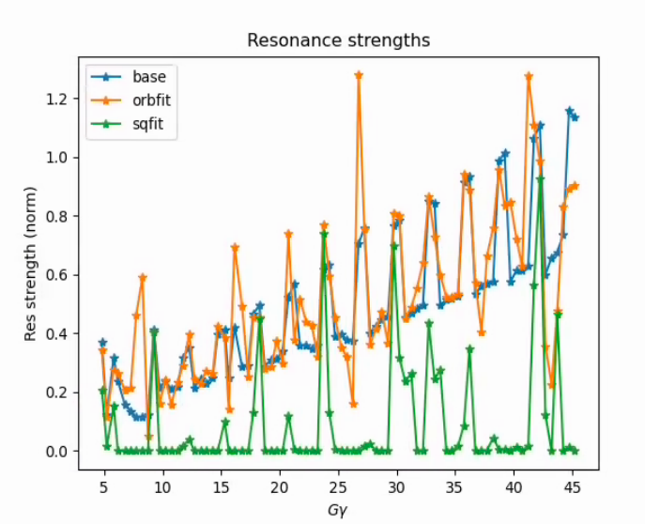
Horizontal resonance correction tests with Bmad
(All in Bmad)
Moving from SPRINT based correction to more sophisticated Bmad model
Including orbit effects is important
Noon-zero closed orbit effects significantly complicates correction.

Slide 4
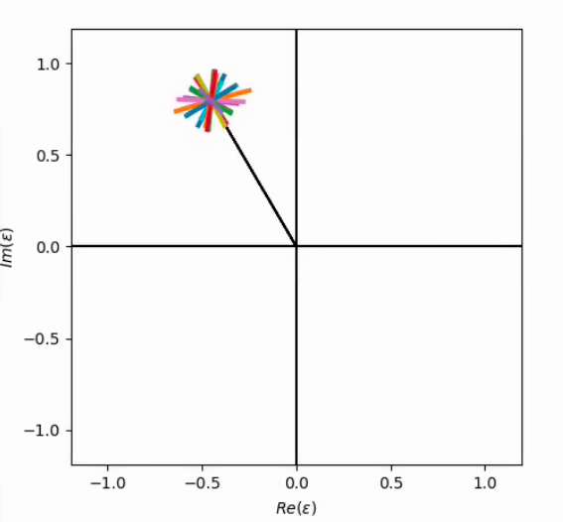
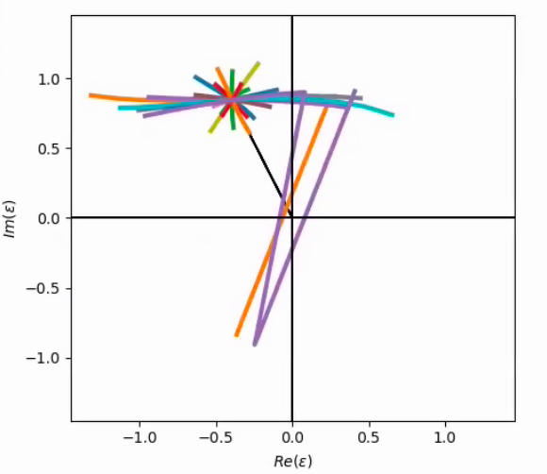
Resonance portraits with orbit feed-down
Resonance is a complex number (black line), each skew quad represents a tunable complex resonance component (colored lines)
With orbit effects: response to skew quads nonlinear, highly variable from magnet to magnet
Ideal orbit
Fit to measured orbit
Goal for now is to avoid or account for orbit driven effects to improve correction

Slide 5

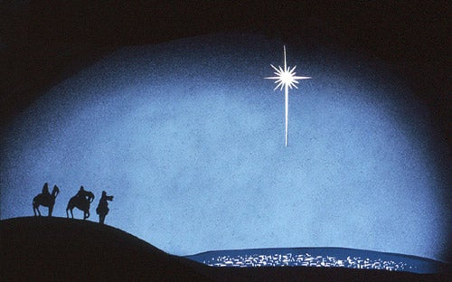
Resonance portraits with orbit feed-down
Resonance is a complex number (black line), each skew quad represents a tunable complex resonance component (colored lines)
With orbit effects: response to skew quads nonlinear, highly variable from magnet to magnet
Ideal orbit
Fit to measured orbit
Goal : More Little Star of Bethlehem ← Less Little Start of Alderaan

