Slide 1
sPHENIX Status
Kin Yip
sPHENIX Director of Operations
Time Meeting
Dec. 23, 2025

Slide 2
sPHENIX Status
sPHENIX has started to take physics (p+p) data since Dec. 15.
We have finished all trigger development and “frozen” the operation configurations for the holiday.
100% streaming physics data-taking for Heavy-Flavor physics is a world-first for spin polarized collider experiment.
We lost communication with the TPC Central Membrane (CM) in the morning of Dec. 19, when most other detectors had issues (presumably due to radiation from the beams). It required an access to fix.
Probably PLC communication error caused ~all racks to be shut off at 11:17 am (Monday). It was recovered in ~an hour or so after an access.

Slide 3
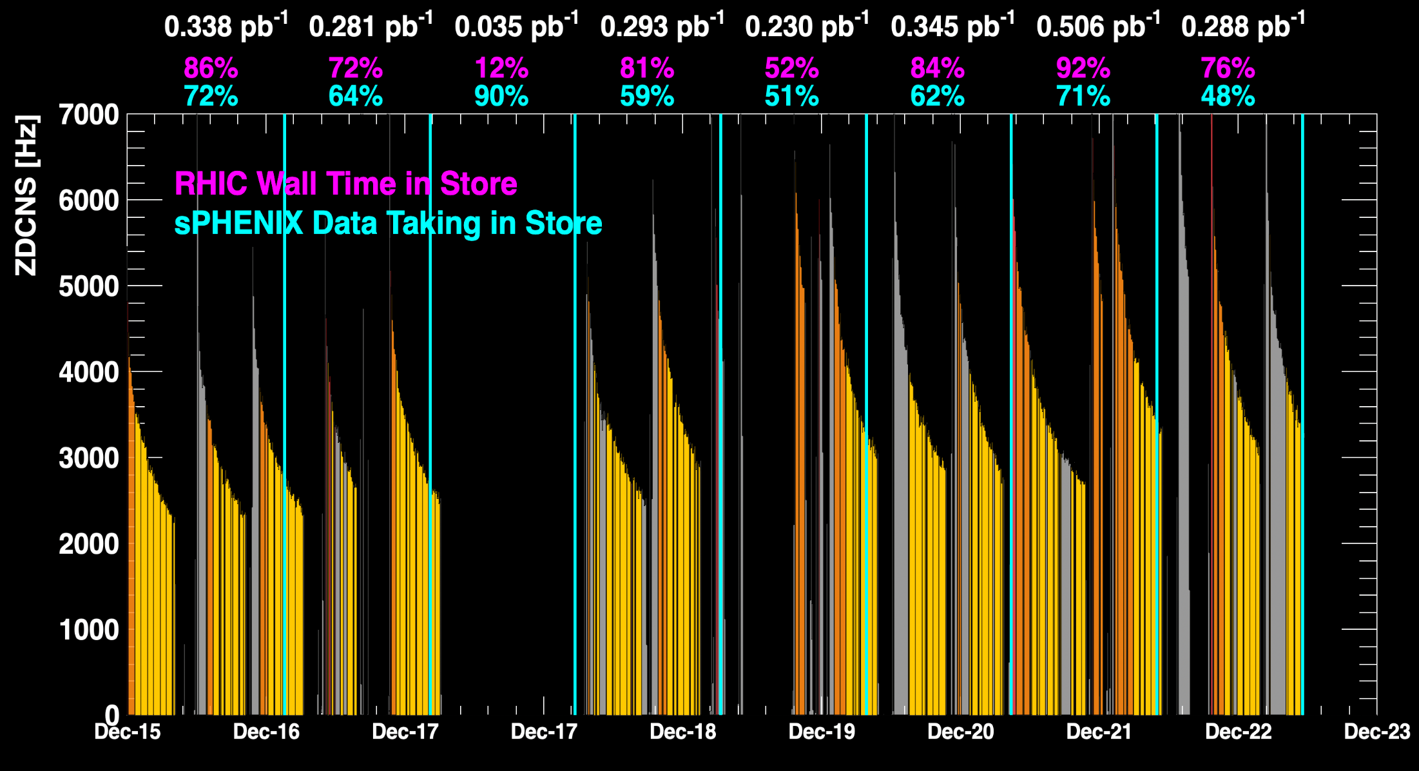
sPHENIX Status (cont.)
1008C pump trips
CDU issue
1008C pump trips
CDU issue
6x6
APEX
TPC Streaming Mode
TPC Triggered mode

Slide 4
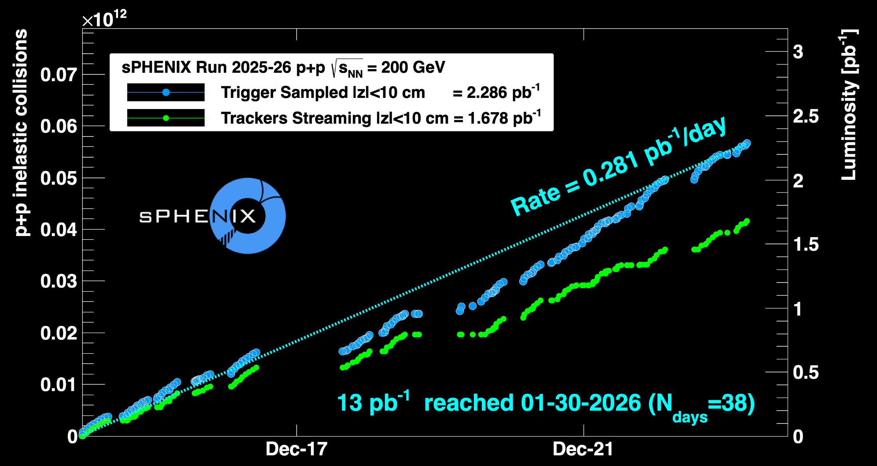
sPHENIX Status (cont.)
Using Run24 vernier scan results for cross-sections
1008C pump trips
CDU issue
1008C pump trips
CDU issue
6x6
APEX

