Slide 1
Data courtesy C. Naylor

Slide 2
Data courtesy C. Naylor

Slide 3
Data courtesy C. Naylor

Slide 4
Data courtesy C. Naylor

Slide 5
Data courtesy C. Naylor

Slide 6
Data courtesy C. Naylor

Slide 7
Data courtesy C. Naylor

Slide 8
Data courtesy C. Naylor

Slide 9
Data courtesy C. Naylor

Slide 11
Data courtesy C. Naylor

Slide 12
Data courtesy C. Naylor

Slide 13
Data courtesy C. Naylor

Slide 14
Data courtesy C. Naylor

Slide 15
Data courtesy C. Naylor

Slide 16
Data courtesy C. Naylor

Slide 17
Data courtesy C. Naylor

Slide 18
Data courtesy C. Naylor

Slide 19
Data courtesy C. Naylor

Slide 20
Data courtesy C. Naylor

Slide 21
Operations for BLIP
No BLIP
this past week
BLIP remains in shutdown.
Notes:
BLIP plot from LogView /MCR/PerformanceStats/timeMeetingBLIP.lvdisp
Avail calc on nsrl time Excel sheet

Slide 22
NSRL activity past weeks: 12/16-23/2025 (as of 0800)
NSRL running continues. Various setup and user beam time through the week.
10 EBIS species, Linac protons logged to NSRL
Including H₂, d, d₂
Run 26-A continues, schedule posted with users up to 30 January.
Availability: 95.3%
Notes:
Graph and avail calc from nsrl time.xlsx

Slide 23
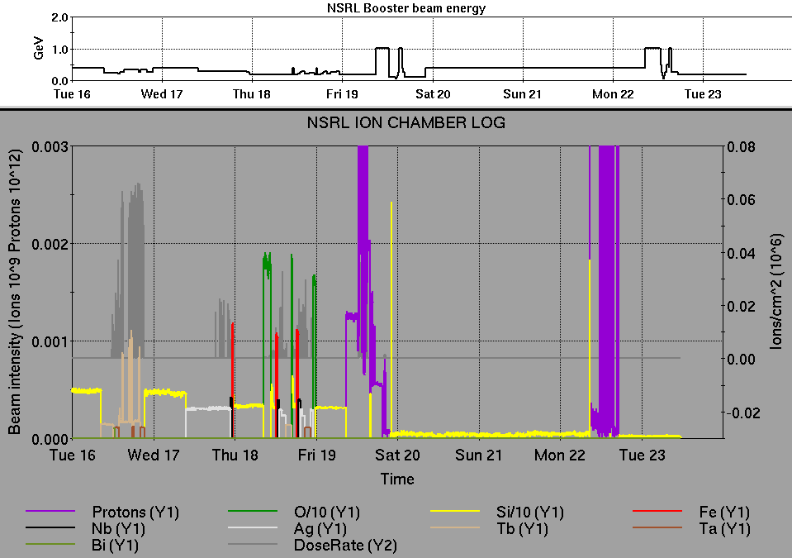
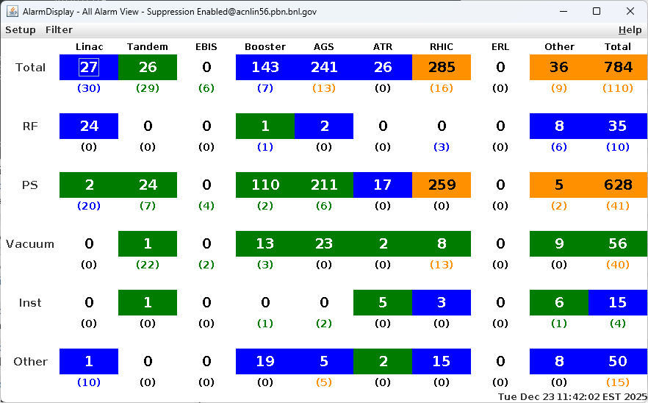
Notes from Operations
Notable failures (>1 hr)
AGS MMPS cycloconverter fault, reset
RHIC ACS failure (3x), access for PLC I/O module replacement
Multiple AtR cooling faults, work on flow switches and filter bags
Blue injection kicker PS control hardware failure, 16-bit data converter replaced
Blue abort kicker misfire at injection, undiagnosed
Multiple power dips with weather stand-down and recovery of numerous systems complex-wide
AGS vertical tune quad PS failure; one unpolarized fill during repair
BtA quad PS qf10, qd11 multiple issues requiring retuning beam during repair
Delayed dump for Linac Mod 1 repair, 8618 tube replaced
sPHENIX equipment failure, pump room trip affecting racks in IR
Other notes
Work on AGS RF stations B, KL
Human error, RHIC MMPS current limit key configuration
Linac air compressor and nitrogen supply failure
Access for sPHENIX TPC issues
Other various trips, resets, tuning (12 resets logged, in addition to short failures)
Polarized beam development and other setup behind stores this week
Notes:
NSRL plot from LogView /MCR/PerformanceStats/timeMeetingNSRL.lvdisp, select Dose Rate and ion species in use
Screenshot of AlarmSummary

Slide 24
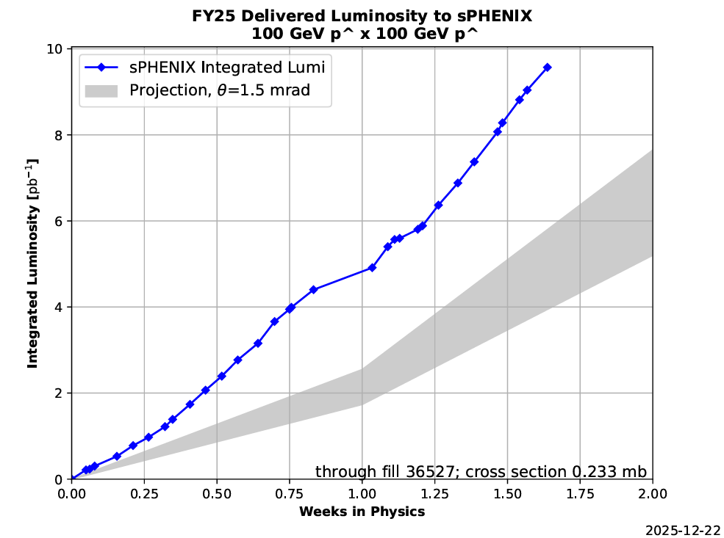

Reminder from Operations
MCR beam operations continue
RHIC physics continues this week with polarized protons from LINAC
NSRL users concluded until early January.
Protons from Linac OPPIS
Other ion beams from EBIS including H₂, d, d₂
BLIP target production not scheduled until March.
Beam in BLIP line ORC cancelled, due to pending restart authorization.
AGS tuning, pp setup, other studies to continue behind stores as time allows.
MCR shift coverage 24/7
Please update calling lists for available staff!!
Data courtesy A. Nicola/C.S. Towle

Slide 25
Keytree notes
Remote keytree systems require a database lookup to validate and authorize distribution of keytokens. The Keytrak system’s database is available for lookup functionality, but can no longer be modified in any way to add or edit qualified personnel.
Personnel affected:
New employees, experimenters arriving after 12/1/2024 could not be enrolled in database
Existing employees & experimenters, not already enrolled, cannot be added or modified in database
Remote keytrees affected:
Iris scan @NSRL
BNLID scan @AGS South gate, North Conjunction Gate
Iris scan @RHIC STAR, sPHENIX, IP12, IP4
Keytrees NOT affected:
BNLID scan @Linac, Booster
BNLID scan @RHIC IP2
MCR keytrees

Slide 26
Keytree notes, continued
Mitigation:
Choose entrants that are currently enrolled to perform the work in the enclosure under Controlled Access (CA).
Obtain CA keys from MCR for remote gate watch
Arrange for local gate watch using other tokens for entrants.
Arrange for Restricted Access, and allow for delays incurred to sweep areas.
CAUTION
Follow procedures. Gate Watch staff will remain vigilant.
No “piggy-backing” – one key/token per entrant.
Access keys are not candy! Authenticated entrant retains possession.
Radiological Controls and the Access Controls System are not to be circumvented. This is (has been) enforced with disciplinary action (dismissal).

Slide 28
Notes:
Reliability comparisons to previous runs

Slide 29
Notes:
Reliability comparisons to previous runs

Slide 30
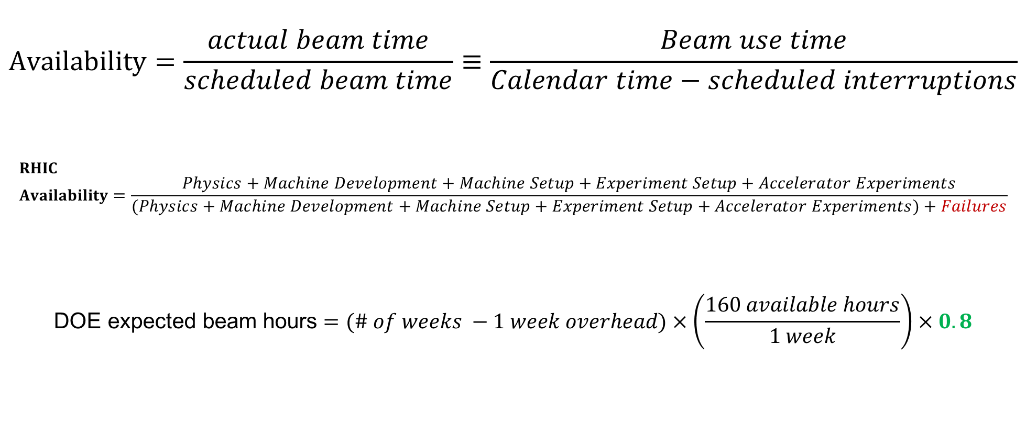
Availability, expected beam hours
$$Availability=\frac{actual beam time}{scheduled beam time}≡\frac{Beam use time}{Calendar time−scheduled interruptions}$$
$$RHIC \\ Availability=\frac{Physics+Machine Development+Machine Setup+Experiment Setup+Accelerator Experiments}{(Physics+Machine Development+Machine Setup+Experiment Setup+Accelerator Experiments)+Failures}$$
$$\text{DOE} \text{expected} \text{beam} \text{hours}=(\# of weeks −1 week overhead)×\left(\frac{160 available hours}{1 week}\right)×0.8$$
Notes:
Normally hidden. Explains how the 85% from DOE comes in to play, & general availability metrics

