Slide 1

Time Meeting
Accelerator Operations Support

Slide 2

FINAL Scheduled RHIC Maintenance Under way!
Many thanks to all for 26 years of support!
Opportunistic maintenance in January
Compliance items to be scheduled at RHIC daily

Slide 3
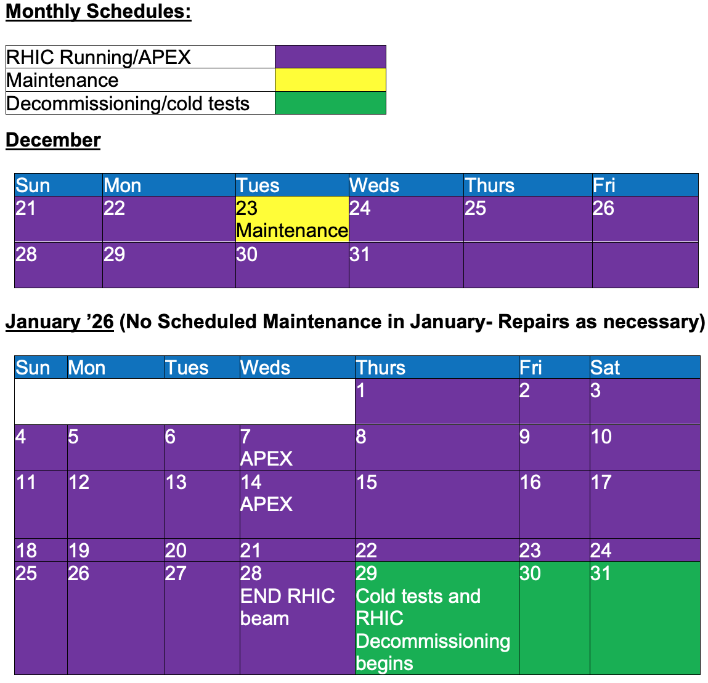
End game

