Slide 1
TAKE FIVE for Safety- Office Ergonomics
Frank Craner
December 30, 2025

Slide 2
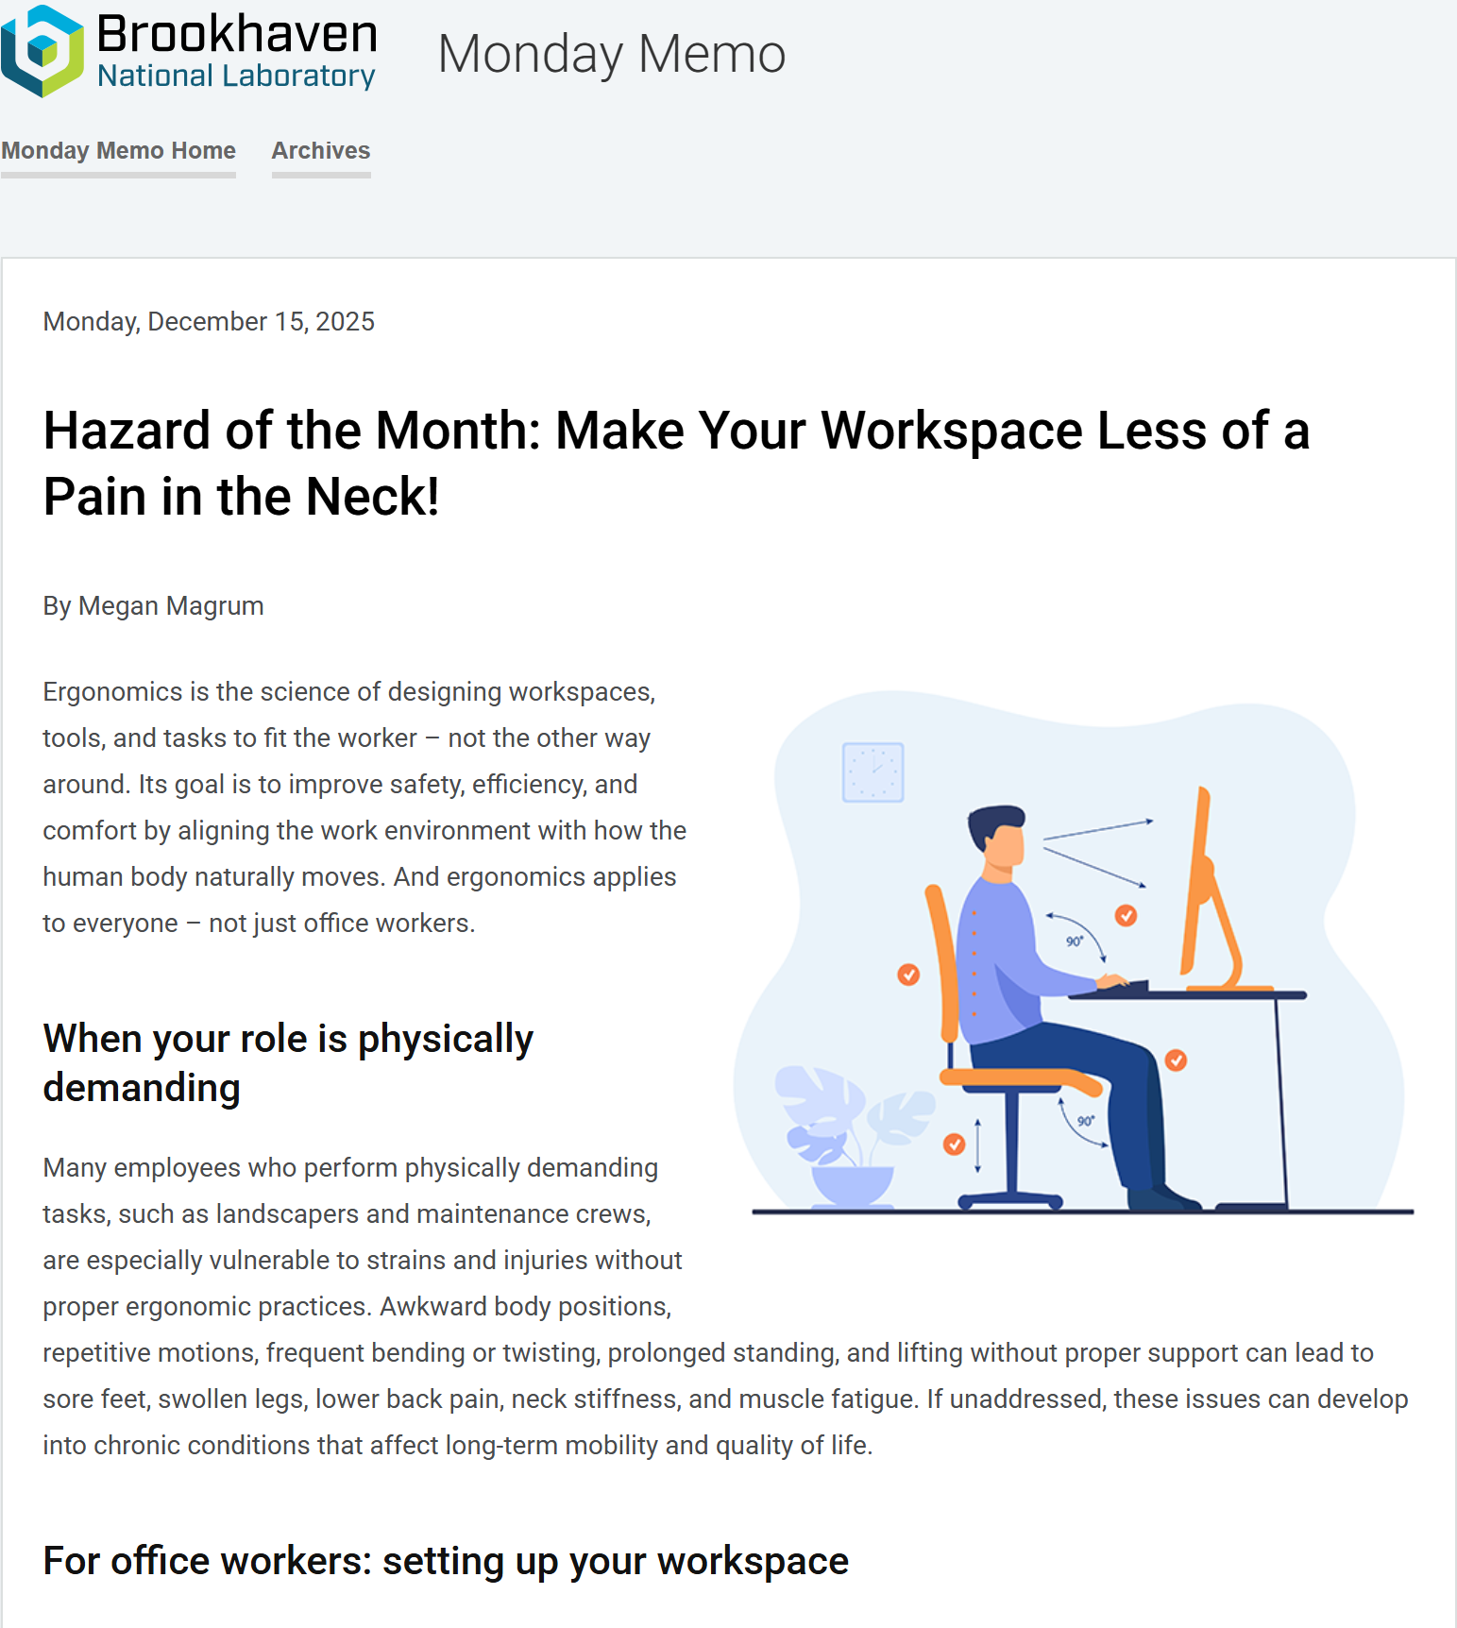

Slide 3
Set Up and Use of Your Office Workspace
Ensure that your setup supports good posture and comfort.
Use adjustable equipment such as chairs, keyboards, monitor stands, and desk height and other ergonomic tools (wrist/arm pads, back support) to increase comfort.
Stand and stretch at regular intervals.
Do not ignore symptoms of repetitive stress, such as muscle soreness and strain in the neck, shoulders, wrists, and lower back.
Take breaks and adjust workstation if needed.

Slide 4
OSHA Recommendations
Workers should be encouraged to do the following when using computers:
• Where possible, position computer workstations in corners or other areas away from doors, entrances and passageways.
• Place monitor so their viewing distance is between 18 and 30 inches.
• Place monitor so the top of the screen is approximately at eye level. This allows the eyes to gravitate naturally toward the center of the screen.
• Use a document holder placed adjacent to and in the same plane as the computer screen.
• Use footrests, where possible, in order to allow them to change leg positions throughout the day.
• Use an appropriate keyboard, mouse or other input devices if they have existing musculoskeletal problems.
• Take mini-breaks of 3 to 5 minutes for every 20- 30 minutes of keyboarding or mouse work.

Slide 5
BNL Resources
The Ergonomic Computer Workstation Assessment Tool can help you determine whether your station is properly arranged.
SHSD designed the new Ergonomic Showroom in Bldg. 30 to teach staff about proper ergonomic workstation setup. It also lets staff try the latest adjustable workstation setups, chairs, and accessories that support a safe and comfortable working environment.
To schedule a hands-on experience in the Ergonomic Showroom or a workstation assessment,
Contact the Lab's Ergonomics subject matter expert, Fred Horn (horn@bnl.gov or Ext. 3451) or Chris Goehle (cgoehle@bnl.gov or Ext. 2568). Or
Stop by the showroom during open office hours on Tuesdays, 10 a.m.-noon, or Thursdays 1:30-3:30 p.m.

Slide 6
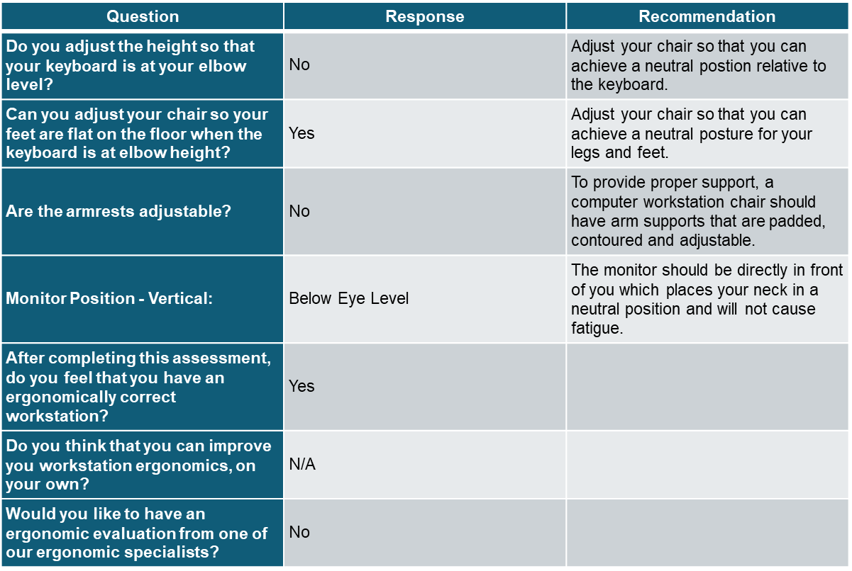
Sample Results of Assessment Tool

