Slide 1
Preinjector Status
D. Raparia
Time Meeting
December 30, 2025

Slide 2
Tandem
MP7
Still sparking will open next week
MP6
Beam has been verified in TTB line
Foil conditioning today
Will be ready for next week APEX

Slide 3
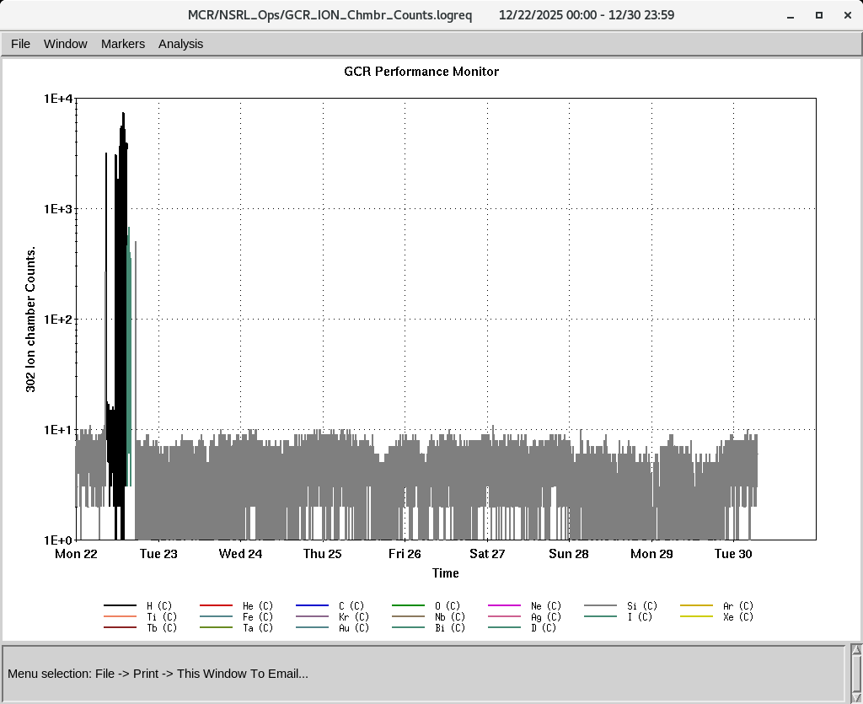
EBIS
Smooth operation for NSRL
Last week successfully Molecular D delivered to NSRL
NSRL is off this week
IONS to NSRL
Molecular H₂⁺¹ , D₂⁺¹

Slide 4
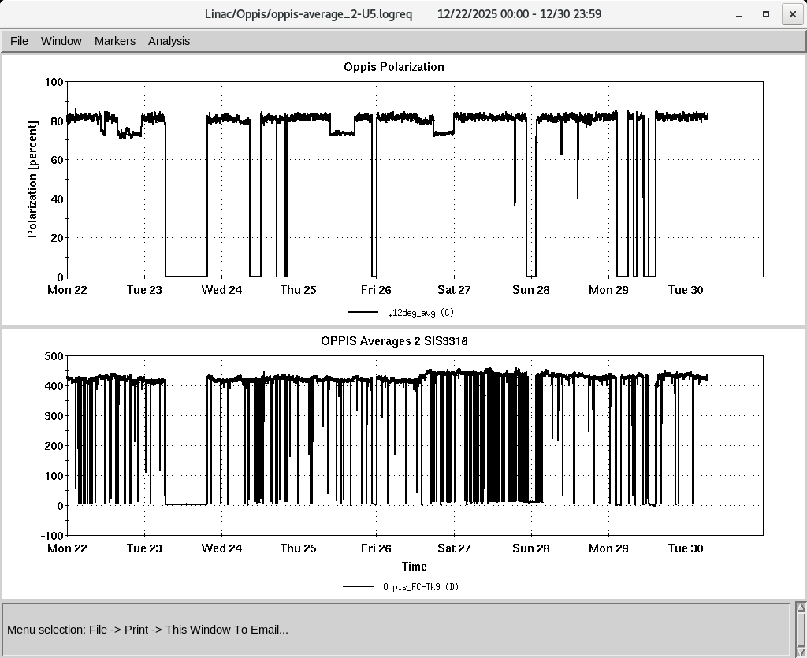
LINAC
PP beam for RHIC
OPPIS operating with normal beam intensity with pol ~ 80%
High intensity H- source under maintenance
Replace 5V PS for Tank 1 –Q45
Mod 5 , 7835 filament current was increase to stop oscillation in the loop efforts
H-Jet , maintenance, started yesterday 7 PM , accesses today , and tomorrow

