Slide 1
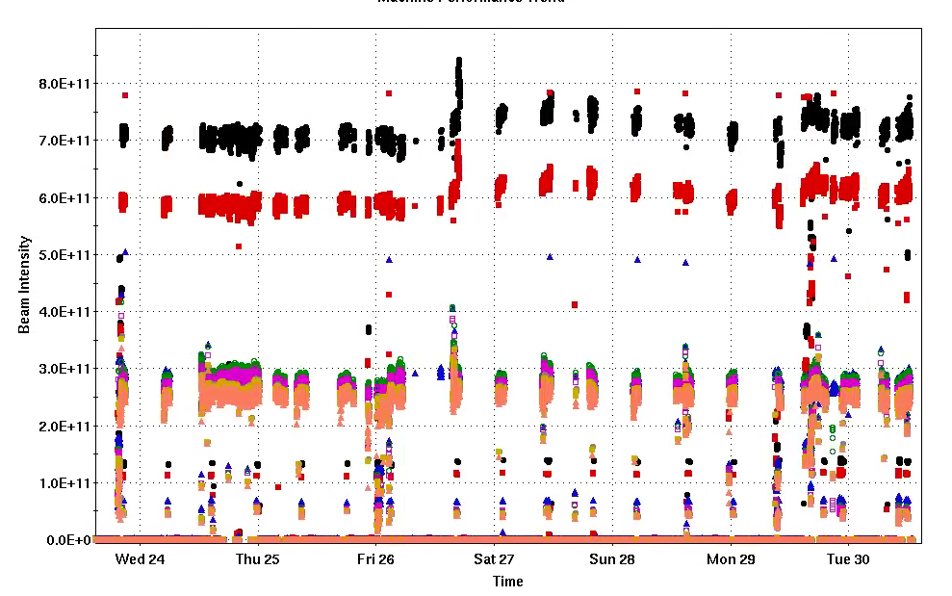
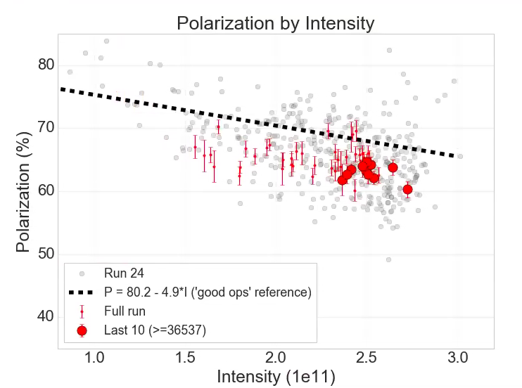
Injector Status: Time meeting 12/30/25
Injector Intensity (protons)
Booster input intensity routinely up to 7x10¹¹
AGS extraction intensity ~ 2.5x10¹¹
Polarizaton a few points under the best operating line: resonance corrections need checking/updating
Intensity

