Slide 1
sPHENIX Status
Kin Yip
sPHENIX Director of Operations
Time Meeting
Dec. 30, 2025

Slide 2
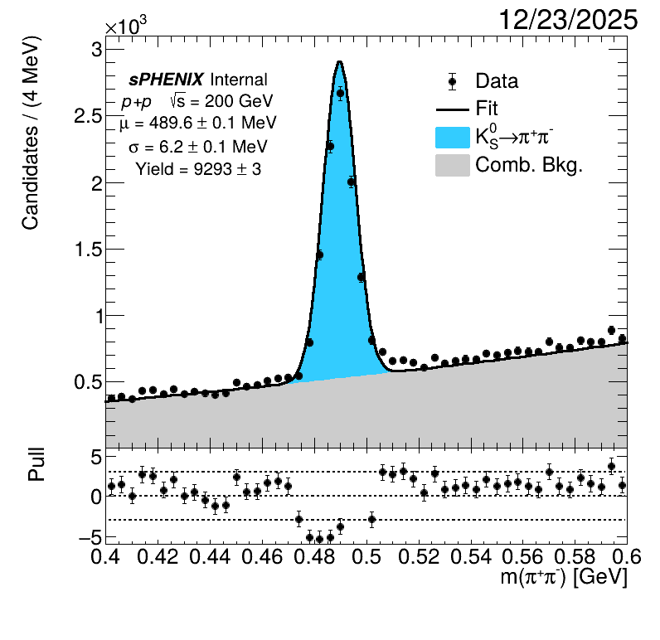
sPHENIX Status
  sPHENIX continues to take physics (p+p) data towards the goal of 13/pb (p+p).
  Quick analyses allow us to see K_{S}, Λ⁰, etc.
  in streaming data and give us some
  confidence in the quality of the data taken.
  For each RHIC store, we’ve optimized initialization steps to ensure the best TPC FEE (Front-End Electronics) availability.
  The DAQ experts have also been optimizing the bufferbox load distribution and data transferring to SDCC.

Slide 3
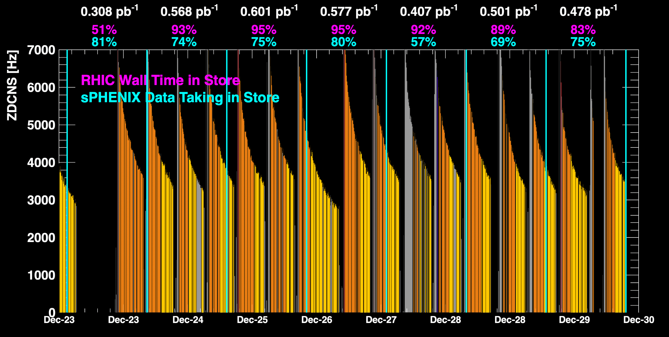
sPHENIX Status (cont.)
1008C pump trips
CDU issue
1008C pump trips
CDU issue
6x6
APEX
TPC Streaming Mode Smooth running in the holiday 😊
TPC Triggered mode

Slide 4
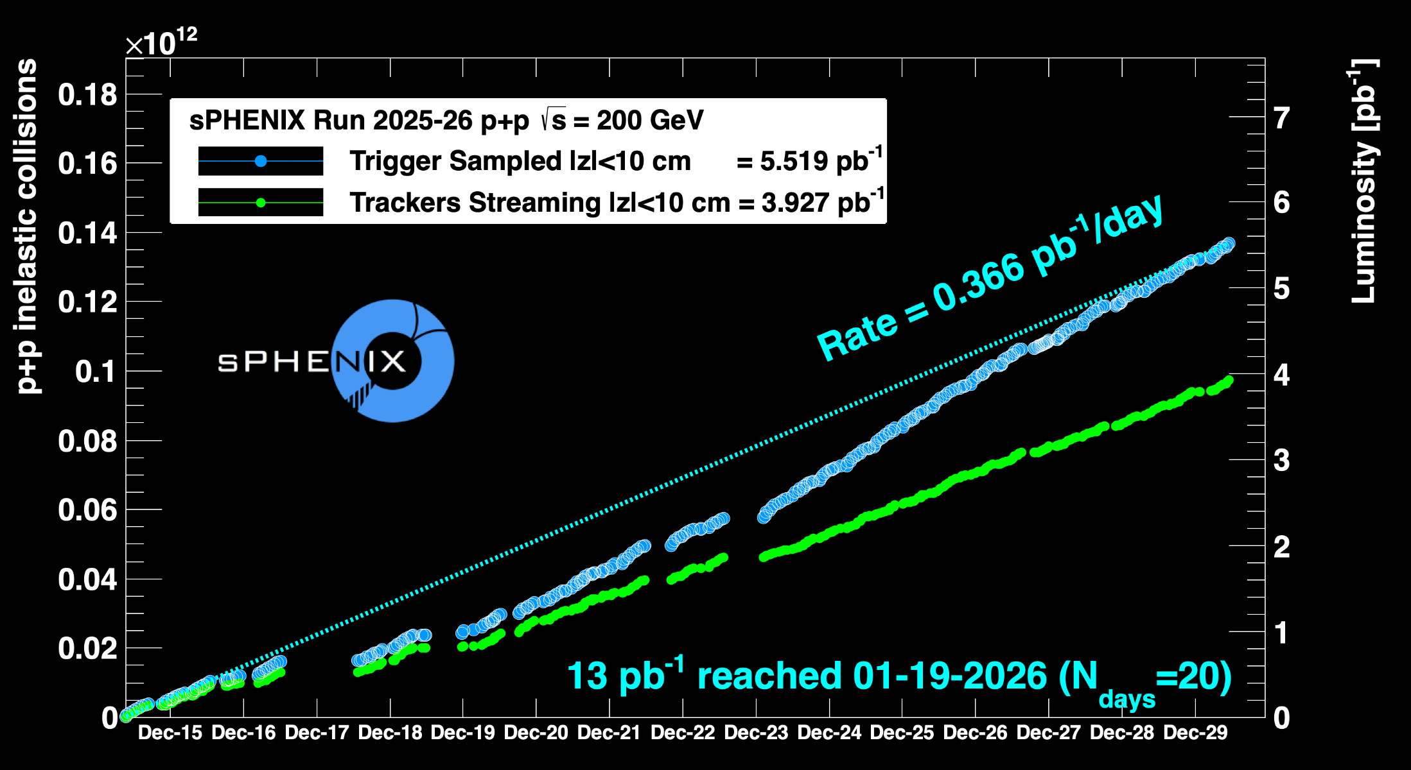
sPHENIX Status (cont.)
Using Run24 vernier scan results for cross-sections
1008C pump trips
CDU issue
1008C pump trips
CDU issue
6x6
APEX

