Slide 1

Time Meeting
Accelerator Operations Support

Slide 2
Access and Maintenance
Opportunistic from here on in.
Short access today (complete) and tomorrow
Emergency Generator tests will be done Jan 28-30th

Slide 3
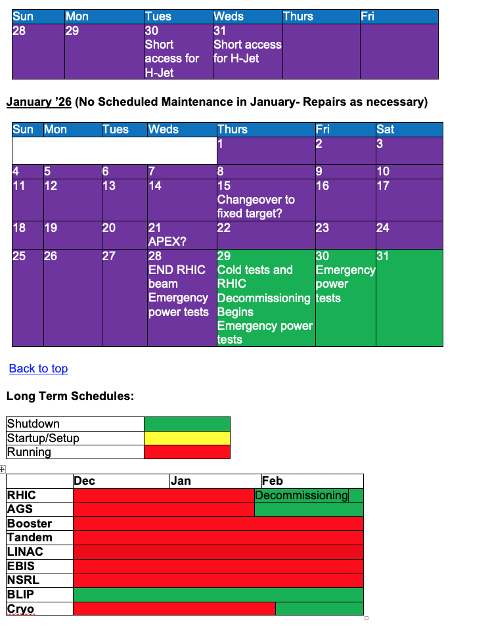
End game

