Slide 1
TAKE FIVE for Safety- Liquid Effluents; ASE Violation
Frank Craner
January 6, 2026

Slide 2
Liquid Effluent Primer
A Liquid Effluent is…“Any treated or untreated aqueous waste that is discharged to the environment (e.g., process wastewater, cooling tower blowdown, parts/equipment cleaning wastewater, air compressor condensate).”
BNL (and Nassau/Suffolk Counties) obtain drinking water from groundwater sources (Sole Source Aquifer)
BNL discharges wastewaters to recharge basins onsite.
Effluents are subject to regulatory limits that protect water from contaminants.
Uncontrolled effluents have the potential to contaminate groundwater.

Slide 3
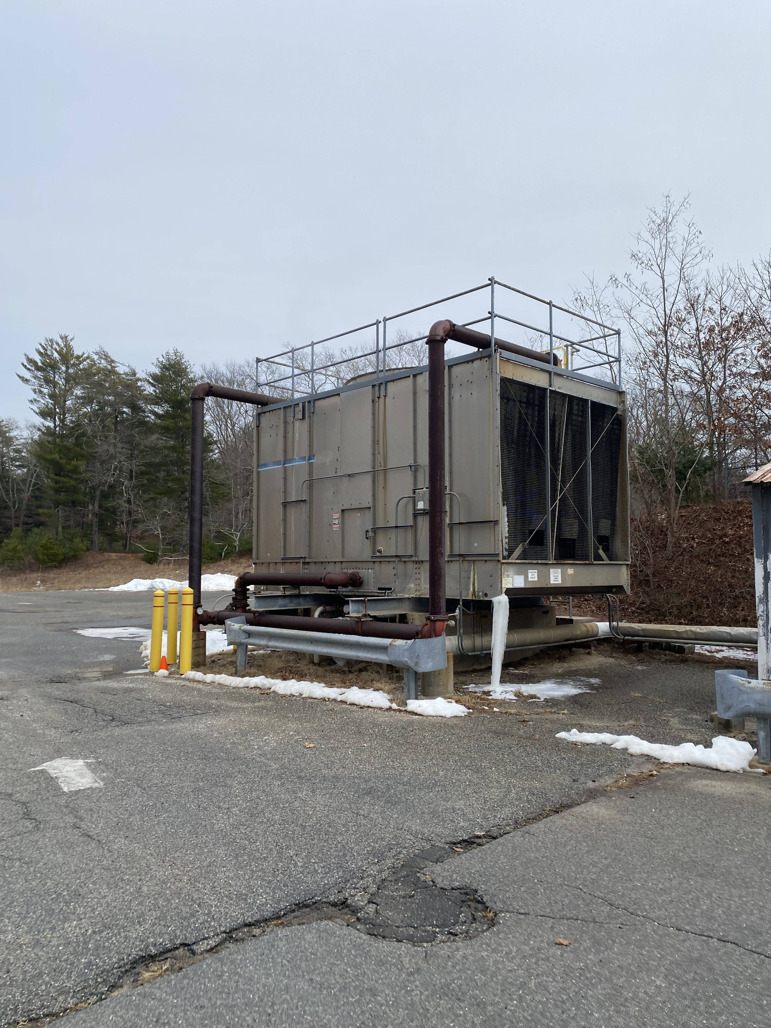
C-AD Wastewater Sources/Contaminants of Concern
Sources:
Cooling Towers
Cleaning Systems (912, 905 (future))
Miscellaneous (i.e., use of sinks, leaked or spilled materials, etc.)
Stormwater
Contaminants of highest risk:
Metals,
Oil and Grease,
Radionuclides,
Water Treatment Chemicals.

Slide 4
Key SBMS Subject Areas
Subject Area | Synopsis
Liquid Effluents | Requires characterization and approval of discharges
Storage and Transfer of Hazardous and Non-Hazardous Materials | Requires control of storage facilities to prevent spills and releases
Spill Response | Requires cleanup/reporting of spills
Waste | Requires characterization and proper accumulation of wastes
Cross Connection Control | Protects drinking water systems from contamination
Rules of Thumb: Properly store all materials and waste; Cleanup/Report all spills; All discharges require characterization and approval; Contact Environmental Compliance Representative with any questions.

Slide 5
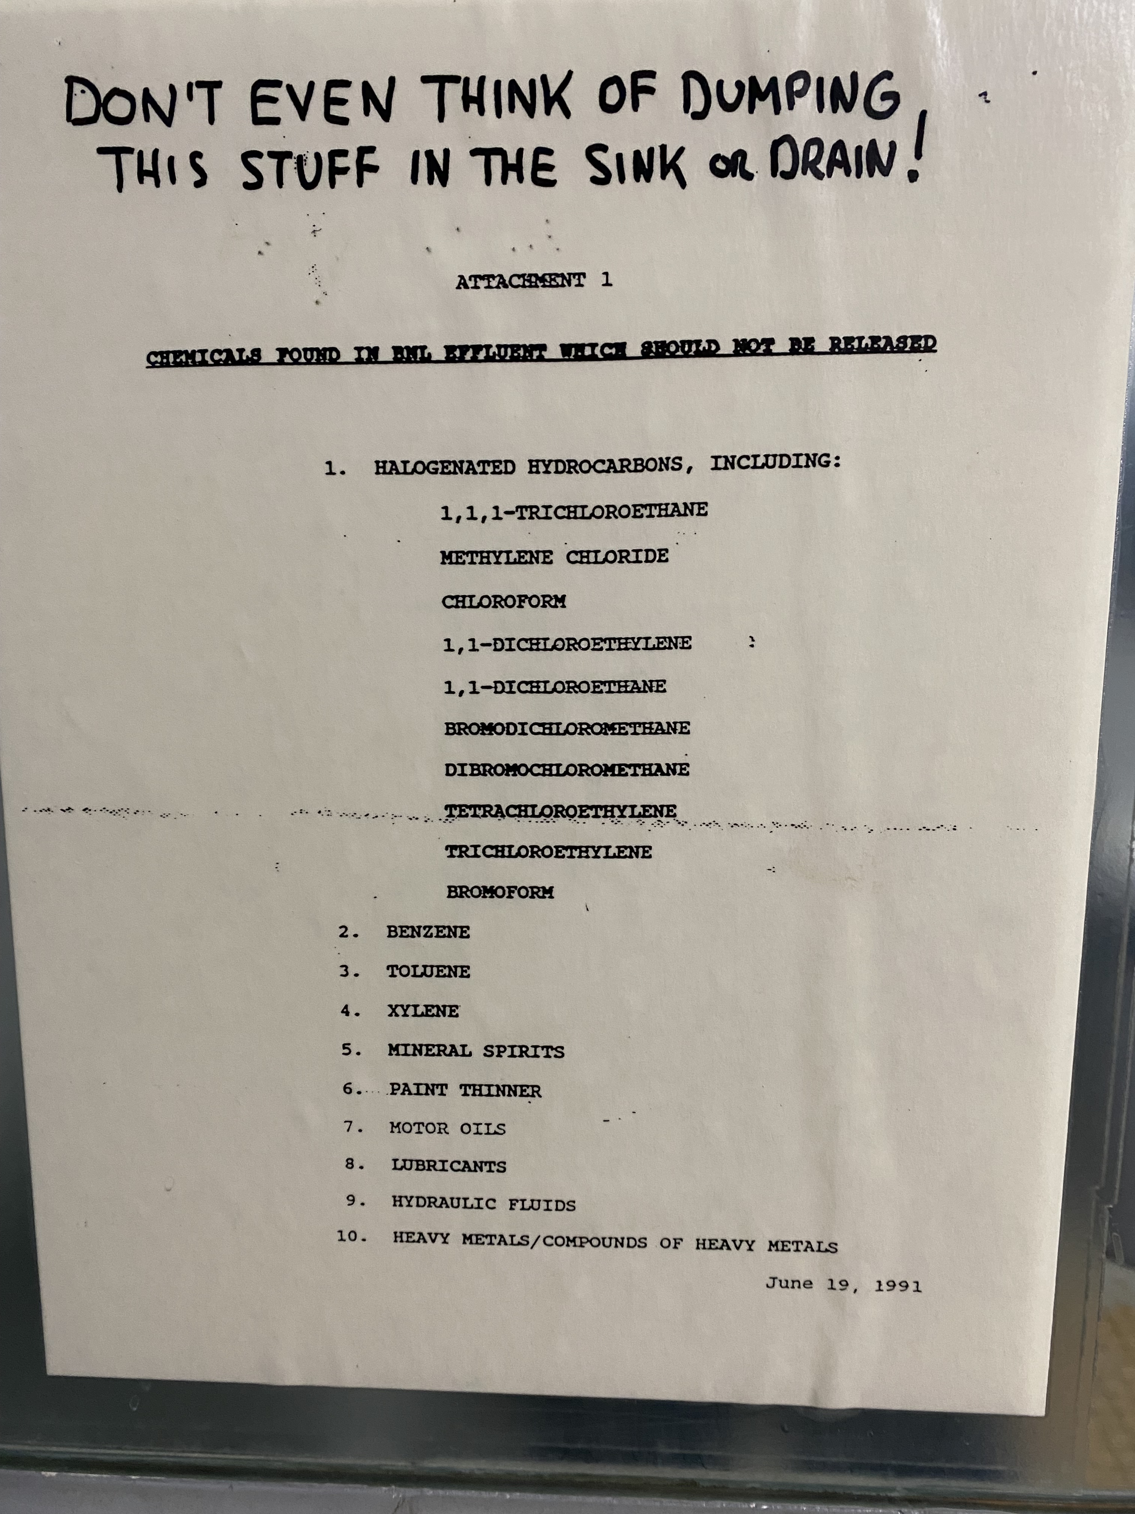
Can I use this material in a sink?

Slide 6
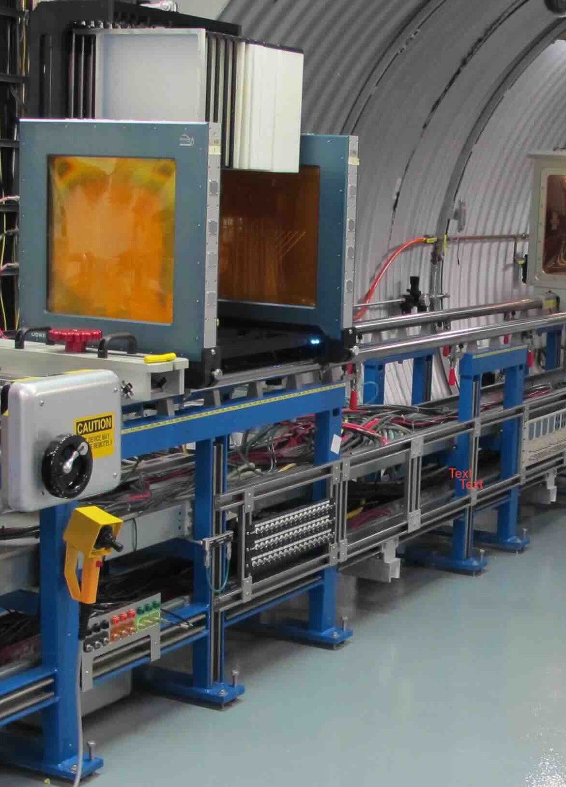
Operation of Beam Without Valid Checklist
SCBNL: E-02262 Date: 05 Jan 2025
Description & Categorization Level:
On Monday, January 5, at 11:45 a.m., the NASA Space Radiation Laboratory (NSRL) operated the facility beamline for approximately ten minutes before it was identified that the operational readiness checklist had expired on December 31. This constituted a violation of the Accelerator Safety Envelope (ASE). Upon discovery, the beam was immediately shut down, and an extent-of-condition review is currently being conducted for all other operational readiness checklists within the facility.
Immediate/Containment Actions:
Beam to NSRL stopped and Operations Lockout Applied
New Checklist being prepared.
USI Evaluation being prepared.
Point of Contact: Raymond Fliller
5.1/2008e011.pptx (11/2023)

Slide 7
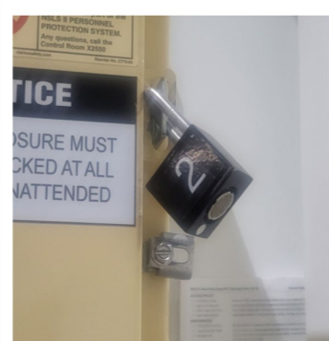
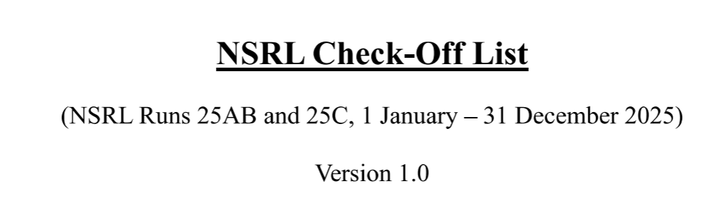
ASE Violations in the last year at BNL
EBIS Operating with an Expired Operational Readiness Checklist
NSLS-II Declares Accelerator Safety Envelope Configuration Management Violation
Operation of Beam without Valid Checklist
All three involve a checklist.
In the CAD cases they expired.
NSLS-II case the checklist said a lock to a PPS cabinet was locked when it was not.
A checklist is more than a piece of paper!

Slide 8
Importance of Checklists
Checklists are an important part of performing work.
They are a tool for experts and novices alike.
They serve as reminders of tasks that need to be performed to ensure that the job is done correctly.
They communicate to others what the tasks are and that they are complete.
Performing work without a properly filled out checklist:
Tells others you may be operating without the necessary controls in place.
Shows inattention to detail – detail that is important to stakeholders
May develop into an unsafe situation if controls are not in place when they are required.
May lead to jobs not getting performed correctly.

