Slide 1
Preinjector Status
D. Raparia
Time Meeting
January 06, 2026

Slide 2
Tandem
MP7
opened yesterday
MP6
Beam has been verified in TTB line and foils conditioned

Slide 3
EBIS
NSRL was off last week
Maintenance , Cryo pump, PS , etc
Gas systems for the EBIS

Slide 4
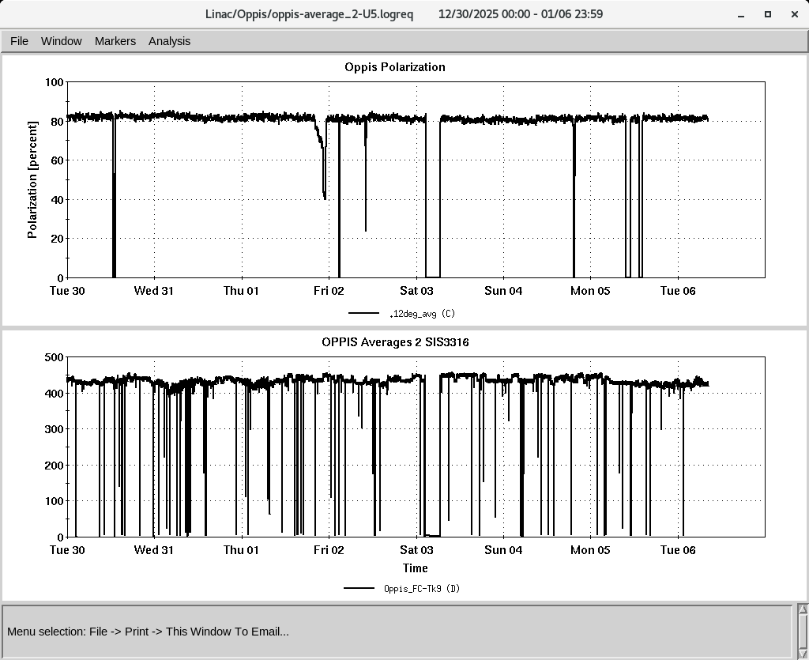
LINAC
PP beam for RHIC
OPPIS operating with normal beam intensity with pol ~ 80%
High intensity H⁻ source restarted and conditioning
H-Jet maintenance completed, H-Jet operating normally

