Slide 1
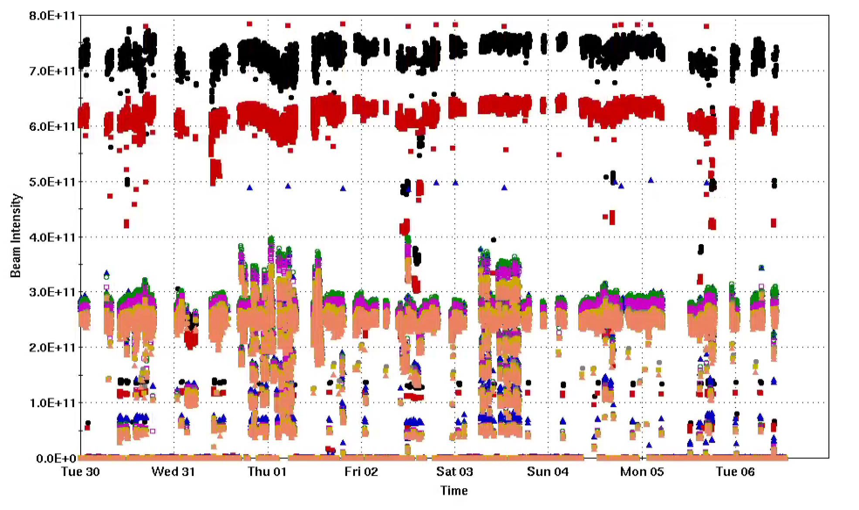
Injector Status: Time meeting 1/06/25
Injector Intensity (protons)
Booster input intensity routinely up to 7x10¹¹
AGS extraction intensity ~ 2.5x10¹¹
Polarization:
  recent work toward improving emittance seem to be helping, slow recovery of polarization toward ideal running
  Resonance correction studies continue
Intensity

Slide 2
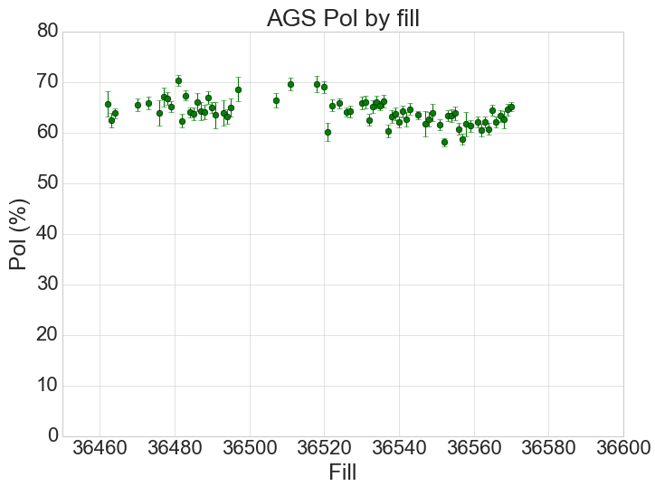
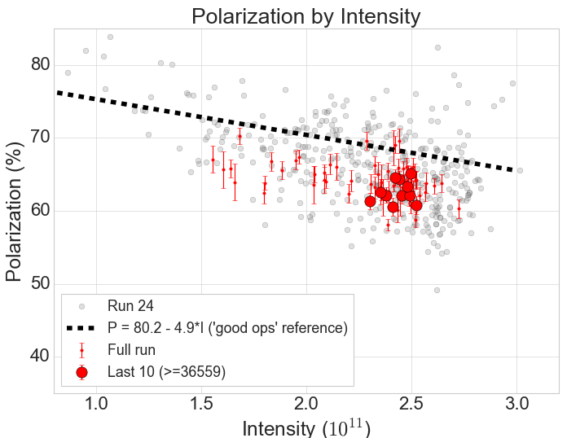
Polarization Summary

