Slide 1
sPHENIX Status
Kin Yip
sPHENIX Director of Operations
Time Meeting
Jan. 6, 2026

Slide 2
sPHENIX Status
sPHENIX continues to take physics (p+p) data towards the goal of 13/pb (p+p).
Thanks the C-AD Access Control for fixing the buzzer for 8GE1 twice.
Data taking has been quite smooth, except for some stores, the initial backgrounds were too high such that we had to wait a little for the background to subside before we could take physics data.
EMCAL power supply (MegaPac) chassis replacement on Sat. (Jan. 3) was about the only major downtime (4.5 hours) for sPHENIX detectors.
Vernier scan was performed Monday afternoon (Jan. 5). Analysis is ongoing ...
We are concerned with the availability of HJet measurements. We appreciate its smooth operation since Dec. 31, 2025.

Slide 3
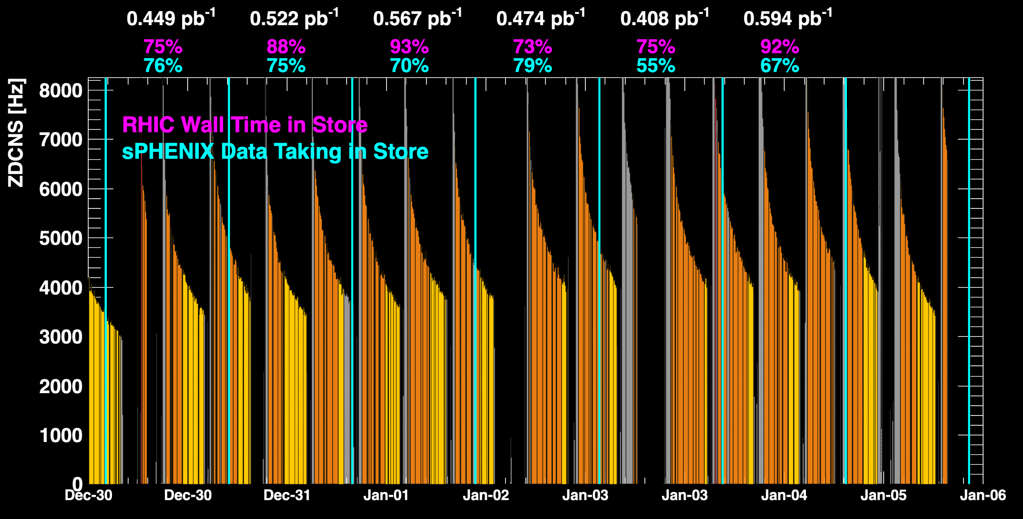
sPHENIX Status (cont.)
1008C pump trips
CDU issue
1008C pump trips
CDU issue
6x6
APEX
TPC Streaming Mode EMCAL MegaPac replacement
TPC Triggered mode

Slide 4
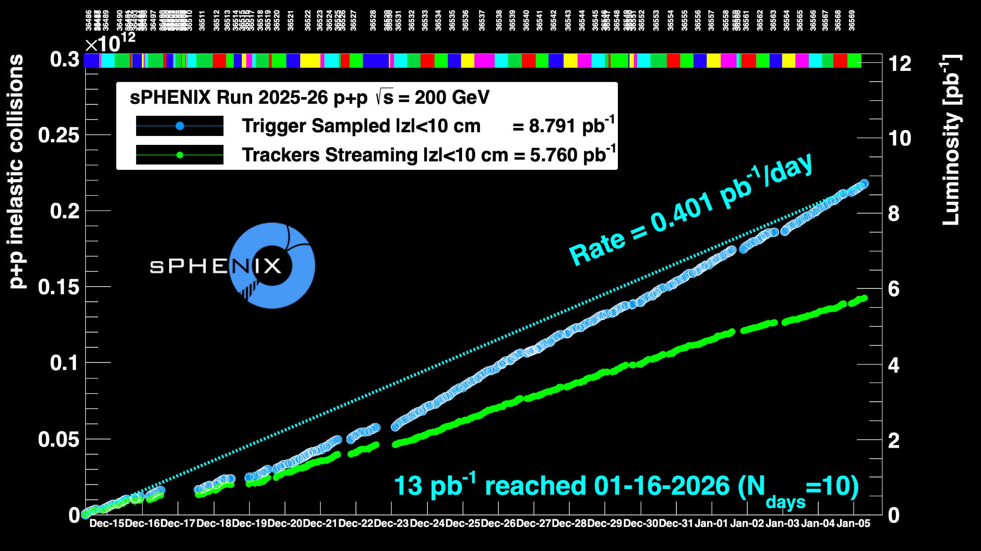
sPHENIX Status (cont.)
Using Run24 vernier scan results for cross-sections
1008C pump trips
CDU issue
1008C pump trips
CDU issue
6x6
APEX

