Slide 1
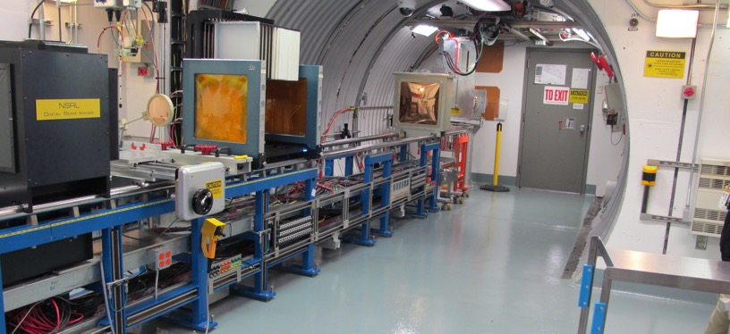
NSRL Time Meeting Report
6 January 2026
Michael Sivertz

Slide 2
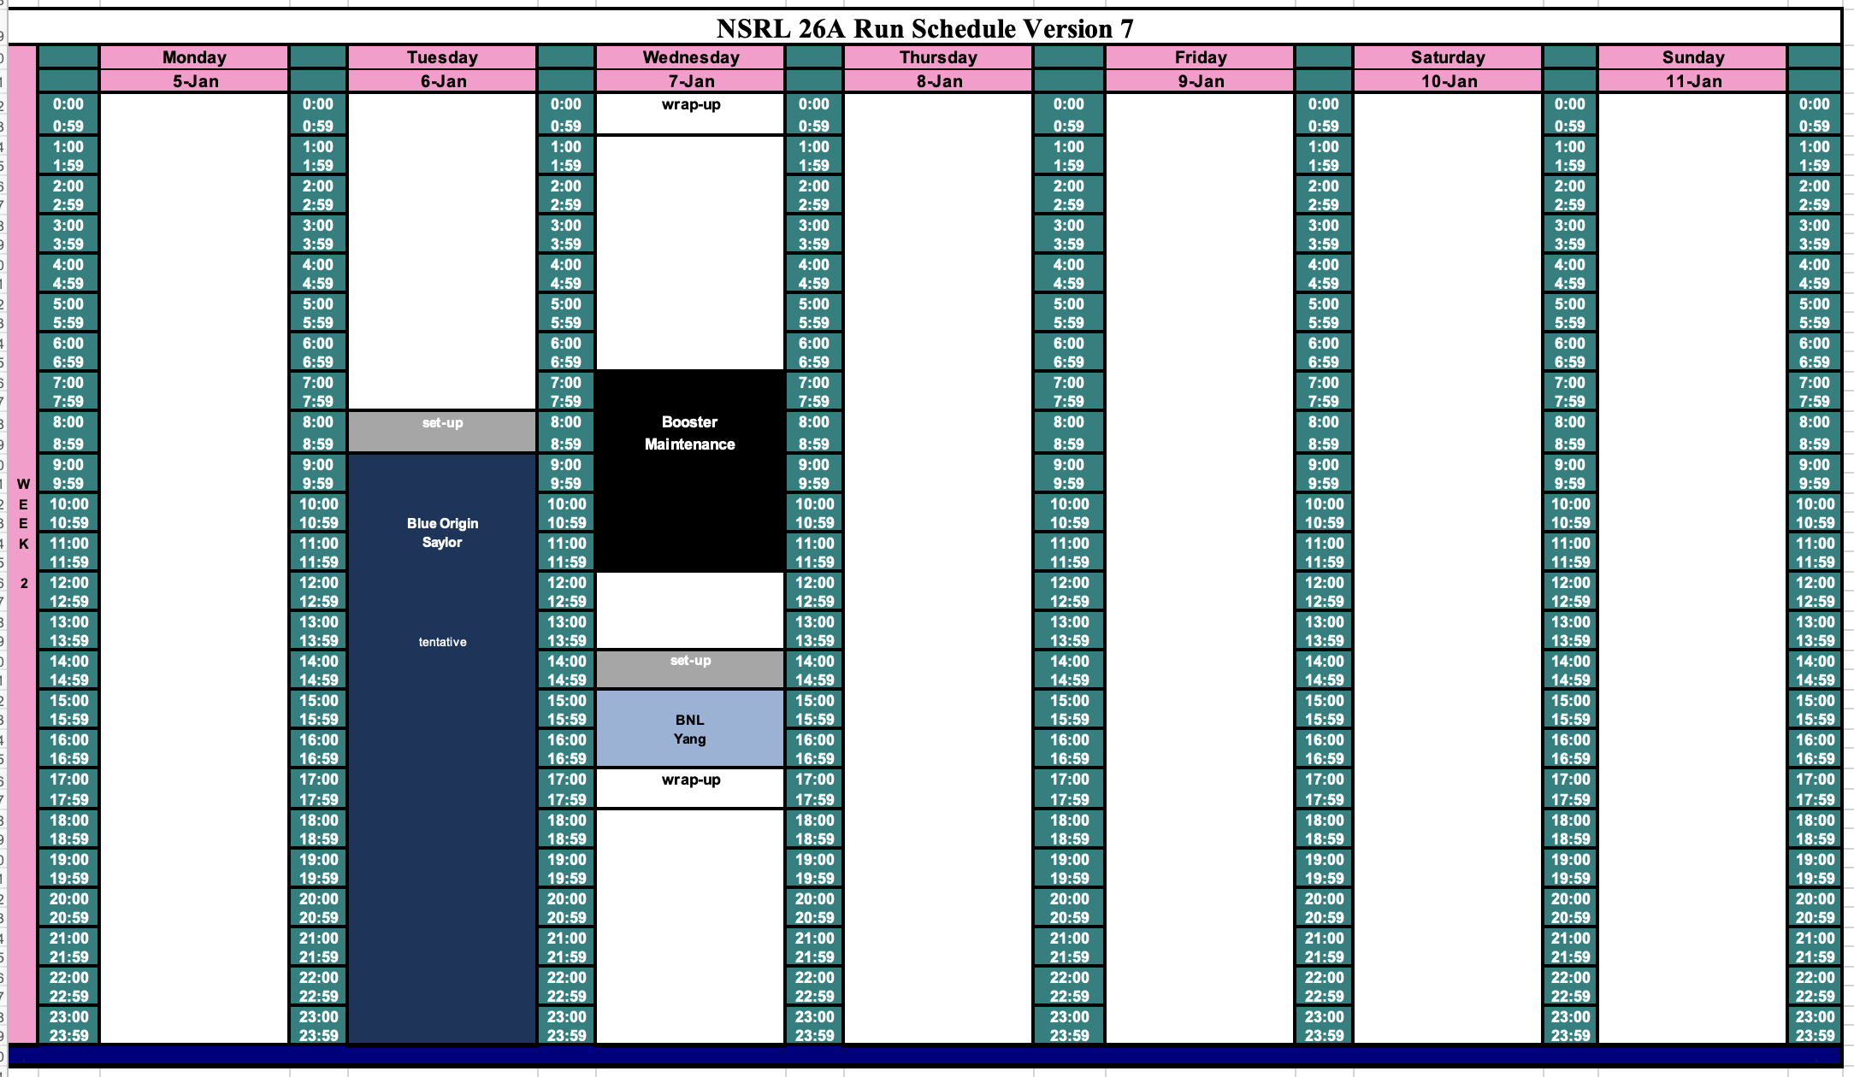
Schedule for this week

Slide 3
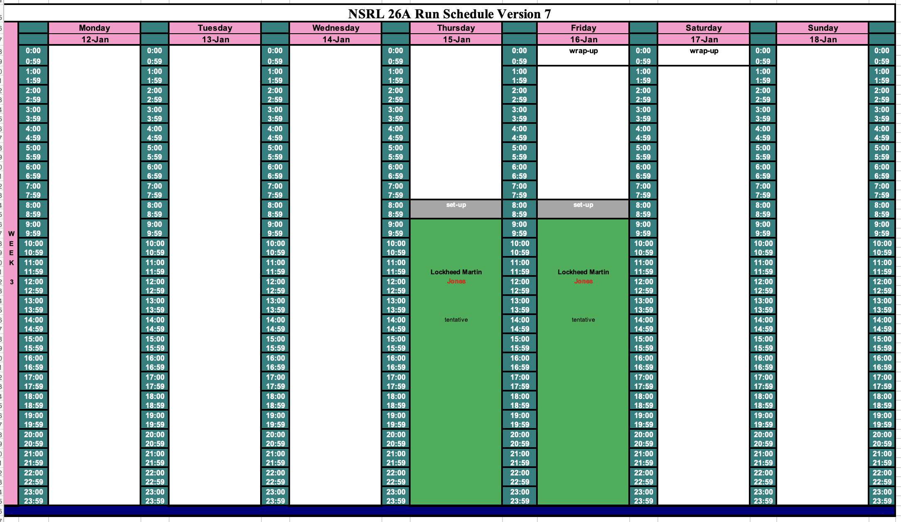
Schedule for next week

Slide 4
Future Schedule
The NSRL Operational Readiness Checklist (ORC) had a period of performance until 31 December 2025, at which point it needed to be renewed.
NSRL had a violation of the ASE when we ran beam yesterday for 10 minutes with an expired ORC.
NSRL is in the process of getting signatures on the new ORC.
NSRL hopes to run today for Blue Origin.
We will not finish 16 hours of running for Blue Origin today, and expect we will need to make up the time on Wednesday Second Shift, or Thursday.
Later this week or early next week there should be a couple of days available to work on the EBIS Linac power supply.

