Slide 1
TAKE FIVE for Safety- Ladder Safety Update
Frank Craner
January 13, 2026

Slide 2
Brief Event Description
On January 8, 2026, at approximately 11:00 am while entering Steam Manhole #59 (east entry) to prepare for a complex Lockout/Tagout (LOTO) in support of a condensate leak repair…
the top steel access rung of the manhole structurally failed and separated from the concrete, falling to the bottom of the manhole.
The worker was standing on the rung at the time of the failure and fell approximately 7–8 feet, landing on his feet at the bottom of the manhole.
The worker exited the manhole without assistance and was transported to the OMC for medical evaluation.

Slide 4
Per the Subject Area, the following definitions apply for compliant and non-compliant vertically fixed ladders.
•Green: Ladder was inspected and found in compliance with standards.
•Yellow: Ladder was inspected and some noncompliance’s with standards were noted, however, with the use of additional provisions, the ladder can be used safely.
•Red: Ladder was inspected and one or more noncompliance’s with standards were noted and the ladder has been taken out of service. An “Out ofService” warning tag is attached to the ladder.
•Blue: Ladder has not been evaluated for compliances and cannot be used.

Slide 5
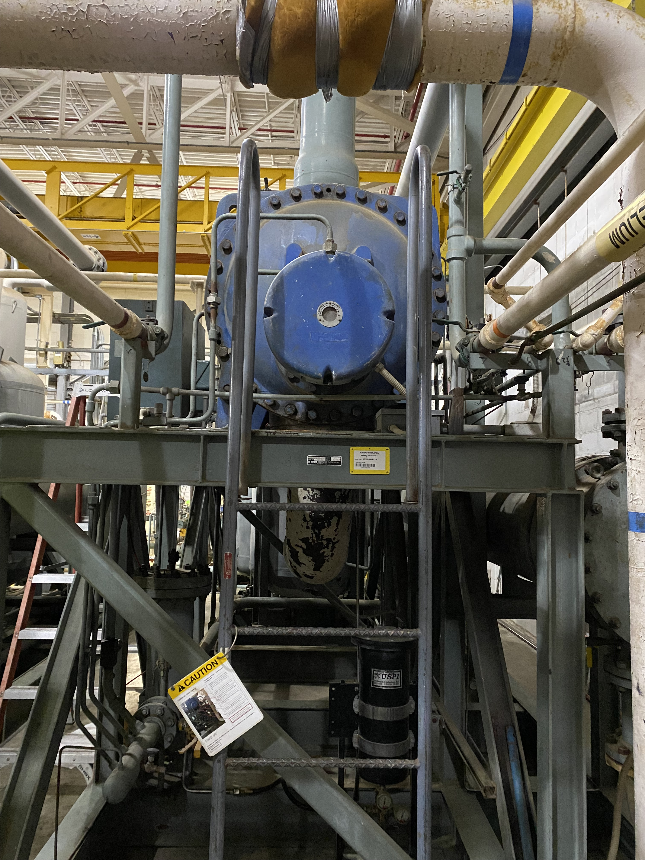
Example of Yellow Ladder

Slide 6
Current Requirement
All YELLOW-TAGGED FIXED VERTICAL LADDERS will be ADMINISTRATIVELY CONTROLLED AS RED (OUT OF SERVICE) UNTIL FURTHER NOTICE.
Per the Fixed Ladders, Design, Inspection, and Use Subject Area, “if no other means of access to the area is feasible, then the use of a ladder classified as ‘Out of Service’ requires enhanced work planning (such as a fall protection plan) and the approval of both the Fixed Ladders SME and Department Chair/Division Manager (or their designees).”

Slide 7
Current Status
Today:
Ladder Safety SME performed inspections of ladders in Cryogenic Compressor skids
Use Work Permit/Fall Protection Plan for use of any other Yellow or Red Ladders.
Inspector training to be provided this afternoon to some ESH staff and 1 member of ITSD
Tomorrow:
Inspector Training of C-AD staff will take place at 1:30 by invitation.
Continue to use Work Permit/Fall Protection Plan for use of any other Yellow or Red Ladders.

Slide 8
Going Forward
Use Work Permit/Fall Protection Plan for use of any Yellow or Red Ladders.
Is it Red or Yellow?
As of now, the only “Yellow” ladders in C-AD that are yellow are in 1005H (New-Yellow)
Ladder Information Systems will be updated to show “new” inspection date.
Yellow Ladders (Old-Yellow) with inspection dates prior to 1/13/25 default to Red.
Yellow ladders that are re-inspected revert back to yellow (New-Yellow) if inspection passes.

