Slide 1
Preinjector Status
D. Raparia
Time Meeting
January 13, 2026

Slide 2
Tandem
MP7
closed and conditioning ?
MP6
Beam has been verified in TTB line and foils conditioned

Slide 3
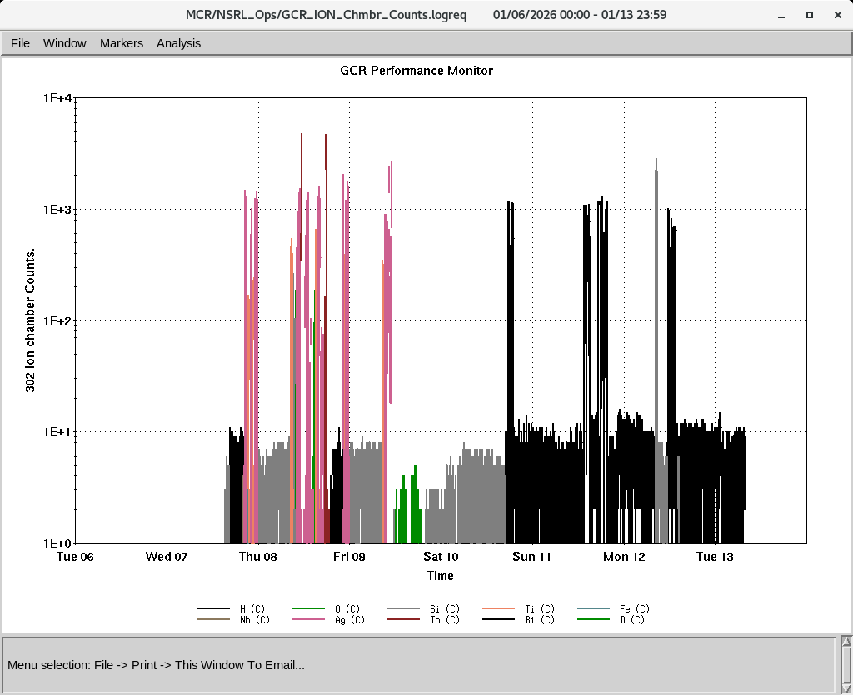
EBIS
Providing beam to NSRL
Providing H₂⁺ , D₂⁺ for booster /AGS setup
Yesterday and today, EBIS Linac RF work to improved RF power
IONS to NSRL
O^{+7,} Si^{+11 ,}Fe⁺²⁰ ,Ti⁺¹⁷ Nb⁺²³,Ag⁺²⁹, Tb⁺³⁵, Bi⁺⁴³,
H₂⁺, D₂⁺
P (Linac)

Slide 4
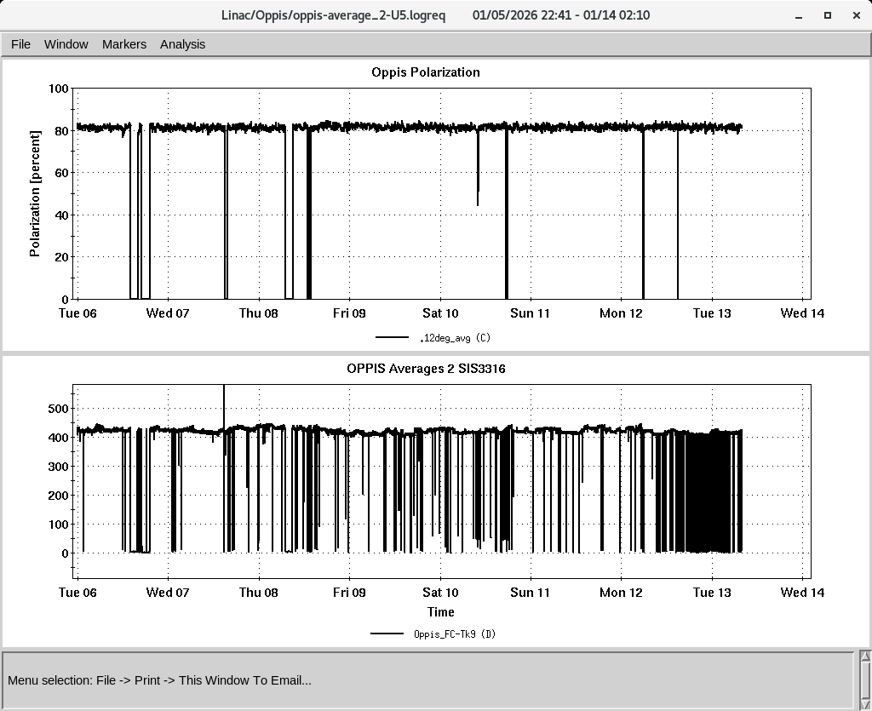
LINAC
PP beam for RHIC and NSRL
OPPIS operating with normal beam intensity with pol ~ 81-82%
High intensity H⁻ source conditioning
Issues with HEBT steerer p136 , and tank quad 5-5 (2x)
Trips mod 4 ( grid), Mod2 PLC communication, and 7835 conditioning
H-Jet was down again, during a brief access on Saturday , the cold head displacer/valve assembly was removed to prep for cleaning and a vacuum bakeout. Yesterday it was operating again

