Slide 1
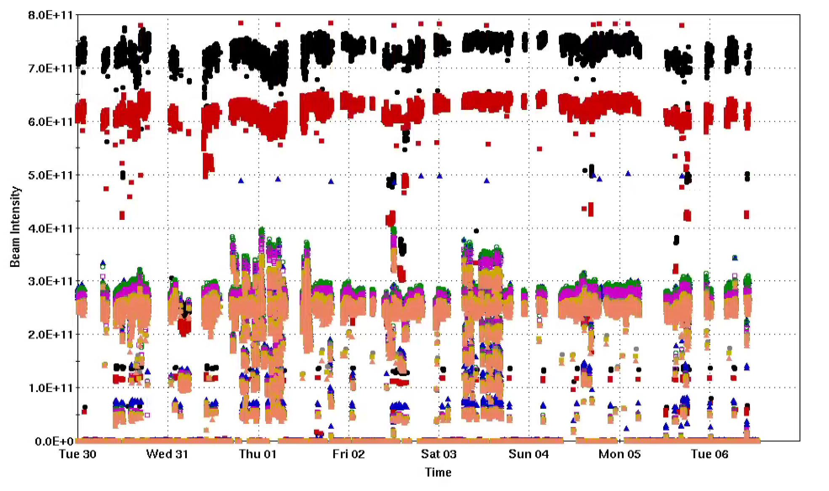
Injector Status: Time meeting 1/13/25
Injector Intensity (protons)
Booster input intensity routinely up to 7x10¹¹
AGS extraction intensity ~ 2.5x10¹¹
Polarization:
Resonance correction studies continue
Preliminary (no beam) setup of molecular hydrogen beam in AGS proceeding
Intensity

Slide 2
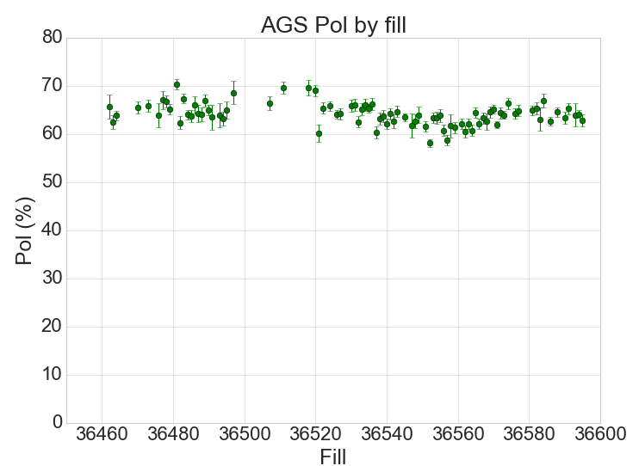
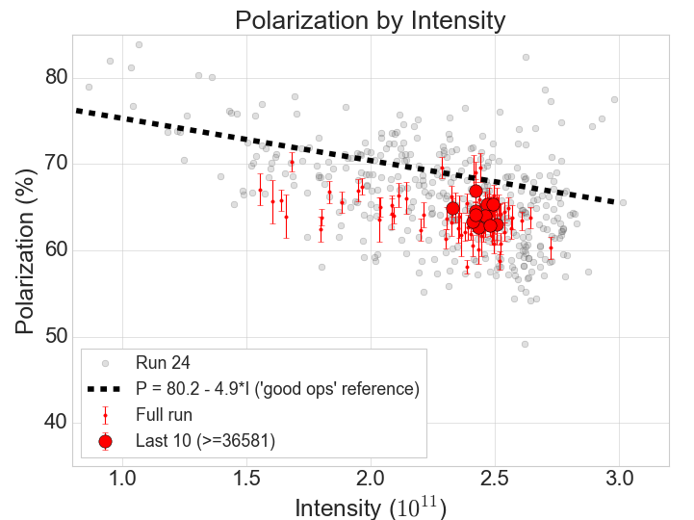
Polarization Summary

