Slide 1
sPHENIX Status
Kin Yip
sPHENIX Director of Operations
Time Meeting
Jan. 13, 2026

Slide 2
sPHENIX Status
sPHENIX continues efficient physics data taking. We’ve reached 56% of 45/pb p+p Runs (24+25) goal. High quality data is important, together with RHIC polarimetry and acceptable background.
On Thur. (Jan. 8), we used collisions with 12×12 bunches with no magnetic field to study track matching between TPC & silicon detectors (which help us understand misalignment) and this also allows us to study distortion in TPC.
Sunday (Jan. 11), there was < 2-hour access by our TPC expert to replace a blown fuse in a controller board (Low-Voltage).
Otherwise, mostly smooth running.
Emergency generator transfer test was done in 1008 together with a few other service buildings on Monday (Jan. 12).

Slide 3
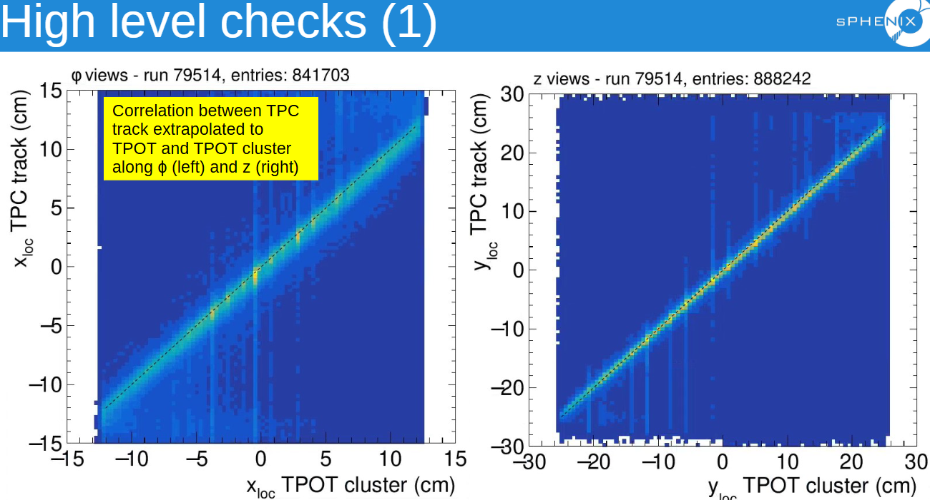
sPHENIX Status (cont.)
We continue to do data reconstruction and quick analysis to check on data quality. For example :

Slide 4
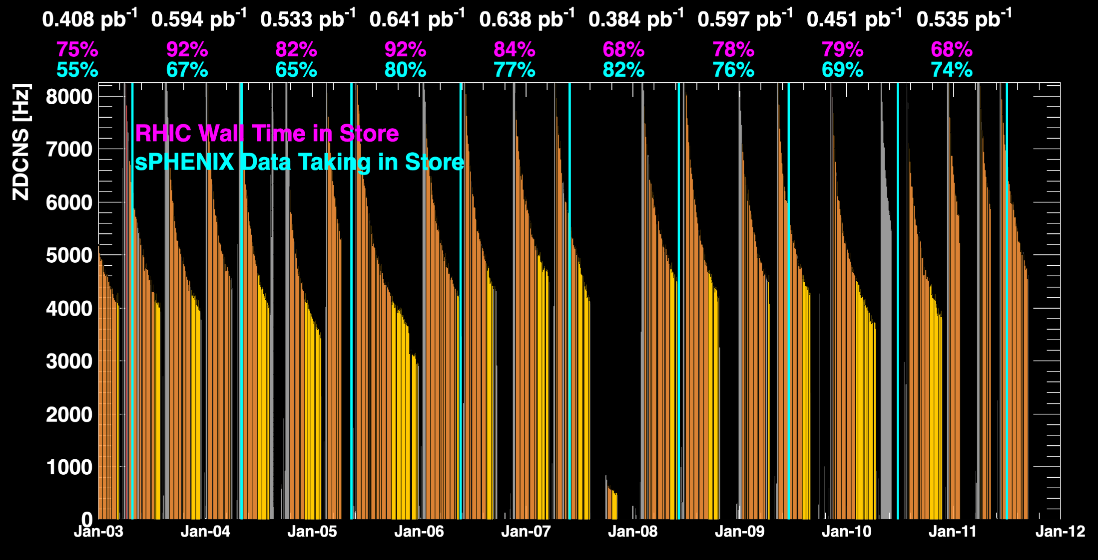
sPHENIX Status (cont.)
1008C pump trips
CDU issue
1008C pump trips
CDU issue
6x6
APEX
TPC Streaming Mode
TPC Triggered mode
12x12 bunches study

Slide 5
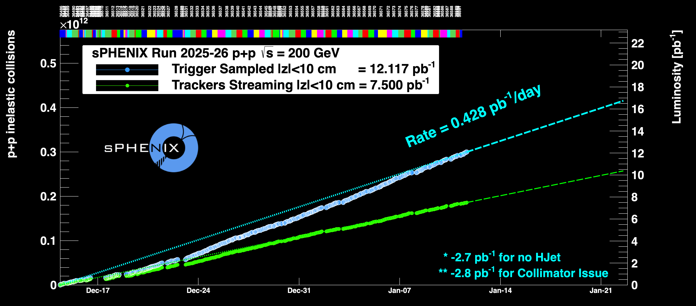
sPHENIX Status (cont.)
Using Run24 vernier scan results for cross-sections
6x6

