Slide 1
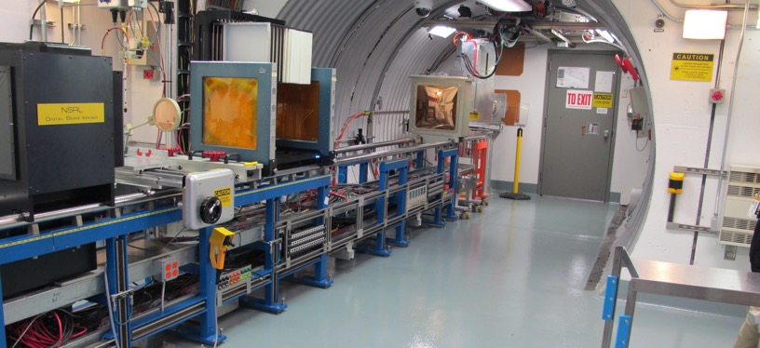
NSRL Time Meeting Report
01/13/2026
Michael Sivertz and Xiaodong Jiang

Slide 2
users last week
Late start.
Wednesday, Jan 7th, 2026. BNL Instrument Group LDRD funded detector tests.
Thursday (Jan 8th), Friday (morning, Jan. 9th): Blue Origin.

Slide 3
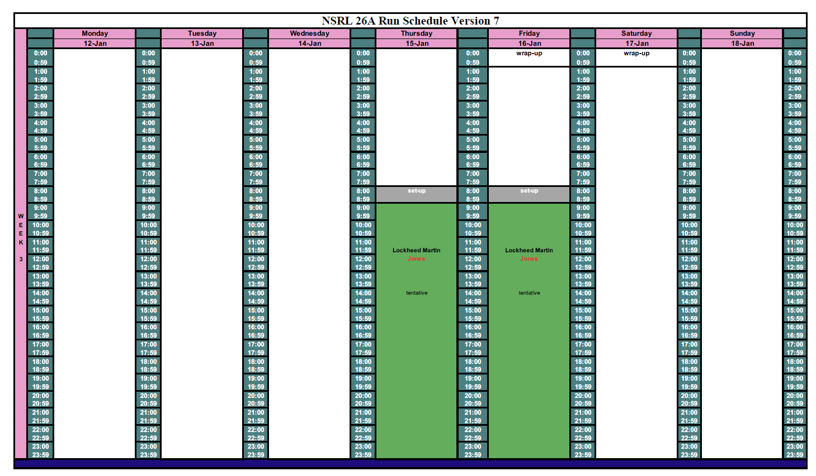
Scheduled for this week
Beam
dev.

Slide 4
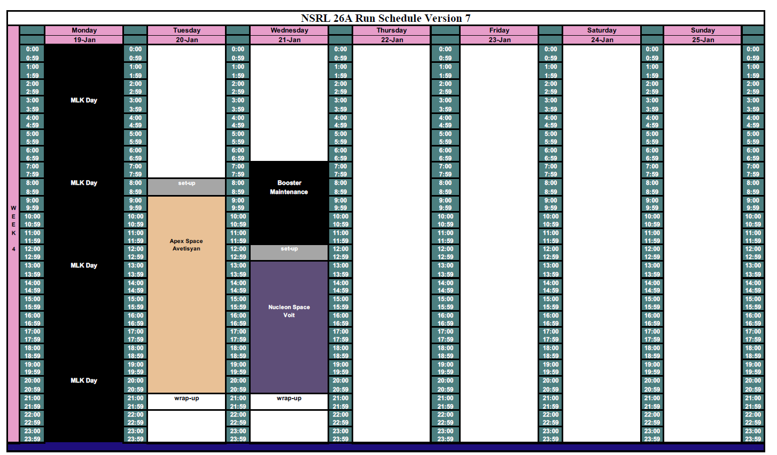
Scheduled for next week

Slide 5
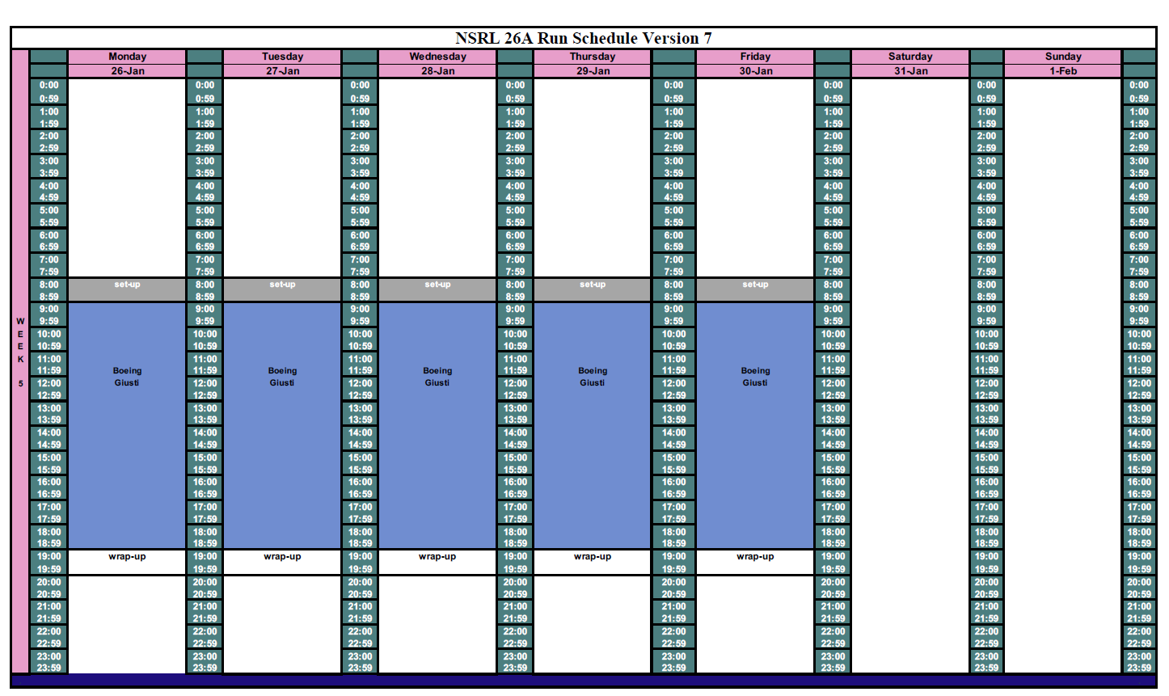
Future Schedule

