Slide 1
Data courtesy C. Naylor

Slide 2
Data courtesy C. Naylor

Slide 3
Data courtesy C. Naylor

Slide 4
Data courtesy C. Naylor

Slide 5
Data courtesy C. Naylor

Slide 6
Data courtesy C. Naylor

Slide 7
Data courtesy C. Naylor

Slide 8
Data courtesy C. Naylor

Slide 9
Data courtesy C. Naylor

Slide 10
Data courtesy C. Naylor

Slide 12
Data courtesy C. Naylor

Slide 13
Data courtesy C. Naylor

Slide 14
Data courtesy C. Naylor

Slide 15
Data courtesy C. Naylor

Slide 16
Data courtesy C. Naylor

Slide 17
Data courtesy C. Naylor

Slide 18
Data courtesy C. Naylor

Slide 19
Data courtesy C. Naylor

Slide 20
Data courtesy C. Naylor

Slide 21
Data courtesy C. Naylor

Slide 22
Data courtesy C. Naylor

Slide 23
Operations for BLIP
No BLIP
this past week
BLIP remains in shutdown.
Notes:
BLIP plot from LogView /MCR/PerformanceStats/timeMeetingBLIP.lvdisp
Avail calc on nsrl time Excel sheet

Slide 24
NSRL activity past weeks: 1/6-13/2026 (as of 0800)
NSRL running resumed following completion of ORC. Linac protons, 9 EBIS ions in use (O, Si, Ti, Fe, Nb, Ag, Tb, Bi, H₂)
Run 26-A continues, schedule posted with users up to 3 April.
Availability: 65.4%
Notes:
Graph and avail calc from nsrl time.xlsx

Slide 25
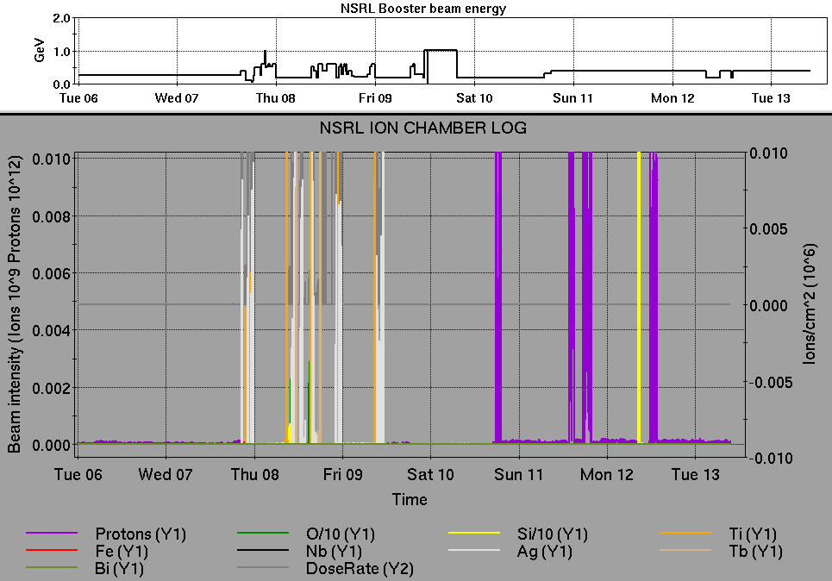
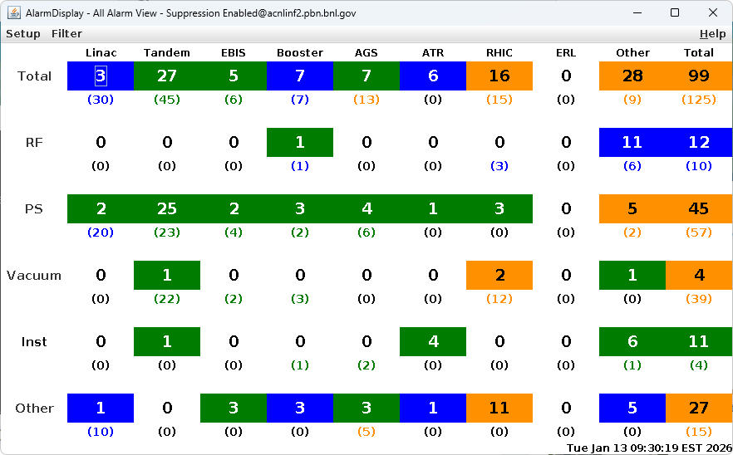
Notes from Operations
Notable failures (>1 hr)
NSRL operations halted due to expired checklist; resumes following Chair approval
Accesses for sPHENIX system failures
STAR magnet cooling issues/ramp tests/trips (5x)
STAR gas system monitor alarms, access for recalibration (3x)
Accesses for H-jet repairs (2x)
yi2-tq6 failure, PS replaced
sPHENIX TPC issues, requiring access
Beam abort, Yellow QLI; yo9-qd7 ZFCT card replaced
sPHENIX TPC issues after beam abort, requires no beam (2x)
Other notes
Linac compressor failure affects Booster ACS, Linac RF, vacuum valves. Access required to restore operations; store extended.
Injector beam not ready, Booster corrector PS failure. PLC reset; store extended
Linac Mod 2 failure, PLC cycled requiring restoration behind store
Linac Mod 5 tank quad pulser failure (2x)
BPM beam abort, corrector PS trip
BLM beam abort, BBQ lock issues; multiple controls resets
LtB current transformer interlocks, and will not reset remotely.
CNI polarimeter failure, NIM crates reset
BPM beam abort, Yellow MPS board reset
Other various trips, resets, tuning
Polarized beam development, H₂ and other setup, training behind stores this week
Notes:
NSRL plot from LogView /MCR/PerformanceStats/timeMeetingNSRL.lvdisp, select Dose Rate and ion species in use
Screenshot of AlarmSummary

Slide 26
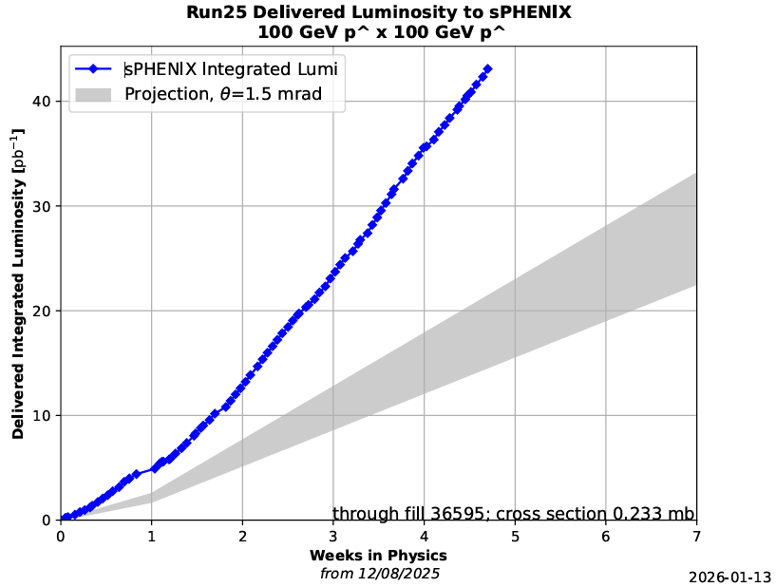
Reminder from Operations
MCR beam operations continue
RHIC physics continues this week with polarized protons from LINAC
NSRL shifts scheduled for users & MD, 2 shifts/3 days this week, 2 days next.
Protons from Linac OPPIS.
Other ions, molecular beams from EBIS.
BLIP target production not scheduled until March.
Beam from high intensity source in BLIP line anticipated 27 February, pending restart authorization and valid ORC.
AGS tuning, other studies to continue behind stores as time allows.
MCR shift coverage 24/7
Data courtesy A. Nicola/C.S. Towle

Slide 27
Keytree notes
Remote keytree systems require a database lookup to validate and authorize distribution of keytokens. The Keytrak system’s database is available for lookup functionality, but can no longer be modified in any way to add or edit qualified personnel.
Personnel affected:
New employees, experimenters arriving after 12/1/2024 could not be enrolled in database
Existing employees & experimenters, not already enrolled, cannot be added or modified in database
Remote keytrees affected:
Iris scan @NSRL
BNLID scan @AGS South gate, North Conjunction Gate
Iris scan @RHIC STAR, sPHENIX, IP12, IP4
Keytrees NOT affected:
BNLID scan @Linac, Booster
BNLID scan @RHIC IP2
MCR keytrees

Slide 28
Keytree notes, continued
Mitigation:
Choose entrants that are currently enrolled to perform the work in the enclosure under Controlled Access (CA).
Obtain CA keys from MCR for remote gate watch
Arrange for local gate watch using other tokens for entrants.
Arrange for Restricted Access, and allow for delays incurred to sweep areas.
CAUTION
Follow procedures. Gate Watch staff will remain vigilant.
No “piggy-backing” – one key/token per entrant.
Access keys are not candy! Authenticated entrant retains possession.
Radiological Controls and the Access Controls System are not to be circumvented. This is (has been) enforced with disciplinary action (dismissal).

Slide 30
Notes:
Reliability comparisons to previous runs

Slide 31
Notes:
Reliability comparisons to previous runs

Slide 32
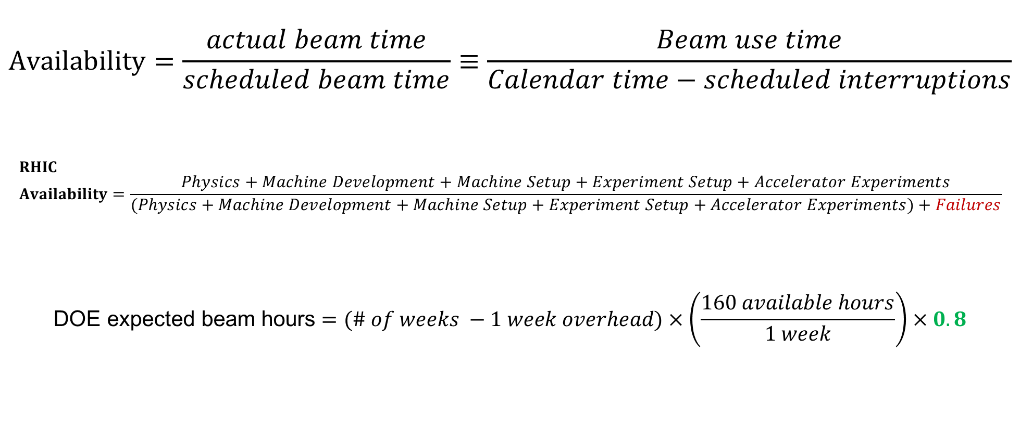
Availability, expected beam hours
$$Availability=\frac{actual beam time}{scheduled beam time}≡\frac{Beam use time}{Calendar time−scheduled interruptions}$$
$$RHIC \\ Availability=\frac{Physics+Machine Development+Machine Setup+Experiment Setup+Accelerator Experiments}{(Physics+Machine Development+Machine Setup+Experiment Setup+Accelerator Experiments)+Failures}$$
$$\text{DOE} \text{expected} \text{beam} \text{hours}=(\# of weeks −1 week overhead)×\left(\frac{160 available hours}{1 week}\right)×0.8$$
Notes:
Normally hidden. Explains how the 85% from DOE comes in to play, & general availability metrics

