Slide 1
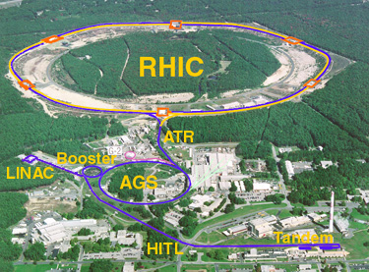
Time Meeting
Accelerator Operations Support

Slide 2
Access and Maintenance
Injector’s Today
Siemens back by 15:30 Hrs
Final January Emergency Generator tests
1/28

Slide 3
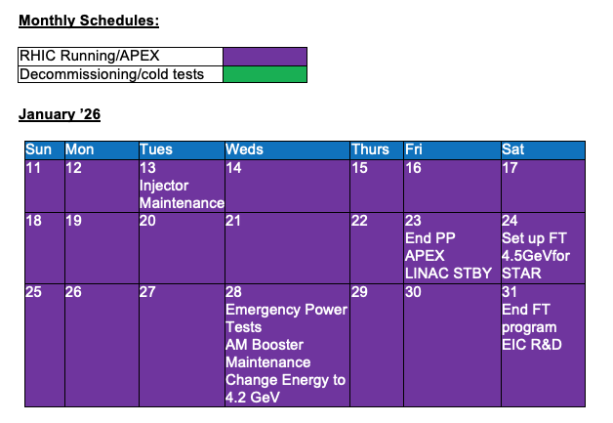
Schedules

Slide 4
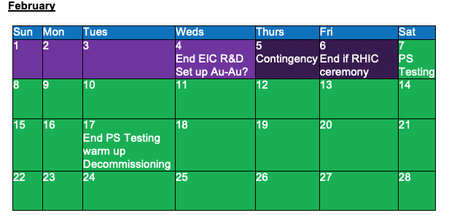

Slide 5
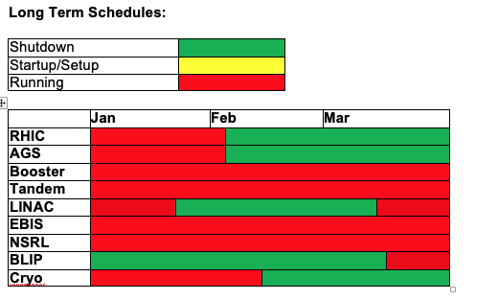
Long Term

