Slide 1
APEX Report
RHIC Time Meeting, Jan 13, 2026

Slide 2
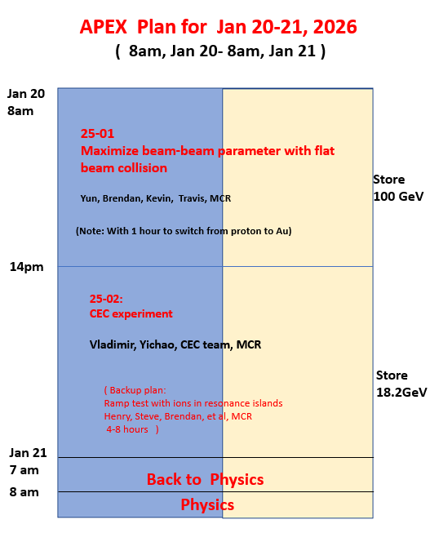
Draft Plan

