Slide 1
Preinjector Status
D. Raparia
Time Meeting
January 20, 2026

Slide 2
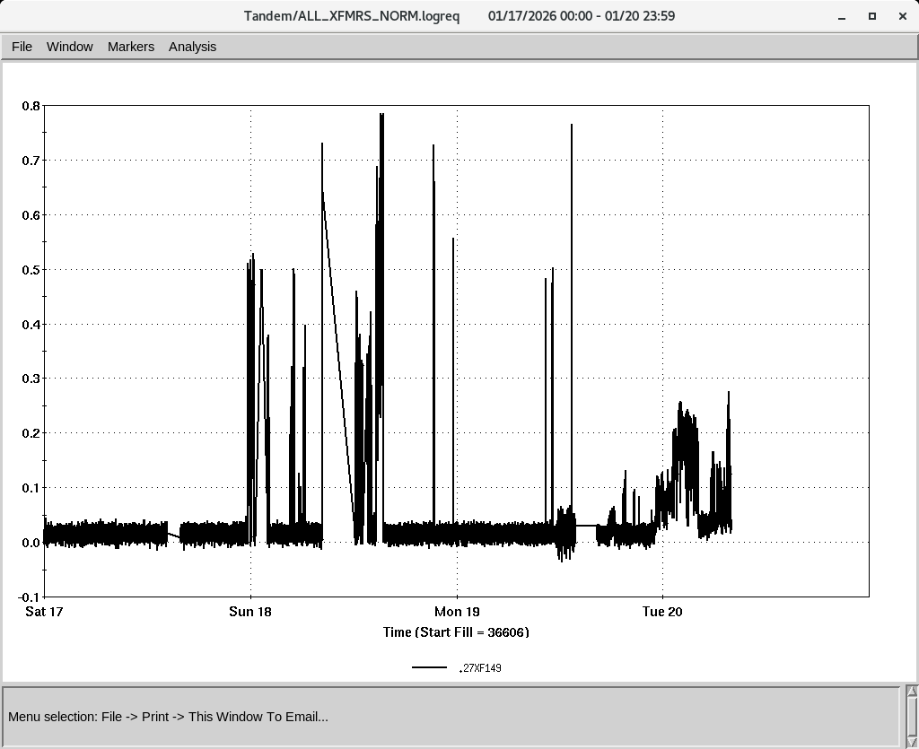
Tandem
MP7
closed and conditioning 13 MV , Au
MP6
Providing O and Au for the setup and Apex

Slide 3
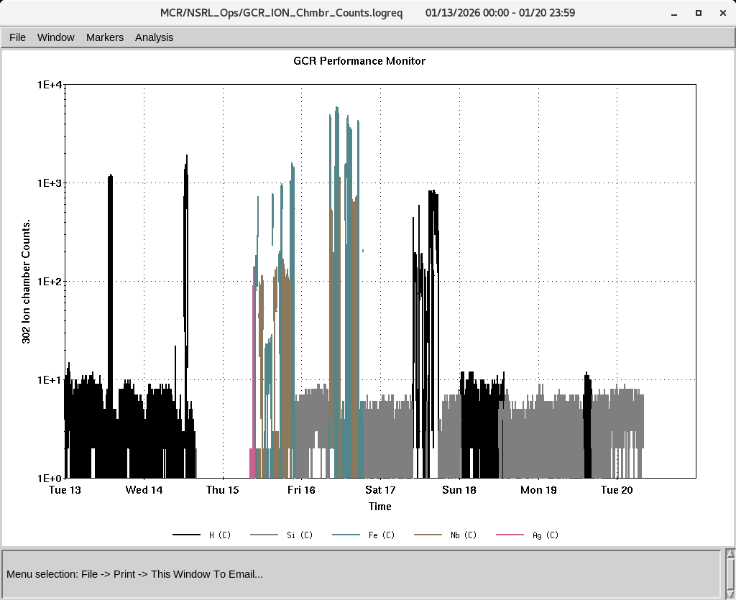
EBIS
Providing beam to NSRL
EBIS Linac RF work to improved RF power , need to replace RF tube
Over the weekend tried multi-pulsing (6 pulses ) Au at 6 A e-current
Rotary target for Au instilled
CO₂ gas is connected for O
IONS to NSRL
Si^{+11 ,}Fe⁺²⁰ Nb⁺²³,Ag⁺²⁹,
P (Linac)

Slide 4
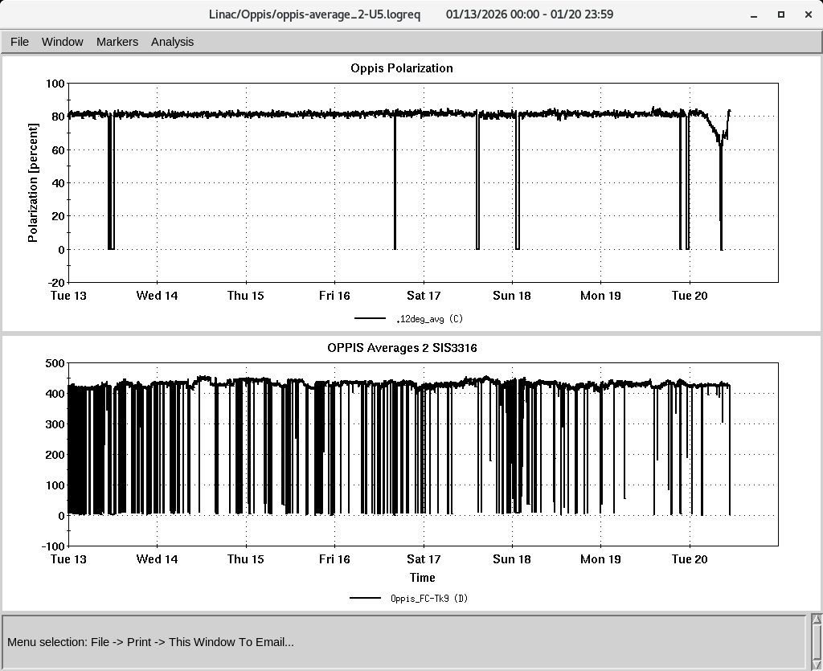
LINAC
PP beam for RHIC and NSRL
OPPIS operating with normal beam intensity with pol ~ 81-82%
High intensity H⁻ source conditioning
Issues with HEBT steerer p136 , linac quads, RF Mod 1
H-Jet was down again, during a brief access on Saturday , work for some time and down again

