Slide 1
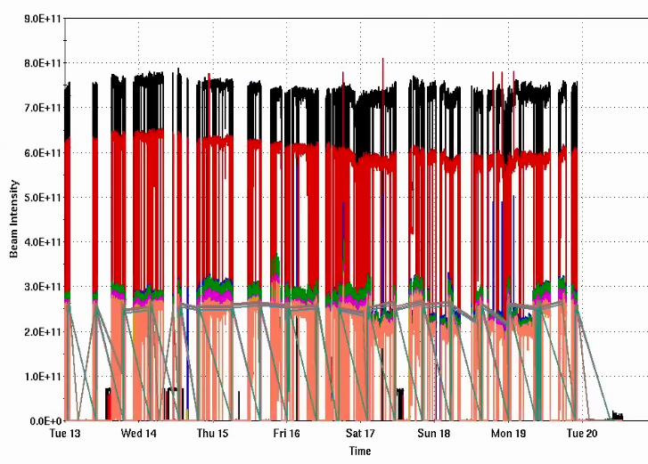
Injector Status: Time meeting 1/20/25
Injector Intensity (protons)
End of polarized proton delivery for RHIC physics!
Brief dip of polarization in final week, decent finish
Delivering Au beam for CeC and STAR fixed target running
Oxygen development to be continued behind fixed target stores
Intensity
Au!

Slide 2
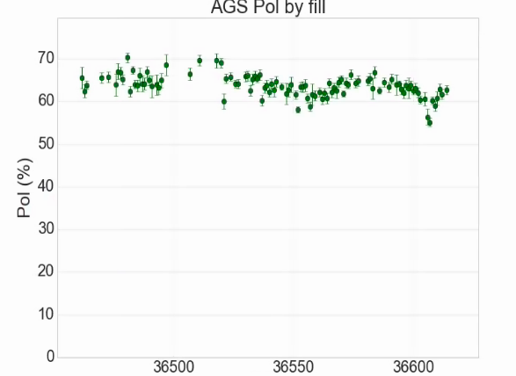
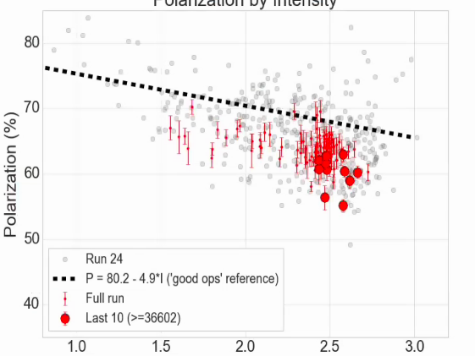
Polarization Summary

