Slide 1
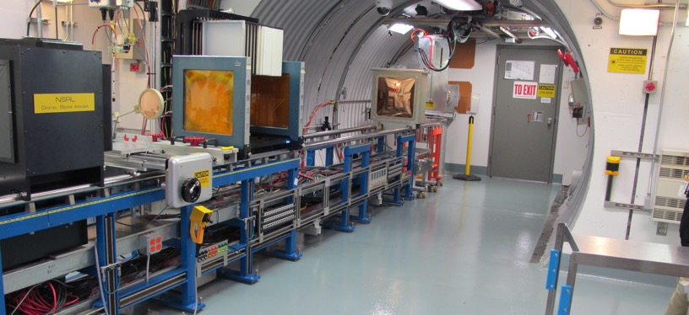
NSRL Time Meeting Report
20 January 2026
Michael Sivertz

Slide 2
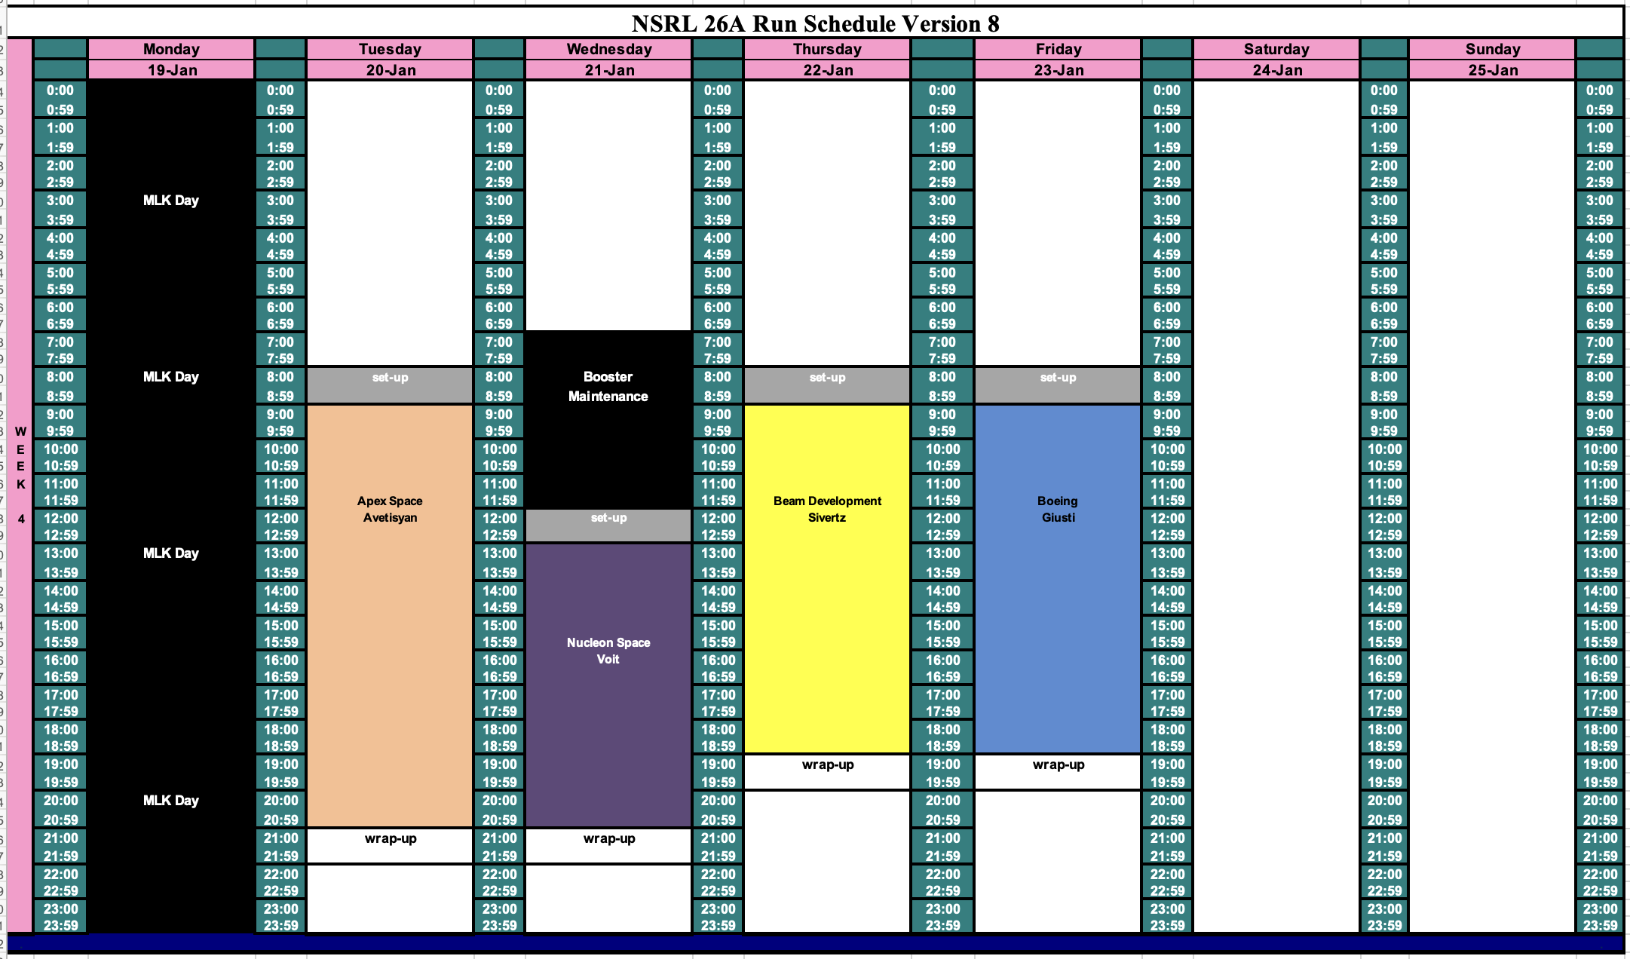
Schedule for this week

Slide 3
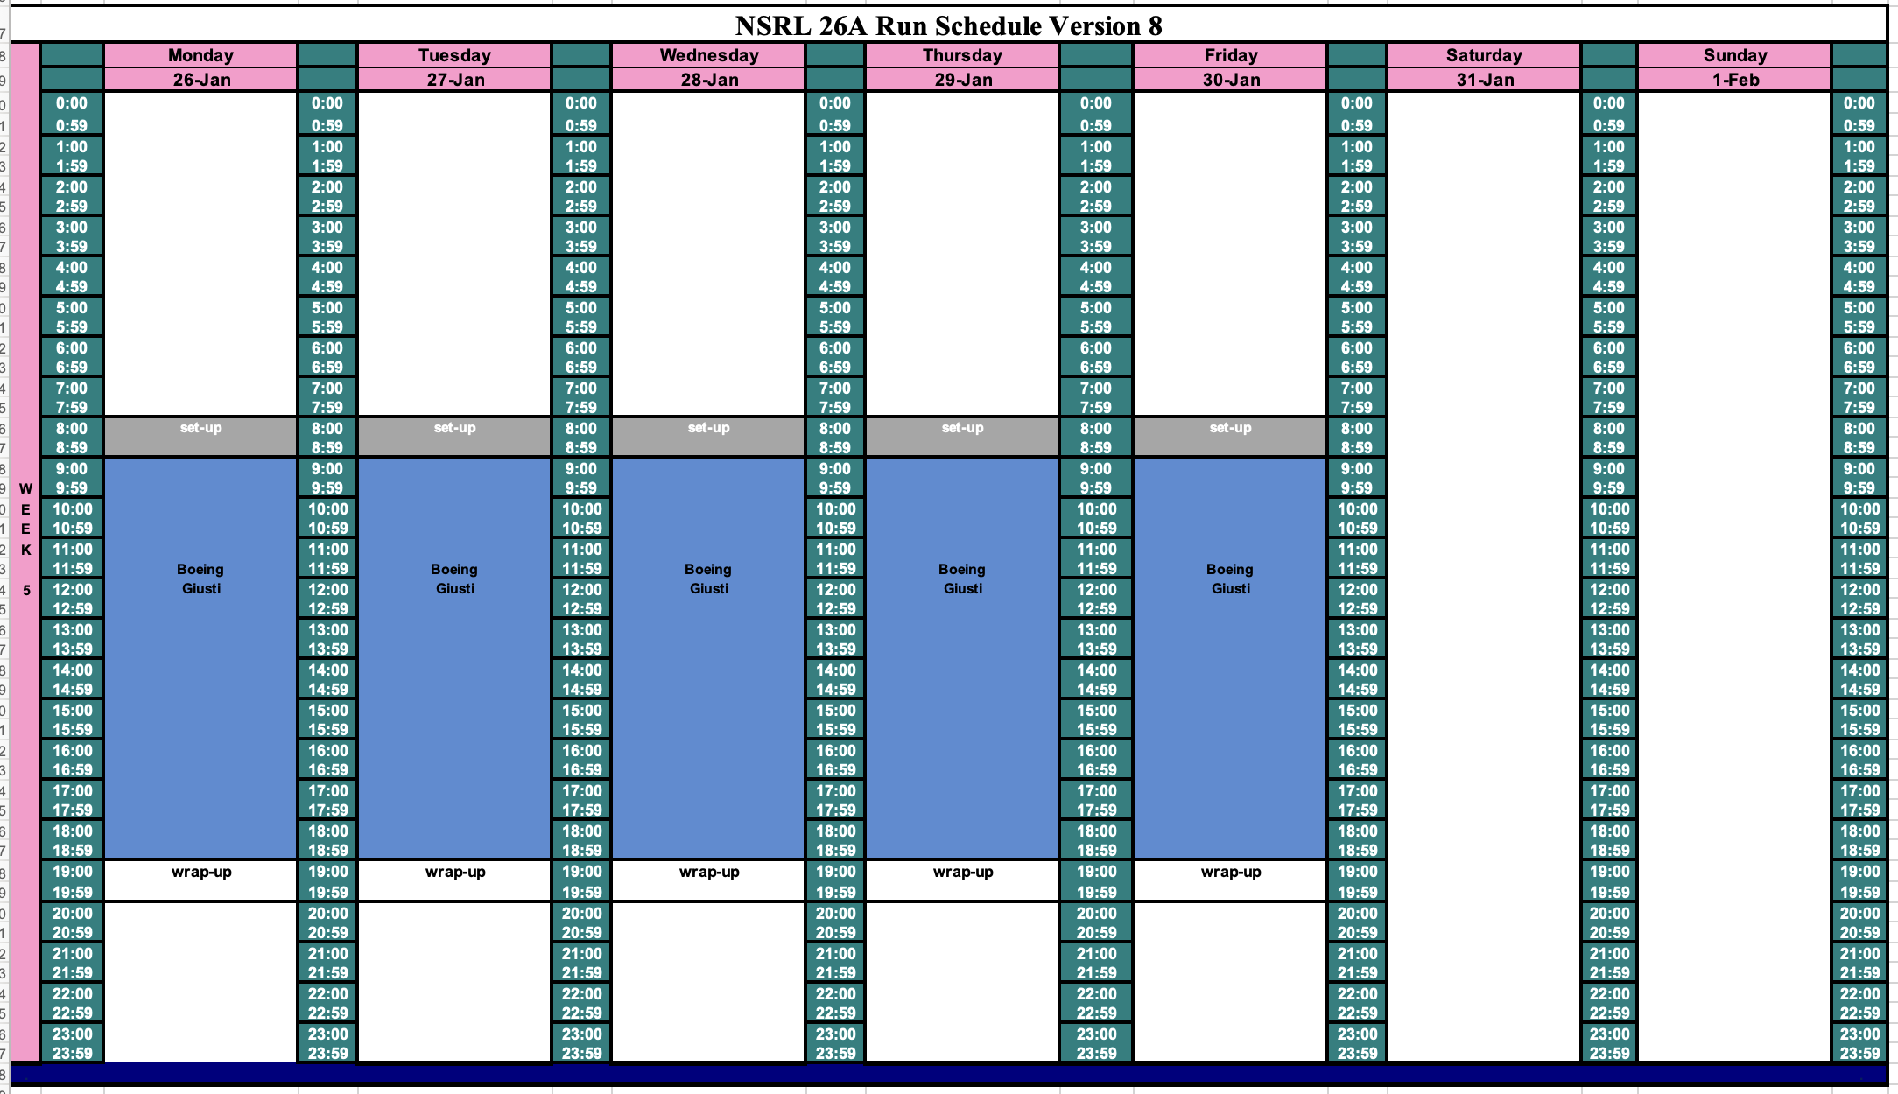
Schedule for next week

Slide 4
Future Schedule
The NSRL electronics testing for a new group, Apex Technologies, will continue through Tuesday and for Nucleon Space on Wednesday this week.
We will conduct Machine Development on Thursday.
We return to electronics testing on Friday and all next week for Boeing.
Will there be Booster Maintenance on Wednesday morning?

