Slide 1
APEX Report
Jan 20, 2026

Slide 2
APEX Planning ( from last Friday’s scheduling meeting )
sPHENIX p-p will stop on 8:00AM 20th Jan.
Followed by 1 day of CeC/Acceleartor R&D, ends Jan. 21, 8:00AM
STAR fixed target will go for 7 days (4+3) or until 1B + 800M events at the two beam energies are secured. Tentatively stops on January 28th, 8:00AM
Followed by 3 days of APEX, tentatively stop on January 31, 8:00AM
Followed by 6 days of O-O. Stope on February 6, 9:00AM (with S4 dumping the beam!)

Slide 3
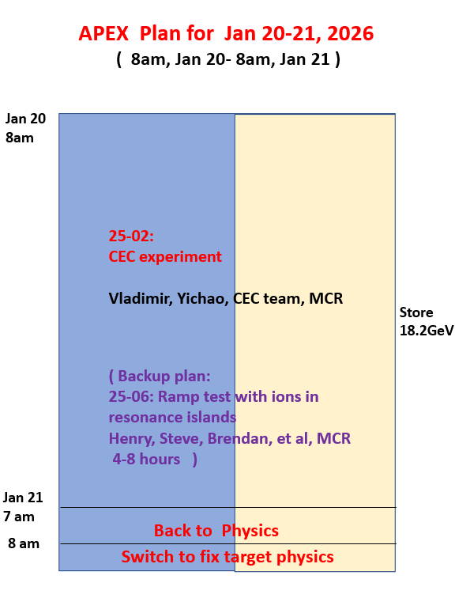
Experiment 25-01: maximize beam-beam parameters for flat beam collision (Yun)
deferred.
Goal of CEC experiment: to demonstrate coherent electron cooling.
Backup experiment: 25-06 ramp test with ions in resonance islands (Henry)

