Slide 1
Preinjector Status
D. Raparia
Time Meeting
January 27, 2026

Slide 2
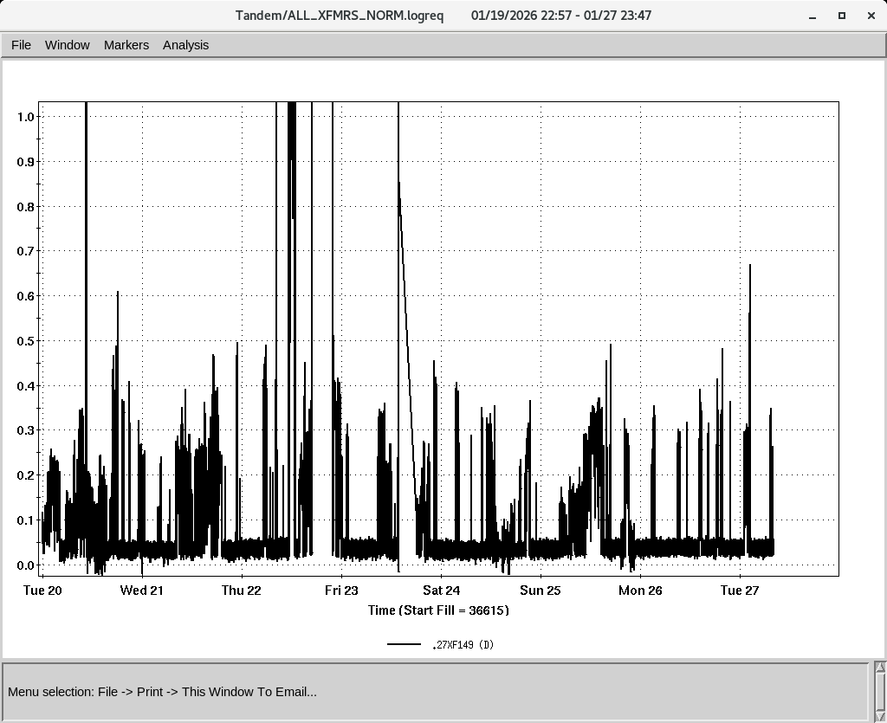
Tandem
MP7
Providing Au for fix target
MP6
Providing O for setup
Tandem Bems at TTB Section 27

Slide 3
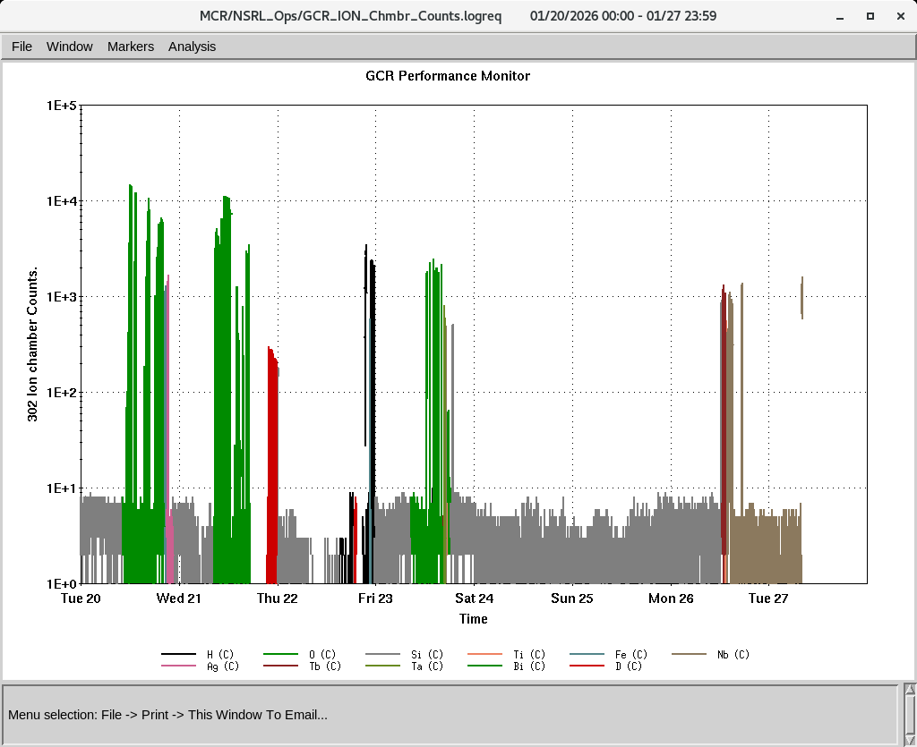
EBIS
Providing beam to NSRL
Molecular D₂
Collector trips
IONs at NSRL
IONS to NSRL
O⁺⁷ Si^{+11 ,}Ti⁺¹⁷ Fe⁺²⁰ Nb⁺²³,Ag⁺²⁹, Tb⁺³⁵
Ta⁺³⁸ ,Bi⁺⁴³
D, D₂
P (Linac)

Slide 4
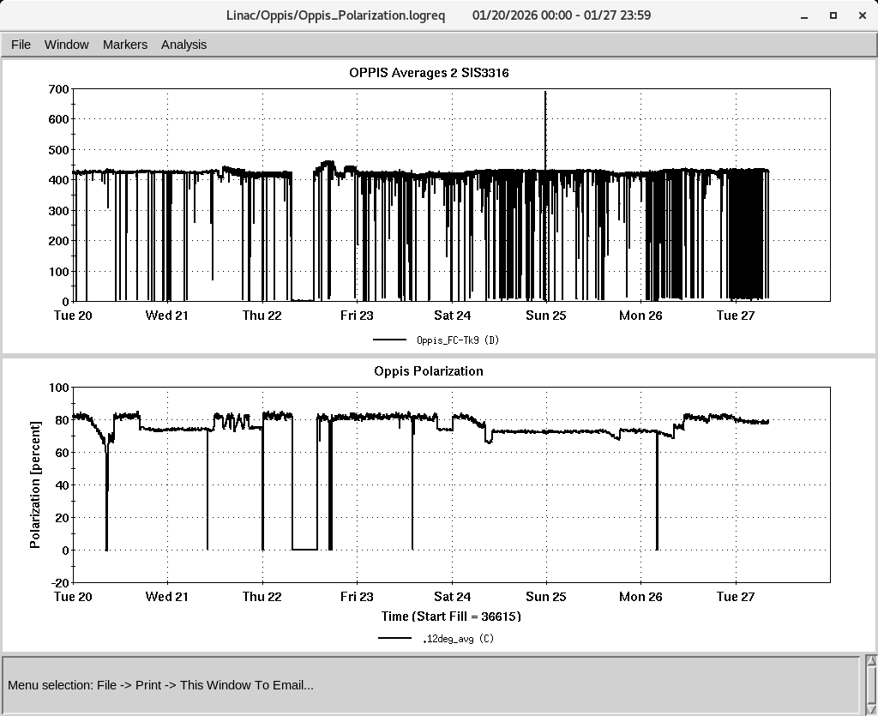
LINAC
PP beam polarization study
OPPIS operating with normal beam intensity with pol ~ 81-82%
High intensity H⁻ source shut down
Some RF trips
No date for BLIP irradiation yest, Linac shutdown on Feb 9th
PP intensity at 200 MeV
Polarization at 200 mV Polarimeter
Notes:
Some RF trips and reset

