Slide 1
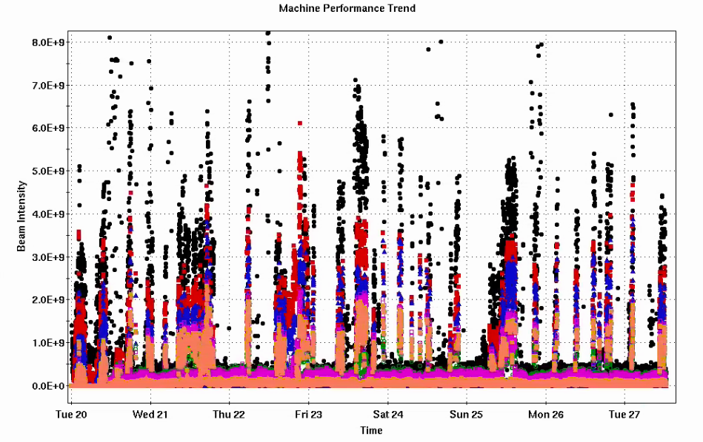
Injector Status: Time meeting 1/27/25
Delivering Au beam for CeC and STAR fixed target running
AGS RF cooling tower failure (fan belt)
Limited time RF could remain on
Not an issue for short fixed target fills, speed bump for injection setup of 8.65 GeV
Resolved now: AGS RF should be kept on now to prevent freezing
Weather impact mostly uneventful
AGS extraction bump has no remote control (for whole run). If building is inaccessible, injection energy changes impeded. Sunday was luck timing (but would have been recorded as “weather” failure.
the un-recorded inefficiencies of accumulated impairments
Injector Intensity (Au)
Intensity

Slide 2
Injector Status: Time meeting 1/27/25
Remaining jobs
Oxygen beam accelerated to AGS extraction ~1.5x10¹⁰
Extraction to W setup happening now
Molecular hydrogen beam in AGS
Wrap-up polarized proton studies
Plan to finish injector beam operation Mon Feb 9th
Injector Intensity (Au)
Intensity

