Slide 1
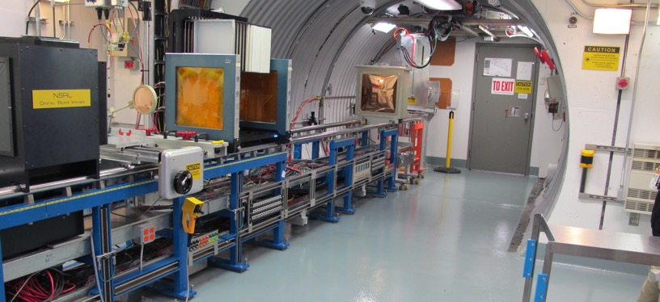
NSRL Time Meeting Report
27 January 2026
Michael Sivertz

Slide 2
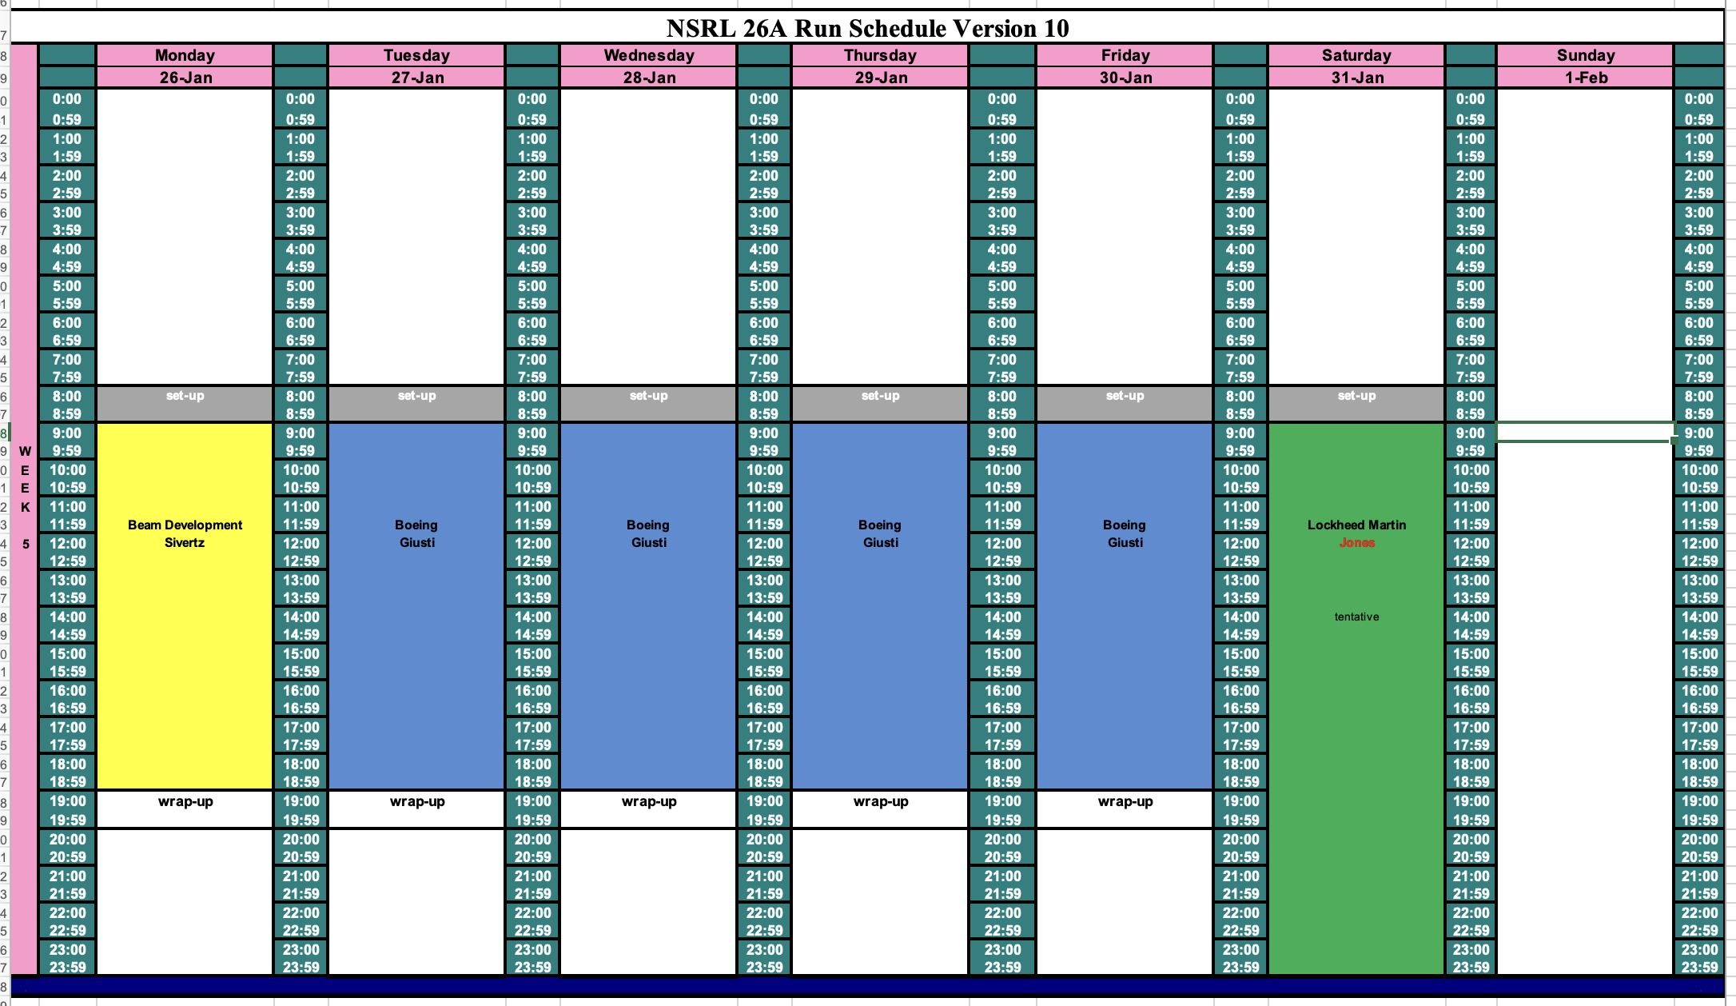
Schedule for this week

Slide 3
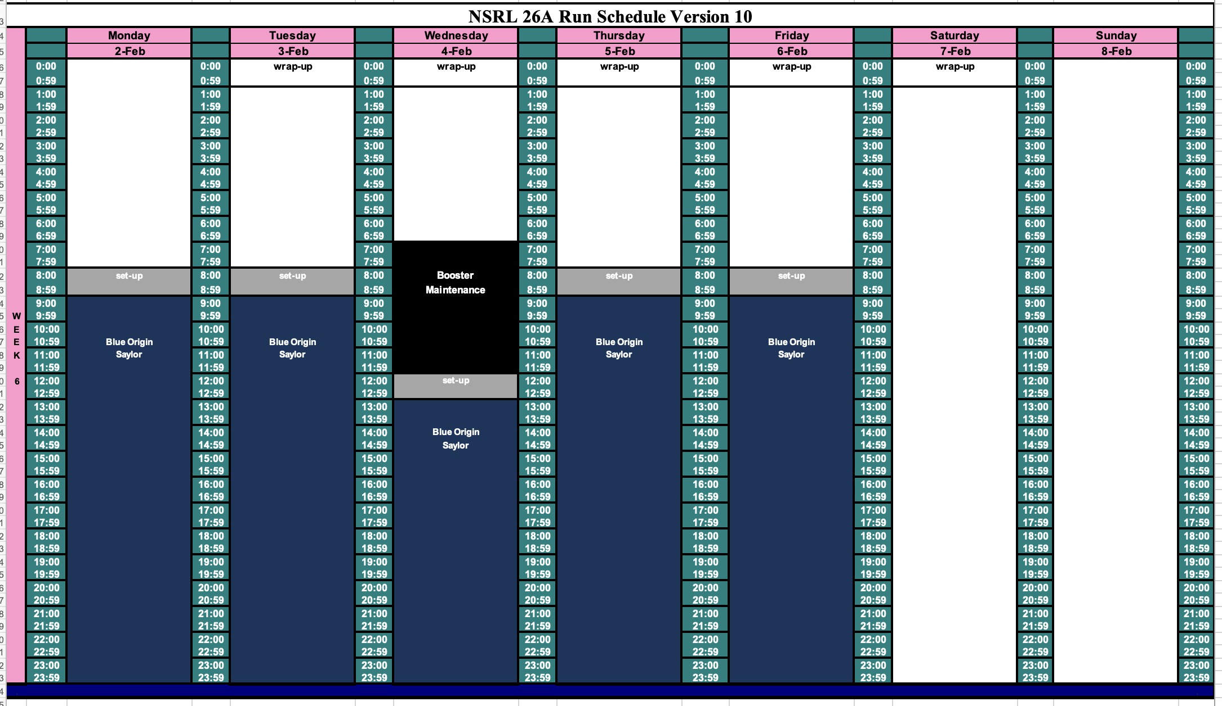
Schedule for next week

Slide 4
Future Schedule
NSRL made use of the snow day Monday to do beam development for the week.
NSRL is doing electronics testing for Boeing all week.
Lockheed Martin tests on Saturday for 16 hours.
Blue Origin will occupy NSRL for the entire next week.
Will there be Booster Maintenance on Wednesday morning, 28 January, and every two weeks after that?

