Slide 1
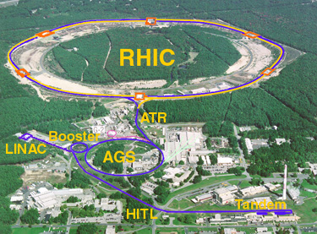
Time Meeting
Accelerator Operations Support

Slide 2
Access and Maintenance
Tomorrow am
Siemens back by 12:00 Hrs
Emergency Generator tests

Slide 3

Meeting here at 3 today

