Slide 1
Preinjector Status
J. Ritter / D. Raparia
Time Meeting
Feb 03, 2026

Slide 2
Tandem
MP7
Providing O for RHIC
MP6
O if needed

Slide 3
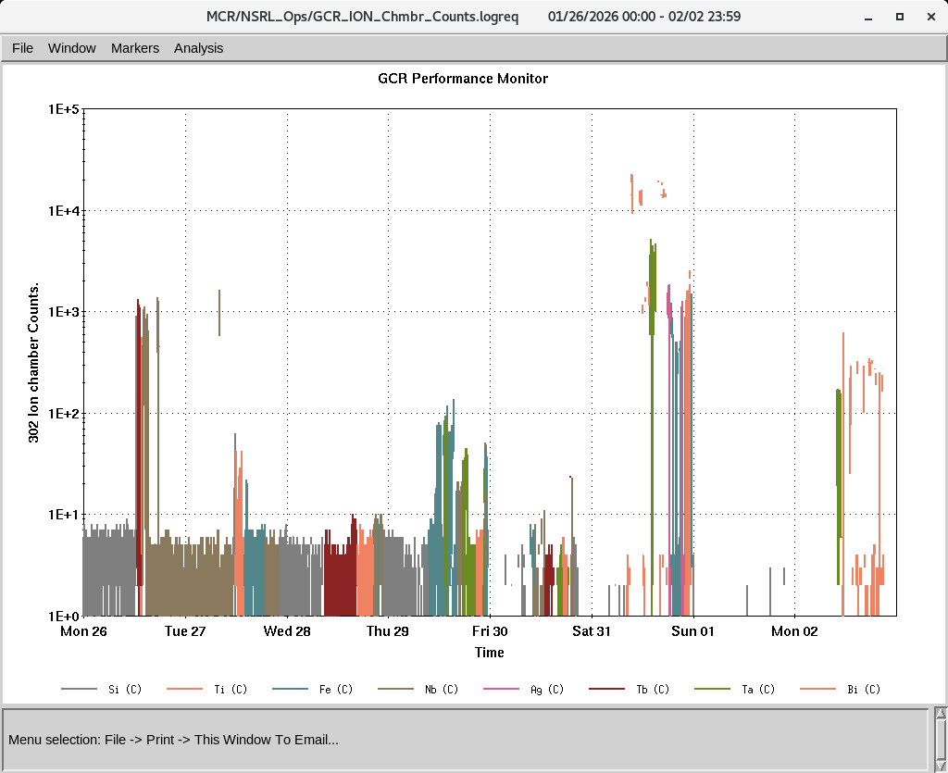
EBIS
Providing beam to NSRL
Molecular H2 for AGS
IONs at NSRL
IONS to NSRL
Si^{+11 ,}Ti⁺¹⁷ Fe⁺²⁰ Nb⁺²³,Ag⁺²⁹, Tb⁺³⁵
Ta⁺³⁸ ,Bi⁺⁴³
H₂

Slide 4
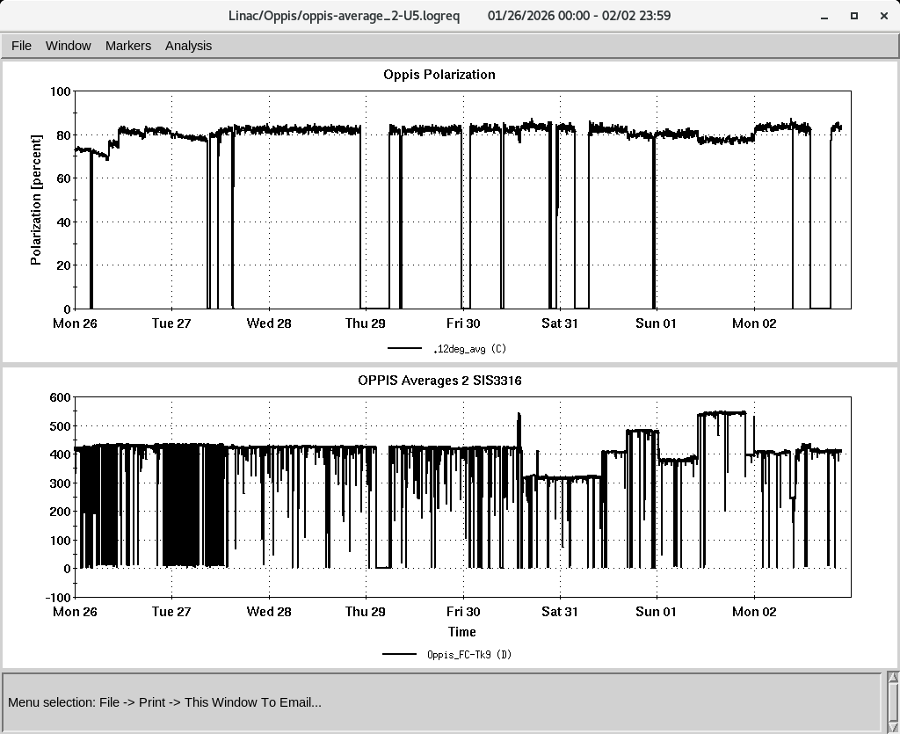
LINAC
PP beam polarization and AGS study
OPPIS operating with normal beam intensity with pol ~ 81-82%
Some RF trips: mo1 ( A7 chasse), Mod 39(50 kV fan ), mod4 and mod6
No date for BLIP irradiation yest, Linac shutdown on Feb 9th
Polarization at 200 mV Polarimeter
PP intensity at 200 MeV
Notes:
Some RF trips and reset

